Slide 1

Institutionalization of Results-Based Financing

Slide 2
Session Agenda
Agenda
07h30: Welcome & Introduction Dr. Gaston Sorgho, World Bank 07:35am: Zimbabwe’s Results Based Financing Journey to Institutionalization Chenjerai Sisimayi & Holly C. Baxter, World Bank 08:10am: Reflections Dr. Sierd Hadley, Overseas Development Institute Dr. Bruno Meessen, World Health Organization 08h35: Discussion 09h20: Closing remarks Dr. Gaston Sorgho, World Bank 09h30: Close
Notes:
Suggested format for agenda (optional)
Page numbers can be removed by clicking on the number and deleting it.

Slide 3

Zimbabwe’s Results Based Financing Journey to Institutionalization
May 2022
Notes:
COVER SLIDE - with photo option 1
The logos can be changed – right click and change picture. If additional logos are to be added, you just need to add them as a photo.

Slide 4
Agenda
Agenda
Zimbabwe’s RBF Journey Toward Institutionalization
Keys to Success / Challenges: Tacit Knowledge
Notes:
Suggested format for agenda (optional)
Page numbers can be removed by clicking on the number and deleting it.

Slide 5
Evolution of the RBF Model in Zimbabwe
Notes:
Quote or call-out slide option.
If quote text is longer, it will auto-size.

Slide 6





Results Based Financing (RBF) Approach in Zimbabwe
RBF introduced as a health systems management tool intended to improve the efficiency of system inputs with a goal of improving health service coverage and quality.
Introduced and implemented as a Fee for Service Conditional to Quality
Quantity Coverage
Package of Services
75% Facility Investments
Quality of Services
Verification
25% Health Worker Incentive

Slide 7
RBF in Zimbabwe – Introduction and Context
Timing of Introduction
RBF in Zimbabwe was piloted in two (2) front runner districts in July 2011, then scaled up to 16 additional districts in March 2012
The approach was further scaled up to cover the remaining 42 rural districts in the country with funding from the Health Transition Fund (continued under Health Development Fund)
Country & Project Context During Design Phase [2010-2011]:
Population: +/-13 million (2002 Census estimates)
Decline in public sector financing - Effect on management, supportive supervision
Increase in household out-of-pocket expenditures due to various forms of user-fees
Decline in outcomes & slow progress on some key health MDGs
Country’s Maternal Mortality Ratio had reached 960 deaths per 100,000 live births (ZDHS 2010/11)

Slide 8
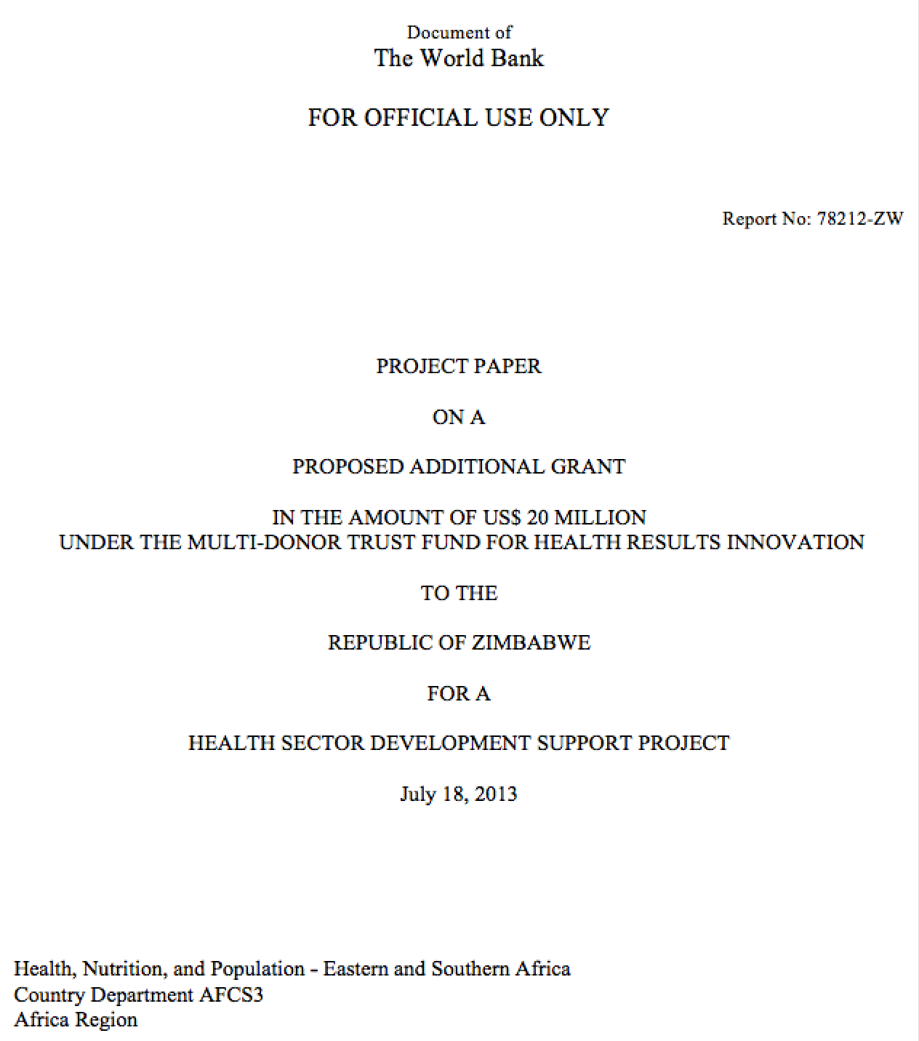


The Objective
PDO (At Inception): “To increase coverage of key maternal and child health interventions in targeted rural districts consistent with the Recipient’s ongoing health initiatives”.
  Health Sector Development Support Project

Slide 9
RBF Designed for the Zimbabwe Context
From inception, RBF aligned with and was designed to support National Health Strategy and policy – equity in access to quality health services;
    User fee removal (package of high impact services)
    Rebuild the quality-of-care standards
    Increase access to priority maternal, family planning and child health services
    Strengthen the referral system (promotes appropriate care seeking at appropriate levels)
    Decentralized service delivery and revitalized primary health care
Prioritized package of services directly linked to burden of disease for mothers, newborns and children under 5
RBF used to operationalize GoZ Results-Based Management Strategy and Results-Based Budgeting Pilot

Slide 10
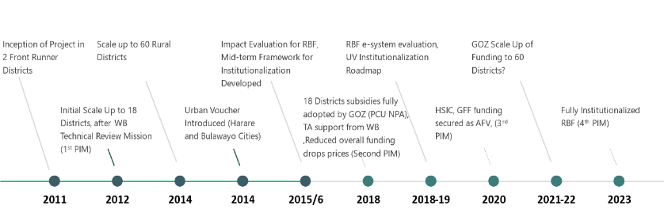
Timeline for General RBF Related Developments in Zimbabwe
The Program Has Significant Points of Reference in Path to Maturity
Still Work In Progress

Slide 11
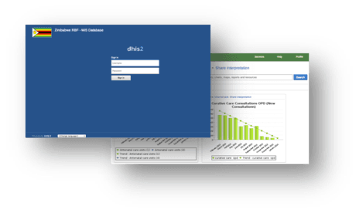

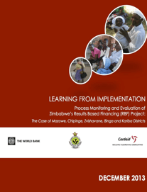

Performance - A Snapshot
SOURCE
The approach enhanced capacity to accurately report and utilize data
Strengthened decentralized planning and investments of subsidy earnings for performance improvement at facility and district levels
Significant improvements in coverage of MCH indicators
  Observed throughout the country in general yet faster rates observed in rural RBF districts for key indicators (IE)
Significant improvement in the quality of select ANC services
Notable improvements in uptake of vouchers in past quarters
Not all indicators showed relative improvement under RBF (IE)
The RBF Program found to be a very cost-effective intervention for strengthening MCH services.
    The Incremental Cost Effectiveness Ratio (ICER) for the RBF Program was below Zimbabwe’s per capita gross domestic product (GDP, $956 in 2012)
Administrative Data
Process Evaluations
Impact Evaluation & CEA

Slide 12



Key Messages from Generated Evidence (Impact Evaluation, Process Evaluations)
Faster Rates of Improvements in Key Coverage Indicators for RBF Districts
No Differential Gain for Some Indicators
Mixed But Positive Message Around Quality
Some Dimensions Show Significant Improvement Under RBF, Others Do Not
Relatively Poorer Households Appear To Benefit Somewhat More From RBF
RBF May Exacerbate Management Challenges at the Heath Facility Level

Slide 13



Key Messages from Generated Evidence cntd…
Incentivized vs. Non-Incentivized Services:
No Neglect of Non-Incentivized Services
Teamwork, Supervision and Community Participation Are Important Channels of Influence
RBF is Highly Cost-Effective
Fully Mature Program Has Potential for Greater Effectiveness
Continue Emphasis and Shift From Project Towards Health System Reform/Approach

Slide 14
Shift to a Lighter Risk-Based Verification
Approach reduced annual verifications costs by 75% from 2012 to 2018
Evolution shaped by themes that emerged in policy and technical dialogue over the years.
Adjustments to Share of Quality in Subsidies;
Introduced Continuous Quality Improvement Initiative
Addressing Verification Costs
Health Development Fund and other partners facilitated Scale-Up
Implementation of Institutionalization Roadmap
Enhancing
Focus on Quality
Partnerships & Sustainability
Acknowledgement of the Urban Poor
  Closer Look on Equity and Continuum of Care
Introduced an Urban Voucher Component
Extended Supply-Side (Community) RBF and Quality Focused RBF in Hospitals

Slide 15
Timeline for Technical Modifications
Technical Modifications Can Be Grouped Into Three Categories
Innovations and Pilots
New Innovations Introduced, Piloted Before Scale Up
Core Features
Core Features of RBF in Zimbabwe
Support Functions
e.g Verification Arrangements
2013
2014
2016
2019
2020
Pricing - Focus Alignment and Cost Containment
Continuous Quality Improvement in 5 Districts
Implement Revised PIM with COVID Addendum
Introduced Urban Vouchers in 2 Urban Districts
Pricing Review/PIM
Pilot Community RBF, Hospital RBF, Geo-Tracking Commodities; Feasibility of Blockchain
Piloting Risk Based Verification
Implement Risk Based Verification

Slide 16
Reflections on RBF Sustainability
Four important focus areas in the in-country dialogue on sustainability
2nd Generation RBF
Consolidating Key Policy Directions for 2nd Generation RBF
RBF Institutionalization
Strengthening Quality
Roll-out and Scale-Up of CQI
Institutional Sustainability
Regularizing Institutional Arrangements e.g Staffing and Public Financial Management Arrangements
Financial Sustainability
Sustaining Operations and Gains Through Predictable Funding

Slide 17
Expectations
Sustained Health Interventions that Protect Poor Citizens of Zimbabwe
RBF institutionalization is anticipated to add value to the RBF Program and the health sector response in general
Strong Government Ownership and Stewardship in Delivery of Health Services
Cost Savings from Implementation Efficiencies
Enhanced implementation of Results Based Management

Slide 18
Capturing Tacit Knowledge
Notes:
Quote or call-out slide option.
If quote text is longer, it will auto-size.

Slide 19
What is Cognitive Task Analysis
Cognitive Task Analysis (CTA) is a method the World Bank is using to help capture experiential and tacit knowledge.
We have successfully used this methodology to develop education and training tools and products, capture tacit knowledge from in-country experts, design knowledge & learning case studies, facilitate Knowledge Cafes and Seminars, and improve the depth of the knowledge we are able to capture and transfer.
CTA improves your ability to uncover and understand expertise and communicate it in clear and concise ways, and helps you understand how experts actually perform in the field in a wide range of domains and countries.
CTA helps capture critical decisions and assessments; the cognitive challenges to performance; and how experts conceptualize situations using their knowledge, cues, factors, and strategies.
CTA allows us to understand not just what tasks are performed, but how cognitive skills like judgment, decision making, and sensemaking are performed. These skills provide the context needed for successful knowledge transfer.

Slide 20
Key Lessons Learned
Notes:
Quote or call-out slide option.
If quote text is longer, it will auto-size.

Slide 21
What Helped Facilitate Progress in Institutionalization
Funding
  Government released funds that they committed.
  Short- and long-term incentives to motivate the staff.
  Suppressed high user fees.
  Evidence of success was published and shared such as reports on how the money was being spent (medicine, equipment, renovations etc.).
“
  Training and orientation is key to the institutionalization being successful. You need to train on what RBF is, the policies, why it is effective, how it will help, and how to measure effectiveness.
  —Coordinator at the MOHCC
”

Slide 22
What Helped Facilitate Progress in Institutionalization
Training & Adaptation
  Training people at all levels to truly understand what RBF was, how it worked, and the benefits of it was the single biggest factor in the institutionalization of RBF in Zimbabwe.
  Zimbabwe’s ability to adapt to the existing structure, tools, and processes already in use in the country was a key to success.
“
  Resistance allowed the RBF system to be adapted to Zimbabwe. If resistance had not occurred, it would have been implemented “as is,” and would have failed. Knowing Zimbabwe had a well-defined system and using existing systems and structures to be adaptable were the key to the institutionalization of RBF in Zimbabwe.
  — Provincial Maternal Newborn and Child Health Officer
”

Slide 23
What Helped Facilitate Progress in Institutionalization
  Creating a sense of ownership in the community & with stakeholders
  Medical staff felt they had control over their work environment, which was new and empowering.
  Healthcare workers spread word of the benefits, advantages and disadvantages of RBF, which helped build acceptance and pride.
  The District steering committee helped identify policy constraints that needed to be reviewed
  MOHCC worked on improving infrastructure, because that was visible.
  They also provided incentives for quality of service.
“
  An RBF program can use external entities to support, but it must be internally driven and involve the stakeholders.
  — Coordinator in MOHCC
”

Slide 24
What Helped Facilitate Progress in Institutionalization
Communication
  Open, honest, adaptable, and regular communication was key to the acceptance of RBF.
  Cordaid produced a quarterly RBF best practice bulletin that was widely circulated to demonstrate which districts were successful and which were lagging behind.
  They found setting a change management plan that focused on strategic thinking, stayed ahead of the change, and set a plan to win the hearts and minds of the people at all levels was critical to success.
“
  Don’t assume that everyone has the same understanding. Try to make everything simple and less complicated to ensure there is a common understanding.
  —Partner Liaison
”

Slide 25
What Helped Facilitate Progress in Institutionalization
Leadership Support
  The government ownership of results-based financing across the country was key to setting the platform for sustainability. Leadership needed to come from the Ministry of Health.
  They put structures in place that defined clear roles, responsibilities, and governance.
Infrastructure
GOZ developed checklists to help improve aspects of healthcare such as availability of supplies and medicine, sufficient training of healthcare providers, maternal healthcare, reduction of complications (sepsis, eclampsia, etc.), etc.
“
  Be selfless. To be effective, you have to put the public interest first, which is difficult.
  —Officer, Policy Directorate
”

Slide 26
What Helped Facilitate Progress in Institutionalization
Verification
  An alternative verification mechanism was needed, which the Ministry and Cordaid developed with the support of the Bank.
  Having the counter verification done independently, but within the country by the University of Zimbabwe, allowed for unbiased verification without relying on outside agencies.
Stakeholder/Donor Support
  GOZ found an RBF program can use external support, but it must be internally driven and involve the stakeholders.
  They ensured that the voice of the community was represented, and that the stakeholders’ perspectives were included in the development of the framework, keeping them engaged throughout the process.
  The Health Development Fund facilitated the scale-up and continued implementation of RBF using the existing Government systems at service delivery level, which has allowed for the evolution and maturing of the program.

Slide 27
What Helped Facilitate Progress in Institutionalization
Pilot Testing
  Pilot testing and being able to adjust what needed to change and adapt was critical to institutionalization. The pilot gave an opportunity to adapt and make the program successful.
“
    Pilot test, adjust what needs to change and adapt, and then institutionalize. The pilot was not wanted but gave an opportunity to adapt and it is what made the program successful.
    -Coordinator in MOHCC
”

Slide 28
Looking ahead

Slide 29
Strengthening the Institutionalization Agenda
    Some work in progress:
    Study to assess opportunities to align RBF with Public Financial Management System (PFMS)
    Leveraging advancements in Electronic Health Records to pilot the use of Blockchain in RBF Verification
    Strengthening accountability through digital based commodity tracking to the last mile
    Ongoing capacity building of institutional and community governance structures
    Skills strengthening in use of data for decision making
RBF and PFMS Alignment
Capacity Building and Skills Analysis
Digital Based Solutions: Blockchain, Last-Mile Commodity Tracking

Slide 30






Harare City
Bulawayo City
Notes:
Non-editable end slide.
To choose end slide with French logos go to: Home>New Slide (arrow down) > GFF/WBG logo FR

Slide 31
Reflections
Dr. Sierd Hadley
Overseas Development Institute

Slide 32
Reflections
Dr. Bruno Meessen
World Health Organization

Slide 33
Main Messages
  An institution is a pattern of social behavior to solve a coordination problem. It is expected and respected by most of the individuals aware of the interaction.
  What economists call a ‘Nash equilibrium’: no one has an interest to deviate, everyone abides to the arrangement.
  A blessing but also a trap.
  I see a shift in the political economy arena in LICs: everyone (citizens, governments, global health community and aid actors) wants to build (more) on the national political dynamics. The ‘no one wants to deviate’ will more and more be a matter of national political actors (and not aid agencies).
  This means something fundamental: Your policy will last – i.e., become a durable part of the nexus of institutions, if it is seen by national stakeholders as making a significant contribution at two levels: its core objectives (health and financial protection) and its contribution to the social fabric.
  testing and being able to adjust what needed to change and adapt was critical to institutionalization. The pilot

Slide 34
Health system as a contributor to the social fabric
Health systems can: (1) offer a unifying national ideal and build social cohesion, (2) influence and legitimise popular attitudes about rights and entitlements with regard to healthcare and inform citizen’s understanding of state responsibilities, (3) strengthen trust in the state and legitimise state authority, and (4) communicate the extent to which the state values various population groups.
(Eleanor Beth Whyle & Jill Olivier, 2020. Towards an Explanation of the Social Value of Health Systems: An Interpretive Synthesis. IJHPM 2020)

Slide 35
From scheme to system
Socio-economic system
Health system
Health financing system
Mechanisms
RBF scheme

Slide 36
From scheme to system
Socio-economic system
Health system
Health financing system
Mechanisms
RBF scheme
Pay more attention to the best contribution at these levels
We have been focusing on this
There is range of maneuver here

