Slide 1

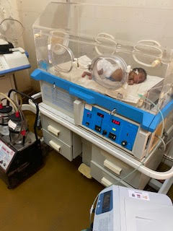
A costing tool to support the Scaling-up of quality care of the small and sick newborn
June 2023

Slide 2
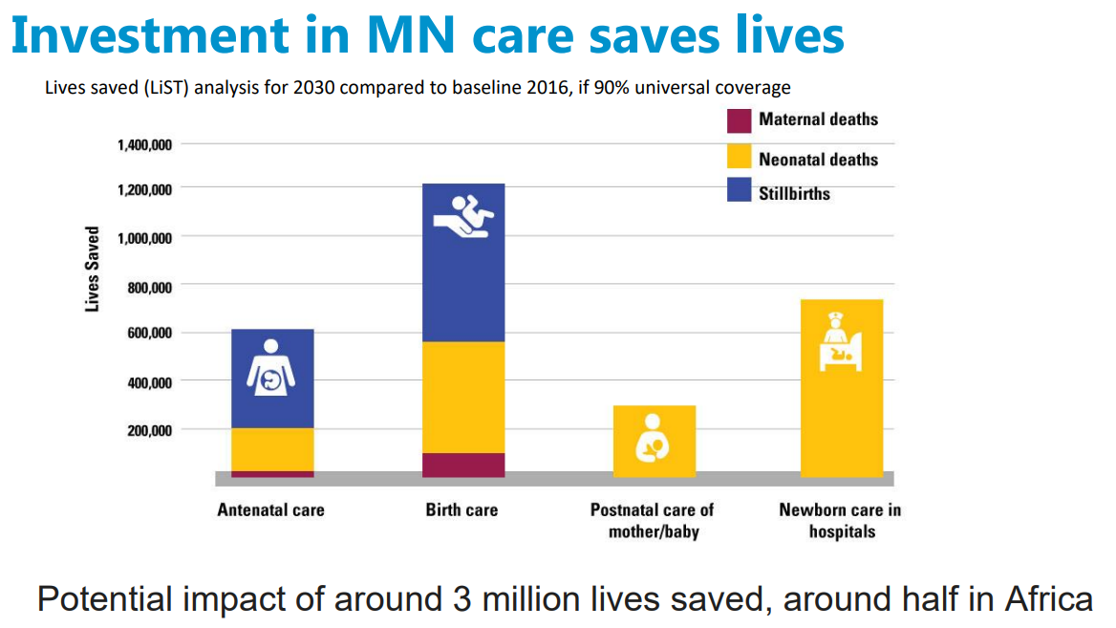

Slide 3
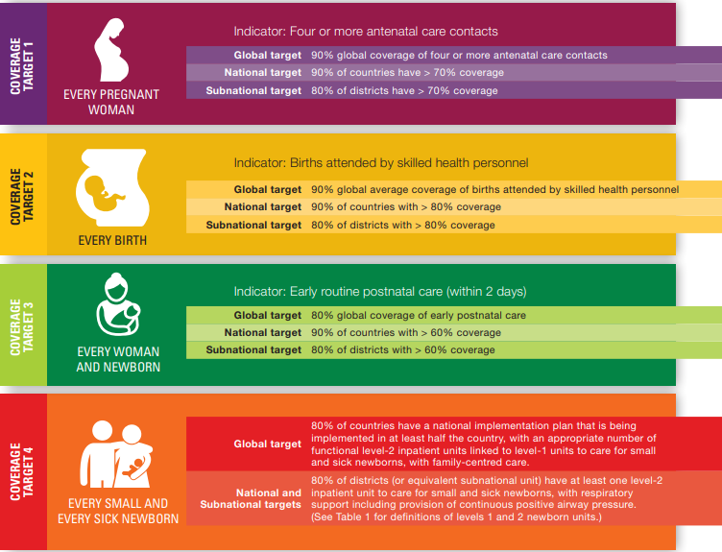
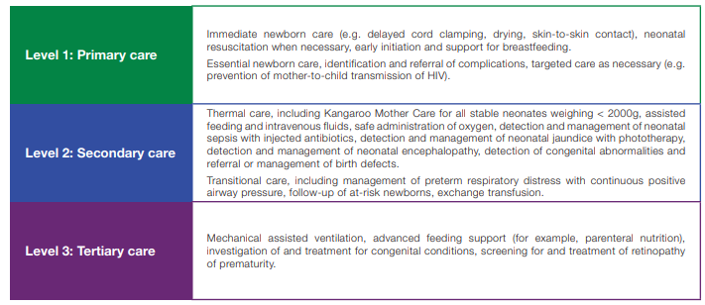
Every Newborn Action Plan
Target 4
80% of districts have at least one level-2 inpatient unit to care for small and sick newborns

Slide 4
    Background
  To meet ENAP target of 80% of districts providing inpatient care for small and sick babies, many countries have adopted or are in the process of adopting international standards of care & guidelines
  But in many countries, standards remain generic & there is no clarity on the system requirements to implement them or how much it would cost
  Without clear & costed guidance for the key quality of care domains, there is an increasing risk of
  ad-hoc adaptations of SNCUs that do not meet quality of care standards
  and/or unrealistic budgets
  We first wanted to ensure that GFF/WB supported projects were informed by a clear understanding of ‘what it takes’ and how much it costs to deliver QoC as defined by each country standards
  We also saw the opportunity to collaborate & leverage some global goods such as work on the ‘generic model’ and other standards/costing exercises, so we started sharing some earlier versions of the tool in Feb 2023

Slide 5
What we have done so far
Built an excel-based costing tool (Beta version) to support planning & budgeting for SNCUs, drawing on
Best available evidence, inc. WHO Frameworks, UNICEF guidelines & toolkits
Case study of Haryana, documenting the journey, challenges and lessons learned. Includes most recent operational guidelines for infrastructure, equipment, HR & QoC
Piloted in Zambia in late 2022
Produced costings informed by country guidelines & stakeholders discussions (MoH, regional and hospital staff, development partners)
Informed allocation of USD 1 million to fund capital costs
Developed a user manual to facilitate reviews & user testing
    Detailed guidance for using the tool to support planning & budgeting in country
    Includes the Zambia report to illustrate the type of analytical work that the tool facilitates

Slide 6
The Costing Tool Approach
A step-by-step approach for costing key domains of SSN Care
Discourages silo-ed facility planning & budgeting
  Includes all key domains & has ‘reminder’ menus for soft components such as QoC
  Starts with expected number of admissions, type of beds and facility areas, which have implications for infrastructure, equipment, HR, QoC
Review steps to unpack what drives the results and aid decision-making
Infrastructure
Equipment
Referral Vehicles & Medical Supplies
Human Resources
Quality of Care @ Facility Level
Quality of Care @ National & Regional, inc. management

Slide 7
The Costing Tool Approach
Balance realistic estimates vs. data-hungry processes
Bottom-up costings for individual SNCUs are not feasible, but one size does not fit all.
The tool allows costing a basic typology of facilities to capture important variations in costings across facilities (i.e. due to facility size or location)
Data-hungry where matters… or where is feasible at this stage
No detailed/ingredient costings for small items such as supervision visits
Detailed inputs for country standards & system parameters
Rules-based costing for large & critical items such as equipment consumables to ensure they are included and do not fall into the ‘hard to plan & even harder to budget basket’
Tailored costings, informed by
system parameters set by country standards (i.e. staff-facility ratios)
local cost drivers (i.e. construction cost per square meter)
facility characteristics (i.e. construction & equipment needs, location, size)

Slide 8
The Costing Tool Approach
Takes advantage of the fact that this type of costings like implementation requires info on ‘specifics’ (i.e. sq. mts. per facility area, type and number of devices, staff numbers, etc.)
The first step under each module is always to set the ‘specifics’ of country standards
Provides a check-list of all key elements & costs (capital & recurrent)
  If guidelines are ‘specific’ enough for regional/facility managers to understand what is needed to set up a facility, it is just a matter of entering system parameters & collecting cost data
  If not specific enough, the exercise involves discussing and thinking through ‘what it takes’ to deliver good QoC in the country

Slide 9
Zambia – What was the process for costing the scale-up?
Review of government policies, standards & guidelines
Source key system parameters (list of required equipment, staff categories, floor standards)
Rapid data collection and several cross-validation rounds (i.e. infrastructure costs against construction prices in Zambia and other African countries)
Prior to country workshop cost ‘hard’ components (Building, equipment acquisition & salaries)
    Important to motivate and ground country workshop discussions of guidelines
Country workshop: Robust discussions & substantial reviews of costed system parameters
Use reviewed parameters to inform next day discussions on allocation of $1 million to capital investments
Identify critical data gaps remaining & assemble additional data (with contributions from MoH & UNICEF) to estimate other equipment costs and costs associated with QoC strategies
Estimated costs of core SSN care components

Slide 10
An overview of what is included in the tool & the Zambia pilot results

Slide 11

Using the costing tool exercise to focus & ground planning discussions
The hard work with the costing exercise is not costing as such, but clearly identifying & specifying what is needed to deliver QoC
The tool system parameters are the ‘minimum’ required to provide clear guidance to facilities

Slide 12

Zambia standards for delivering care to SSN
Stratifies facilities delivering neonatal care
Identifies categories of care at each facility level, including inpatient care of SSN
Sets facility standards including:
  Size of the unit & types of bed
  Floor space per bed
  Required ancillary areas & environmental design
  Staff categories, inc. numbers of nurses
  Equipment specifications for neonatal units as well as for triage and ambulance
  Infection prevention and control
  Referral systems and transport
  Quality Assurance
Adopts the WHO framework for improving the QoC of SSN
Includes standards based on the eight domains of the framework as well as associated quality statements & measures
Notes:
These are just some examples

Slide 13
In Zambia, even currently detailed service standards needed more work to provide specific guidance
  Floor standards – how many sq. mts. per facility area?
  Equipment – relatively detailed standards available, but yet not detailed enough to ensure the ‘right’ equipment was included in all vendors’ quotations.
  HR – insufficient information to estimate the required staff ratios
  QoC – Limited information for basic issues such as number and content of mandatory trainings for staff
  The tool emphasis on ‘specifics’ for system parameters means that they can be used for developing facility operational guidelines

Slide 14
Zambia –What was included (Typologies & Other)
Facility Size: 9, 12 & 18 beds
Location Costs: Mid ~ Urban, High ~ Rural & Very High ~ Remote
Construction: New vs. Rehabilitation
Equipment: Three levels of need: Major, partial and limited
Capital and recurrent costs (i.e. maintenance included)
Human Resources: Standard Costs & Hardship Allowances (Rural ~ +20%)
In-service training, coaching & Higher education courses included
QoC: Some might be missing, though most included in other modules (i.e. equipment for CQI inc. in facility furniture/other equipment)
National/Regional: Includes commissioning, development of facility templates &CQI costs
Assumes leveraging of national strategies for some components

Slide 15
Human resources costs - Zambia
Consensus @ workshop that the same numbers would be required to deliver QoC for a 9-bed and a 12 bed unit
As expected largest share of costs driven by required numbers (nurses) & salaries (doctors)
Nurses account for ~ 34%-42% of salaries across all facilities
Nutritionists, security guards & cleaners account for ~24% - 29%
Staff Development
Critical component, but relatively small cost
Let’s look at HR in more detail

Slide 16
Required Staff Numbers - Does it matter if guidance is not specific?
Zambia guidelines:
Identify required staff such as doctors, nurses and nutritionists
Other stuff, such as biomedical technologists & house keepers are not included
Staff/facility ratios are only included for nurses
Support staff can be easily ignored, but they are critical for quality of care & have important cost implications.
The costing exercise helped ground & inform stakeholder discussions
We drew on international evidence to fill the gaps and motivate discussions
Robust discussions at the country meetings led to substantial revisions

Slide 17
Human Resources… Let’s check for example the impact of not accounting for support staff (Step 1.1. & Step 1.2. Row 79)

Slide 18
Human Resources… See for example the impact of not including support staff in the costing tool (Step 1.1 rows 39 to 47)

Slide 19
Infrastructure Costs – Zambia
Modelled New construction costs by facility size & 3 point cost estimates
High cost @ $600 per Sq. Mt = base scenario
Total New Construction Costs:
$132k to $227 k for 9-bed NNU
$165k to $285 k for 12-bed NNUR
$198k to $341 k for 18-bed NNU
Key cost drivers:
Cost per SQM ($480, $600 & $720)
Space per bed: Inpatient areas account approx. for ~38-44% total floor space
Circulation space assumption =10% vs. 30% in Haryana
Minimum space required for other areas

Slide 20
Equipment Costs – Zambia
As expected, large impact of equipment prices
Shared equipment (Mobile X Ray & Blood Gas Analyser*) represent approx. 20% of costs in the Base Prices Scenario for the three facilities
* Only for 18 bed NNU
Even after excluding shared equipment, a few items account for the bulk of costs
Generally, the top six items inc. resuscitaire, ventilators, oxygen concentrators, phototherapy units, closed incubators account for approximately 50% of costs for each facility
Note: Base Prices use mid-point if three prices available. If only two prices available, it uses the maximum.
Base Prices are used for the calculations of recurrent costs

Slide 21
Equipment Acquisition - Only the Tip of the Iceberg
In-country consensus that other equipment costs are significant and needed to be included.
No hard data available & no facility in country currently operating as per standards to source some of the cost parameters
Agreed on using rules-based costing to account for these costs
Estimates were provided by UNICEF based on their recent experience in Zambia & triangulated with their colleagues in India
Distribution & Installation ~ 20 to 40% of equipment value with significant variations across provinces
Large recurrent costs
Consumables & Renewables ~ 30 to 40% of equipment value (annual)
Equipment Maintenance ~ 10 to 15% of equipment value (annual)

Slide 22
Planning & Budgeting– Quality of Care @ Facility Level
QoC Strategies - Reminder Menu
Care Integration inc. referrals
Post-discharge follow-up
Infection Prevention and Control inc. WASH
Family-centered Care
Developmentally supportive Care
CQI supported by actionable HIS/data
Other
Reminder menu that can be used as a check list
For Zambia, no additional costs as QoC strategies were included in other components. For example:
  Adequate infrastructure, equipment & HR capture laptops, staff and space for CQI
  Key components of care coordination and integration inc. staff, guidelines, ambulance and associated referral costs included elsewhere
  Utilities assumed to be funded out of facility budget

Slide 23
Planning & Budgeting– QoC @ National & Regional
QoC_National & Regional - Reminder Menu
High level oversight
Infrastructure & equipment Commissioning
Supply Chain Management
Facility Templates for guidelines, protocols & SoP
CQI
Other
Reminder menu that can be used as a check list
For Zambia:
  Country standards & guidelines were used to sketch what some of these strategies would involve
  Costs were sourced from similar national-level initiatives and extrapolated
  However, for some areas such as high-level oversight & financing, limited info available, so not included

Slide 24
Cost of National & Regional Strategies - Zambia
Substantial training costs to facilitate current staff attending higher education courses
Other costs included: MEL as part of CQI, development of facility guidelines & commissioning
Does not include supply chain management costs such as development of health technology management systems. Assumed to be covered by national strategies for the health sector.
Note the model does not allocate these costs to facilities, so all facility costs are exclusive of national and regional strategies costed here

Slide 25
Summing Up:
What level of resources* are required to set-up a facility in Zambia?
* (USD 2022)

Slide 26
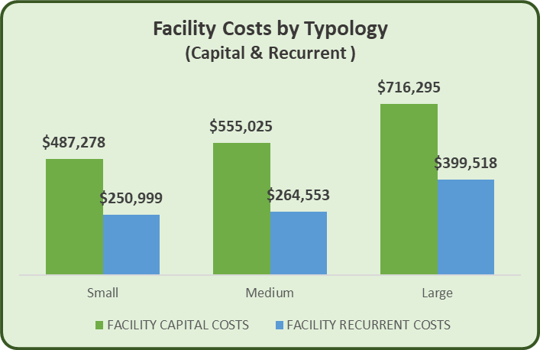
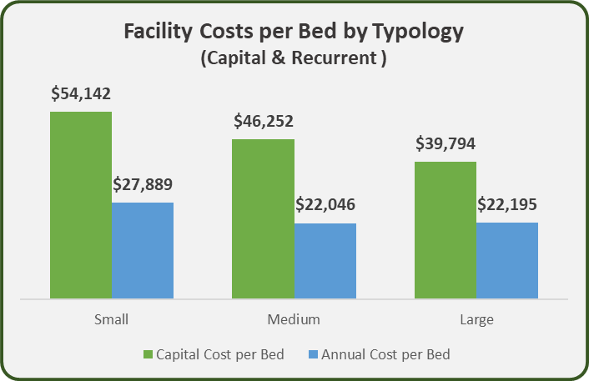
Zambia - Resources required to set-up a facility
Base Scenario:
New Construction
Equipment: Major Need @ base prices
Human Resources = Standard
Location Costs = High ( i.e. $600 per Sq. mt. of construction)
Recurrent costs are significant
Important economies of scale when looking at costs per bed
But do not forget that even for the same size & location, significant impact of individual characteristics, particularly on capital costs:
  Does the facility need new construction or rehab?
  Is it partially equipped or needs all essential equipment?

Slide 27
Tool Analytics to support planning & budgeting
Facility typology & scale-scenario analytics facilitate:
Exploring the potential impact of strategic decisions
Examining the impact on annual budgets

Slide 28


Slide 29
LESSONS LEARNED – Strategy Development & Implementation
Once the ‘specifics’ of country standards are set, costing them is relatively easy
However, in terms of country standards, lack of global normative guidance is a hindrance… i.e. some of the standards in Zambia seemed conservative, but current international guides vary substantially…
What happens when there are gaps in country standards & guidelines?
  Very generic standards will hinder implementation
  To motivate and ground country discussions, gaps can be addressed through the international literature & costing can provide order of magnitude estimates
However, without concrete guidance each facility/regional manager would be reinventing the wheel when making decisions on issues such as:
  Number of beds that would be required and the in & out referral criteria
  Type of beds & minimum floor requirements to allow for no-separation policy, equipment ratios, etc….
Setting those ‘specifics’ inc. for facility standards, guidelines & QoC strategies
    Critical to ensure facilities have adequate systems, resources & budgets to deliver good QoC
    Requires a robust process geared towards implementation & ideally supported by evidence-based benchmarks and guidance

Slide 30
LESSONS LEARNED –What this work can contribute in countries like Zambia
  This type of costing exercise can aid the process of planning and budgeting for the scale-up by
      providing a step-by-step process that ensures all core components are included
      helping to focus discussions
      facilitating rapid costing of country standards to facilitate decision making
      producing costed guidelines for various typologies
  The tool analytics can support realistic discussions on the strategic scope of the Scale-Up:
        Some important decisions: i.e. larger number of smaller facilities vs. fewer facilities of larger size & geographical coverage?
        What are the implications of different strategic directions?
        What are the key cost drivers for each component/domain?
        What is the potential impact of the scale-up on annual health budgets & how to ensure its sustainability?

Slide 31
Discussion
Next Steps
Country/Project Application
Questions

