Slide 1
GFF Data Portal Objectives
Create accessible dashboards that visualize country and program-level data across output, outcome, and impact indicators with the goal of enhancing data use.
Provide secure, well-managed storage for data across the GFF Logic Model.
Serve as repository for routine monitoring data shared from GFF partner countries.
Provide single access point for consolidated population-based survey data, process data, HF, and RMET data.
Streamline reporting processes.
All data validated by country teams as part of the process.
Through the web portal, global reporting data may be accessed at any time by development partners, partner countries, donors, and the GFF.

Slide 2
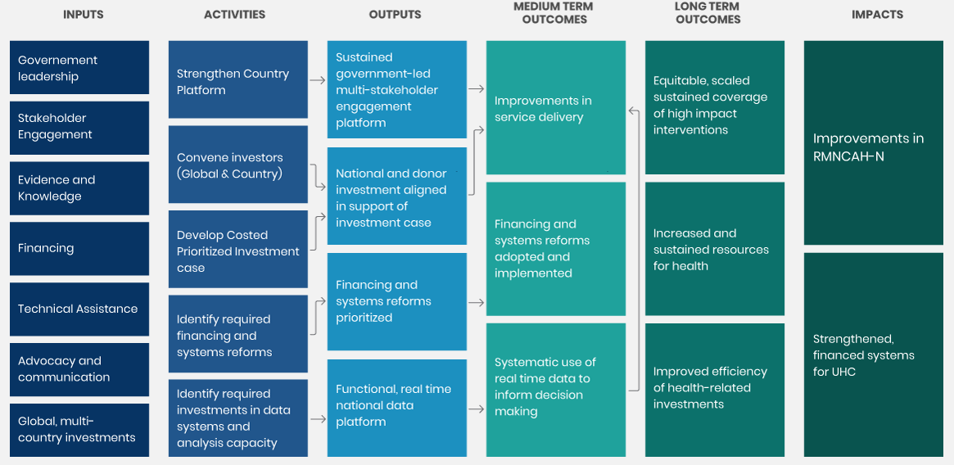
GFF Logic Model provides basis for systematically determining what needs to be measured
ALL GFF COUNTRIES
IMPLEMENTING 1-3 YEARS
3+ YEARS
Areas where measurement is being strengthened:
- Gender, equity, SRHR, adolescents
- Private sector
- Quality and efficiency
- Alignment
The GFF adopts a contribution perspective. The impact achieved is led by and belongs to countries.

Slide 3
GFF Framework for operationalizing results strategy: components are dynamic and inter-related
Evaluation &
implementation research
GFF activities are aligned with country systems, connect to country-led processes and aim to reinforce data use at multiple levels
Synthesis & review
Data and
evidence use for strategic planning,
action & improvement
Routine monitoring
Country data sources, systems, and capacities

Slide 4
Bringing together the strategy in the GFF data portal
Country-approved implementation data forms the backbone of the data on the portal.
Data Collection
Data Processing
Data Visualization for Use
DHS / MICs
Population-based surveys
Data extraction
Data Repository
Data storage,
Cleaning, calculation,
standardization,
triangulation
Web Portal
External/ internal facing
visualization of data
Country analyses
GHED / Other global health financing
Data request letter
RMET / BOOST
Monitoring GFF engagement
Donor reporting
WB operations
Data extraction template
Analytic products
Country specific data
Notes:
Moving forward we will be requesting standard routine indicators across priority programmatic areas from all GFF partner countries in addition to the country CIS indicators requested this past year.

Slide 5
What data is included in the portal?
Data Source | Description
Demographic Health Survey (DHS) and other surveys | Population-based health survey (standard indicators, performed every 3-5 years)
WHO Global Health Expenditure Database / other global health financing | Health expenditure data. Standard indicators, reported annually. Present dataset reported through 2019
Resource Mapping Expenditure Tracking (RMET) | Domestic and external financing analysis linked to Investment Case priorities for each GFF partner country (usually annual, country dependent)
Monitoring GFF Engagement | GFF Secretariat scoring on standard indicators to monitor progress along core elements of the GFF logic model (standard indicators, reported annually)
World Bank operations data | GFF co-financed World Bank project indicators (vary by country, reported annually)
Implementation progress data from countries | Indicators which represent measurable results linked to country-specific prioritized reforms. Usually provided from facility routine monitoring systems, collected quarterly and reported annually on data portal. Indicators vary by country.

Slide 6
Routine data collection was informed by the country theory of change frameworks
Reforms linked to measurable output and outcome indicators
…that are each linked to a known data source
Reforms/Initiatives
Output Indicators
Outcome Indicators

Slide 7
Web Portal Demo

Slide 8
Putting the Portal to the Test – Common Data and Reporting Questions
I’m aware there are about 8 indicators that a lot of global partners are working on. How do I know how my country is doing compared to others in these areas?
Are GFF countries making progress across nutrition outcomes? Which countries?
We’re having our first country platform meeting after several months, and the team wants to examine subnational progress prior to and since the onset of the Covid pandemic. How do I do that?
My country is revising the IC and we need to examine the financial inputs from government and donors. Has that landscape changed over time?
My government has committed to spending a certain amount of its budget on health. How do I know if that’s been done, and how does that amount compare to other countries in the region?
This is great, but I don’t understand what these indicators mean or where you’re getting the data from.

Slide 9
Annex

Slide 10
Country theory of change frameworks become data requests sent to countries each March
The country theory of change framework serves as the basis for the annual data request, sent to country teams as a formal request for routine monitoring, health financing, and other data outlined in the theory of change framework.

Slide 11
Putting the approach into action: measuring progress for PHC reforms
The GFF’s approach for monitoring progress against PHC reforms is flexible and holistic, with a reforms in the domains of Health Financing, RMNCAH-N service delivery, and HSS working together to improve and strengthen primary care outcomes.
For results monitoring, the GFF supports countries in identifying and collecting data for indicators that are best suited for the country’s specific reform areas with a focus on PHC.
Across countries, progress in service delivery can be measured across core programmatic areas. For PHC, results monitoring includes measurement of core RMNCAH-N outcomes, rapid-cycle monitoring, supply chain and systems reforms, and monitoring resilience in the context of Covid-19.
Diving into the data for individual countries provides a further lens towards understanding progress.

