Slide 1


Managing risks of SEA/SH in World Bank financed operations.
Aïda Diop, Senior Social Development Specialist, GBV Focal Point, AFW (Mali, Senegal and Côte d’Ivoire CMUs)
17 April 2024 – Girls and Women Empowerment Specialists
Notes:
Objectives / Key points:
Welcome everyone for the training.
Introduce yourself and your co-facilitator(s).
Indicate how you want participants to call you by underlining the name. State minimal information on your position.

Slide 2


Session content and objectives
Content
Objectives
SEA/SH Risk Management with a Survivor-Centered Approach
Identifying and Assessing SEA/SH Risks
Key Proportional SEA/SH Mitigation Measures and Monitoring
Resources available
At the end of this session, you will:
Understand what is Gender-Based Violence (GBV) and what are Sexual Exploitation Abuse and Harassment, and why they are a priority concern to address in WB projects and as part of the ESF.
Learn how to identify and continuously assess risks of SEA/SH.
Learn practical measures and strategies to mitigate and monitor the risks of SEA/SH both in projects with civil works and in HD.
Become aware of the resources and support available, and where to access them.
Notes:
Be ready to answer our questions, and to ask them too.

Slide 3
1
SEA/SH Risk Management with a Survivor-Centered Approach
Definitions and Basic Concepts
The Survivor-Centered Approach
SEA/SH Risk Management as part of the ESF

Slide 4
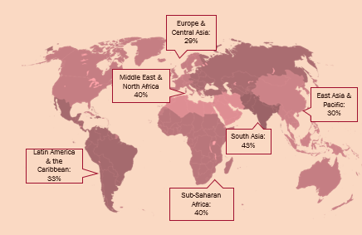
1. SEA/SH Risk Management with a Survivor-Centered Approach
a. Definitions and Basic Concepts
Gender-Based Violence (GBV) and SEA/SH
GBV is an umbrella term for any harmful act that is perpetrated against a person’s will, based on their gender (socially-ascribed differences between males and females).
GBV is the most extreme manifestation of gender inequality.
It disproportionately affects women and girls and takes many forms.
GBV
SEA/SH
Sexual Exploitation and Abuse and Sexual Harassment (SEA/SH)
are forms of GBV.
Notes:
Objective/ key points: Understanding what is GBV, and how it related to gender inequality.
Understand SEA/SH in a continuum
why the term GBV has been used historically to refer to violence against women and girls…
“Violence against women is a manifestation of historically unequal power relations between men and women, which have led to domination over and discrimination against women by men and to the prevention of the full advancement of women” (UN Declaration on the Elimination of Violence Against Women 1993).
It has many manifestations, including:
Child sexual abuse
Forced/early marriage
Trafficking of women and girls
Killing in the name of honor
Sexual violence
Intimate partner violence
(Source: Violence against Women and Girls-Lessons from South Asia,2013, World Bank)
GBV also happens everywhere. All over the world, GBV impacts disproportionately women and girls, and the term GBV is often used interchangeably with the term “violence against women and girls”. In some circumstances, men also experience GBV, especially sexual violence, most commonly perpetrated by other men. Other groups (i.e. LGBTQI individuals) can be particularly at risk too. In addition, among women and girls, other identities may further compound their vulnerability (i.e., women with disabilities, displaced or refugee women, women or girls’ heads of households, etc.)
Sexual Exploitation Abuse and Harassment are three manifestations of GBV. They can be associated with development or humanitarian work, undermining the trust with communities, development objectives, and most importantly harming individuals that projects are supposed to support (i.e., basic violation of do no harm). We will talk today about the mitigation of SEA/SH, but projects can unintendedly exacerbate other forms of GBV, that are not covered by this training, or by the recommendations of the Bank Good Practice Note. These should be identified and addressed as part of ESS1.

Slide 5
1. SEA/SH Risk Management with a Survivor-Centered Approach
a. Definitions and Basic Concepts
What is SEA/SH?
Example forms
SEXUAL EXPLOITATION
Any actual or attempted abuse of a position of vulnerability, differential power, or trust, for sexual purposes
Occurs when access to or benefit from Bank-financed goods, works, or services is used to extract sexual gain
SEXUAL EXPLOITATON
A project actor demands sexual favors in order provide cash to a beneficiary
A healthcare worker refuses to provide services to an LGBTI+ person unless they perform a sexual act
A community member is promised employment in exchange for sex
Notes:
Tips for the trainer: After showing the definition, ask participants to share a few examples of what this could look like in a project, before showing them the examples in each slide
Objective/ key points: Bank-financed projects may introduce goods, benefits, or services to a project-affected community. Project workers may have access to the goods, benefits, or services that are Bank financed. This creates a power differential. The power differential is created when a project worker has real or perceived power over a resource that can then be used to leverage or pressure a community member into an unwanted sexual act. If the project worker uses this differential power to extract sexual favors, he/she is sexually exploiting a project beneficiary.

Slide 6
1. SEA/SH Risk Management with a Survivor-Centered Approach
a. Definitions and Basic Concepts
What is SEA/SH?
Example forms
SEXUAL ABUSE
Actual or threatened physical intrusion of a sexual nature, whether by force or under unequal or coercive conditions
Occurs when a project actor uses force, or unequal power, to perpetrate or threaten to perpetrate an unwanted sexual act.
SEXUAL ABUSE
A community worker sexually assaults a beneficiary
A project worker has a sexual relationship with an underage child
A teacher threatens to disclose a sexual or gender minority student’s identity to their family or school community unless they perform sexual favors
Notes:
Objective/ key points: Bank-financed projects may introduce goods, benefits, or services to a project-affected community. Project workers may have access to the goods, benefits, or services that are Bank financed. This creates a power differential. The power differential is created when a project worker has real or perceived power over a resource that can then be used to leverage or pressure a community member into an unwanted sexual act. If the project worker uses this differential power to extract sexual favors, he/she is sexually exploiting a project beneficiary.
Tips for the trainer: After showing the definition, ask participants to share a few examples of what this could look like in a project, before showing them the examples in each slide

Slide 7
1. SEA/SH Risk Management with a Survivor-Centered Approach
a. Definitions and Basic Concepts
What is SEA/SH?
Example forms
SEXUAL HARASSMENT
Sexual advances, requests for sexual favors, or any other behavior of a sexual nature that might reasonably be perceived as offensive or humiliating to another, when such conduct interferes with work, is made a condition of employment or creates a hostile work environment
SEXUAL HARASSMENT
A project worker leaves an offensive picture that is sexually explicit on a co-worker’s desk
A teacher asks all students of a specific gender to greet them with a kiss on the cheek everyday
Notes:
Objective/ key points: Bank-financed projects may introduce goods, benefits, or services to a project-affected community. Project workers may have access to the goods, benefits, or services that are Bank financed. This creates a power differential. The power differential is created when a project worker has real or perceived power over a resource that can then be used to leverage or pressure a community member into an unwanted sexual act. If the project worker uses this differential power to extract sexual favors, he/she is sexually exploiting a project beneficiary.
Tips for the trainer: After showing the definition, ask participants to share a few examples of what this could look like in a project, before showing them the examples in each slide

Slide 8


1. SEA/SH Risk Management with a Survivor-Centered Approach
a. Definitions and Basic Concepts
Contextual prevalence of GBV is high worldwide, across all regions and all spheres of life.
The impact of GBV is high
It produces multiple harmful consequences for survivors, their communities and countries.
Absence of cases doesn't mean that the problem doesn't exist.
GBV is underreported due to many barriers.
By implementing enabling reporting mechanisms and informing communities of their rights, we empower survivors to come forward, look for support and hold perpetrators accountable, breaking the cycle of violence.
As part of the ESF, we have the duty to actively work to identify, reduce, mitigate and respond to GBV risks, including SEA/SH
That are likely to be created or exacerbated by features of project implementation
Notes:
Both prevalence, context related risks and impacts of GBV are high.
Consequences:
For women
Injuries
Depression or anxiety disorders
Sexually transmitted infections including HIV
Unwanted pregnancy
Higher risks of early marriage and intimate partner violence
Low self-esteem, self-harm or suicide
For their children
For families/communities
For countries/societies
Costs of services incurred by survivors and families
Lost workplace productivity and costs to employers
Perpetuation of violence
Cost for nations includes costs related to service provision, out-of-pocket expenditures, and lost income and productivity – 2% of global GDP.
Absence of cases is often linked to barriers in reporting mechanisms that compound the existing socio-cultural, behavioral, legal, economic and accessibility barriers that prevent survivors from seeking help. 1 in 2 women who have experienced physical or sexual violence never sought help to stop violence, and never told anyone. Only 9% of survivors globally report to the police, and 2% to a social workers or medical professional. (DHS)
Some of the features of Project implementation that may contribute to exacerbating risks are: the presence of a predominantely male workforce, labor influx workers, small, rural communities, potential for transactional sex of Good and services, absence of behavioral standards and related training for workers, close proximity of workers to community women, girls, and other groups at risk, living arranegements of workers, etc.

Slide 9

Quick history of the SEA/SH agenda at the World Bank
1. SEA/SH Risk Management with a Survivor-Centered Approach
a. Definitions and Basic Concepts
In 2016, following a first Inspection Panel Case in Uganda with SEA/SH allegations, the Bank established a Global Gender-Based Violence Task Force to improve the institution’s response to these issues.
A GBV Action Plan was written in 2017 with recommendations for protecting women, children, and other populations at risk where Bank projects occur.
Following the recommendations of the GBV Task Force, all World Bank-financed IPF involving major civil works and other projects that can cause SEA/SH should:
Identify and assess the risk of exacerbation/introduction of SEA/SH at the community level and assess the local capacity to prevent and respond to GBV,
Mitigate the risks by identifying and implementing appropriate SEA/ SH risk mitigation measures,
Respond to any reported GBV allegations, whether related to the project or not.
Notes:
But how did we get to paying this attention to risks of SEA/SH, specificially. While work on GBV prevention, mitigation and response stems from the gender startegy, it’s with two inspection panels case that we were pushed, as an insitution, to acknowledge how pervasive risks of GBV and SEA/SH associated to our operations are, and start mobilizing resources to help Task Teams and Borrowers to address this through guidance, staffing, training, tools, etc.

Slide 10
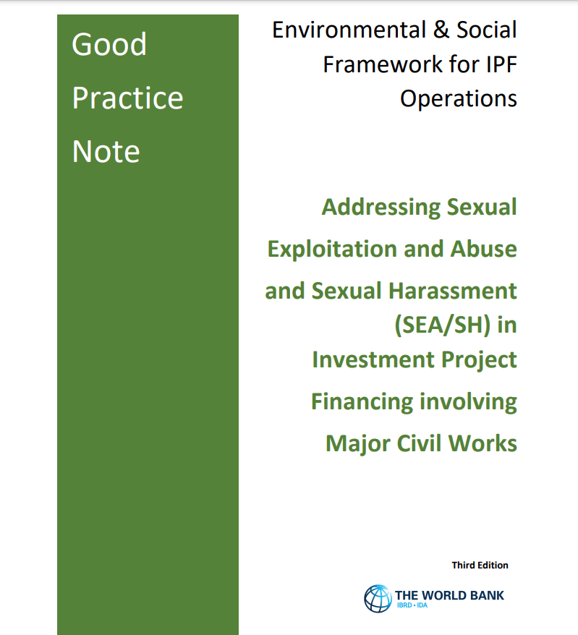

1. SEA/SH Risk Management with a Survivor-Centered Approach
World Bank Good Practice Note on Addressing SEAHS in Investment Project Financing involving Major Civil Works, (2018, Third edition 2022)
English, Arabic, French, Spanish, Portuguese
World Bank Good Practice Note on Addressing SEA/SH in HD Operations ( First Edition, 2022)
English, Arabic, French, Spanish
Notes:
Objectifs/points clés : Présentez la diapositive 39 comme un bref aperçu du programme d'exploitation, d'abus et de harcèlement sexuels (EAS/HS) de la Banque mondiale.
Expliquez que comprendre le contexte historique est essentiel pour comprendre l’évolution et les progrès réalisés dans la lutte contre l’EAS/SH au sein de l’organisation.
La diapositive 40 présente les orientations disponibles de la Banque mondiale. L’ESF exige de la Banque et du Client qu’ils analysent et atténuent tous les risques pertinents. Par conséquent, si l’EAS/SH constitue un risque dans un projet, le FSE exige que des mesures soient mises en place pour atténuer ces risques.
Consciente que la VBG est un sujet difficile, sensible et encore relativement nouveau pour nombre de nos collaborateurs et de nos emprunteurs, la Banque a développé deux GPN qui fournissent des conseils sur la manière d'identifier et de gérer les principaux risques.
Expliquez que les deux GPN, l'un pour les projets de travaux de génie civil et l'autre pour les opérations HD, abordent les caractéristiques et les opportunités spécifiques à ces secteurs, y compris le rôle des entrepreneurs et des marchés publics, ainsi que l'ampleur et la nature des opérations HD, le rôle des fonctionnaires, etc. Cependant, les principes clés et les mesures d'atténuation doivent être appliqués proportionnellement à tous les autres FPI susceptibles de créer des risques d'exploitation et d'exploitation sexuelle.
Conseils pour le formateur : Mettez en valeur l'engagement de la Banque mondiale à lutter contre l'EAS/SH en mettant l'accent sur les expériences antérieures, les exigences du FSE et l'importance d'appliquer proportionnellement les principes clés des GPN à toutes les catégories de projets.

Slide 11






1. SEA/SH Risk Management with a Survivor-Centered Approach
b. The Survivor-Centered Approach
Adopting a survivor-centered approach
Enable access to quality and holistic care Health, psychological, legal/security aligned with minimum national and international standards
Safety
Survivor’s safety should always be considered the first and most important priority
Informed consent
Survivors must have all the information they need to make informed decisions; information must be provided in an accessible manner based on their circumstances
Confidentiality
Do not disclose information without the informed consent of the person concerned. Share anonymized, non-identifiable information on a strict need-to-know basis
Respect
Actions are to be guided by respect of survivors’ rights and choices. Survivors need to feel that they are believed and in control of what happens
Non-discrimination
Survivors should receive equal and fair treatment regardless of their age, race, religion, nationality, ethnicity, sexual orientation, or any other characteristics
Notes:
Since the onset, the Bank deliberately adopted a survivor-centered approach to its work on GBV, including the one on SEA/SH risk management. But what does a survivor-centered approach means, concretely?
The survivor-centered approach aims to ensure that survivors are treated with dignity, respect, and fairness throughout their journey toward healing and justice, prioritizing their confidentiality, safety, and well-being at all times.
It is rooted in some key, guiding principles:
The first principle is to ensure timely access to quality and holistic services. Survivors should have access to comprehensive support, including health, psychological, and legal (key package of services included in the GPN), but also security, safehouse/shelter, and livelihood assistance. It is crucial to address their diverse needs to facilitate their recovery.
Safety is of paramount importance. The survivor's safety should always be the primary concern and should be assessed through incident response. This entails creating secure environments that protect survivors from further harm, including retribution, and ensure their well-being. While the project’s ability to maintain safety is limited, the government has a responsibility to protect its citizens. At the project level, confidentiality and safety planning are key tools to maintain safety.
Informed consent is another critical principle. Survivors must have all the necessary information to make informed decisions about their care. Information should be provided in a language they understand, presented clearly, and accessible while considering their personal circumstances, including their age. Confidentiality plays a vital role in the survivor's journey. It is imperative to respect and uphold their confidentiality, including their families. Disclosure of any information related to the survivor’s experience should only occur with the informed consent of the survivor and on a strict need-to-know basis, even if anonymous (i.e., with staff that needs this information to perform their duties).
Respect is a guiding principle that should underpin all actions. It means treating survivors with empathy, without making assumptions about guilt or innocence, and respecting their decisions. Survivors should be believed and supported from the beginning, recognizing the potential validity of their experiences.
Non-discrimination is fundamental in providing equitable support. Survivors of gender-based violence should receive equal and fair treatment, regardless of their age, race, religion, nationality, ethnicity, sexual orientation, or any other characteristics. This also means that all survivors that disclose non-project related incidents of GBV to the project should be referred to care based on the project referral protocol. (Note that, in addition to being against a rights-based approach, providing services only to survivors of project-related cases may create incentives to report project-related cases to access life-saving care or critical support. In addition, services need to be provided in a timely manner, without waiting for the results of a potential investigation).

Slide 12




1. SEA/SH Risk Management with a Survivor-Centered Approach
b. The Survivor-Centered Approach
Other groups at-risk
Among women and girls some characteristics increase their vulnerability
e.g., Age, poverty, rural, displacement, indigenous, disability, advocates for their rights.
Groups i.e., children, LGBTQI+ individuals and those with disabilities, may be vulnerable to gender-based inequality and violence, including SEA/SH, in any context.
Identify these groups through the project's social assessment and adapt SEA/SH mitigation measures, including tailored communication strategies, GM entry points and procedures, etc.
Include consultation with vulnerable groups and advocacy organizations in the Stakeholder Engagement Plan throughout the project, facilitated by experts in the field.
Notes:
It's important to recognize that gender-based inequality and sexual exploitation/sexual harassment can affect various groups, in addition to women and girls, and children, including those who are LGBTQI, people with disabilities, and others. Individuals are subject to multiple vulnerabilities in light of the many dimensions of their identity.
Vulnerability can also be influenced by characteristics such as socioeconomic status, rural/urban residence, displacement, and speaking out about gender issues. Identifying these groups through social assessments and implementing tailored measures, like communication campaigns and entry procedures, is crucial.
Consulting with relevant organizations and experts should be included in the Stakeholder Engagement Plan.

Slide 13




1. SEA/SH Risk Management with a Survivor-Centered Approach
b. The Survivor-Centered Approach
Special considerations for child survivors
Why is it important?
What can be done?
ESS shall ensure the analysis of specific risks for diverse children.
Consultation with diverse children as part of the SEP, conducted by professionals with expertise ensuring safe and enabling participation.
The GM SOPs apply the principles of the best interest of the child, obtain assent and consent, involve caregivers, use age-appropriate communication, etc.
The mapping of GBV service providers to map tailored/specialized services for diverse children.
Risks to minors may differ from risks to adults
Children under the age of 18 constitute a large portion of survivors
Mitigation approaches and responses to SEA/SH incidents should be mindful of age
Learn more here
Notes:
As we increasingly worked on this, it became apparent that children, adolescent girls and in some contexts boys, are exposed to specific risks of SEA/SH, in light of their gender, and of their age. This is true for INFRA projects, where girls are at risks of SE, early marriage etc with project workers, at times brought in communities by the project, but also in health, education, SPJ, where children are often direct beneficiaries of activities and services, and are confronted by large power differential with project workers (teachers, social workers, health professionals, etc.)
This lead to a review of the INFRA GPN, and to the integration of stronger guidance on child survivors in the HD GPN
What are some of the key actions that project can take to address the needs of children?
Currently piloted by some transport projects in SAR and Nepal.
What are some of the key things to take into account, when adapting SEA/SH risk management approaches to the needs of children?
Securing informed consent/assent
Confidentiality and best interests (e.g., we can override confidentiality if we feel it is in the best interest of the child or other children, etc.)
Medical response is different - doses of meds etc.
Communications are different.
Engagement of caregivers

Slide 14

Can project workers engage in sexual relationships with, for example, a 16-year-old?
No, engaging in sexual relations with individuals under the age of 18 is prohibited while working on WB funded projects as a condition of employment, and regardless of national age of consent.
The only exception if pre-existing marriages.

Slide 15
1. SEA/SH Risk Management with a Survivor-Centered Approach
c. SEA/SH Risk Management as part of the ESF
SEA/SH Risk Mitigation – A Shared Responsibility
SEA/SH risk management is a shared responsibility between the Government, the World Bank as well as contractors/consultants.
Government/PIU
Contractors/Consultant
WB Task Team
Assess risks, develop plans, and contracts, implement, provide oversight, and monitor the processes.
Uphold contractual obligations to manage risk
Provide technical assistance, due diligence, and implementation support as needed.
Notes:
Objectives / Key points:
GBV risk management, like the entire ESF, is a shared responsibility.
The government leads the risk assessment and implementation of the management plan: contracting, implementation, supervision, and monitoring and reporting. For this reason, the timely mobilization of PIU expert is key. The government is also responsible for ensuring that SEA/SH obligations are trickled down through contracts.
Contractors and consultants must fulfill contractual obligations to manage risks.
Support is provided primarily through SDS on projects, which received training and over the past years have gained increasing knowledge on this. Depending on the risk level, the Bank may assign a GBV specialist to join the social team. In these early years, Bank's involvement and need for guidance is more intense than in other issues: we are more involved (i.e., for mapping, incident response, etc.)
It is important to incorporate appropriate expertise, especially for high and considerable-risk projects, both within the client's consulting team and supervision, as well as in the Task Team.
PIU awareness and ownership is key since the beginning of the project (recruitment of social/GBV specialists key as early as possible), but all project stakeholders need to be informed and engaged on this.
Tips for the trainer:
Emphasize that GBV risk management is not an isolated effort; it's a collaborative endeavor involving various stakeholders.

Slide 16






1. SEA/SH Risk Management with a Survivor-Centered Approach
c. SEA/SH Risk Management as part of the ESF
SEA/SH risk management in the project cycle
PREPARATION
DECISION MEETING
NEGOTIATION
EFFECTIVENESS
IMPLEMENTATION
WB Task Team completes SEA/SH risk screening tool and assigns a risk rating to the project. This is reflected in C-ESRS and PID/PAD
Borrower assesses E&S risks, including SEA/SH risk analysis.
SEA/SH risks and mitigation measures addressed in PAD and TOR of ESF instruments
Final SEA/SH risk rating in PAD and A-ESRS
Describe proposed mitigation measures across relevant E&S documentation (ESCP, ESMF/P, LMP, SEP, security plans, SEA/SH action plan)
Key mitigation measures agreed between WB and Borrower and reflected in the ESCP
Resources and timing for mitigation agreed upon
Complete actions if and as required by effectiveness, in accordance with the ESF
TT supervises Borrower’s implementation and monitoring of agreed mitigation measures
Borrower’s E&S and ESCP reports include progress on SEA/SH
Mitigation measures and risk level reviewed and adapted as planned and needed
Allegations reported through ESIRT
Continue to assess SEA/SH risks throughout project cycle
Notes:
So what needs to happen, procedurally speaking, to address risks of SEA/SH during a project cycle?
The GPN recommends an adaptive approach to SEA/SH risk management anchored to the project cycle, with actions required at each stage of project preparation and throughout implementation, to be integrated into E&S instruments and approaches, with a varying degree of specialization depending on risk level.
In preparation, the risk screening tool combines indicators on national-level, contextual risks, and project-specific risks. The tool is just a starting point, both within the Task Team and with the Client.
SEA/SH risks need to be screened and assessed as part of the Client-led social assessment, and addressed in the relevant ESF instruments, with important discussions on resourcing and timing of key mitigation actions taking place before appraisal.
Risks and mitigation measures need to be reflected in the C- and A-ESRS, as well as in the PAD, under the relevant standards of the E&S section (for some high-risk projects, where contextual risks of GBV and SEA/SH are particularly high, it may make sense to add it also in the context section)
The ESCP details the timing of key mitigation measures (such as the requirement to hire a GBV specialist in the PIU, to develop a SEA/SH action plan, or to roll out CoC) and integrates them into the legal agreement.
Actions during Preparation’s stages:
Concept:
Screen for SEA/SH risks – risk level in concept note and C-ESRS
Initiate discussions between World Bank and clients on SEA/SH as part of the E&S work plan
Pre-appraisal:
Address SEA/SH risks and mitigation measures in the PAD and TOR of ESF instruments
Evaluate/mobilize expertise within the PIU
SEA/SH requirements reflected into procurement plans
Appraisal:
Final PAD and A-ESRS indicates SEA/SH risk level and mitigation plans
Risk assessment and mitigation measures with timelines addressed in ESF documents (ESCP, ESMF, SEP, LMP, etc.). For Moderate risk+, draft SEA/SH Action Plan in the ESMF
Funds for GBV experts, GBV and TPM services (H&S risk)
In implementation, the implementation of SEA/SH risk mitigation is monitored and reported on as part of the project’s E&S reporting, and is part of Bank supervision and due diligence, with progresses, challenges, and delays documented in the ISR and Aide Memoires. Depending on the ongoing stakeholder engagement and assessment of risks, trends identified in SEA/SH cases received, etc. risk management plans are revised and updated.
Tips for the trainer:
Deliver the information on SEA/SH risk management with clarity, emphasizing the flexible approach across the project cycle, highlighting the integration of actions into E&S instruments, and showcasing the iterative nature of risk assessment and mitigation for a comprehensive understanding among participants.

Slide 17
SEA/SH in ESF instruments
1. SEA/SH Risk Management with a Survivor-Centered Approach
c. SEA/SH Risk Management as part of the ESF
ESRS
  Discuss SEA/SH risks according to the relevant standards (ESS1, ESS2, ESS4, ESS10, and ESS5 and 7) and outline main mitigation measures.
ESCP
  Describe the main SEA/SH measures under relevant standards and needs for capacity and training.
  Define deadlines, based on the project schedule
ESMF/P and C-ESMP
  Project-specific SEA/SH risks and corresponding mitigation measures
  For moderate risk+ projects (H&S in HD), integrates the SEA/SH action plan
SEP
  Discuss risks and mitigation measures (and beyond) with women and girls, groups are risks and organizations
  Identify appropriate entry points for SEA complaints and integrate survivor-centered procedures for responding
LMP
  Include processes to enforce codes of conduct/behavioral standards and related training to different project actors
  Pathways to file and respond to SEA/SH in GM for workers
Notes:
While some projects will develop separate and stand alone SEA/SH Action Plans, other ESF instruments and plans are key to implement and streamline SEA/SH commitments and actions.
In addition to the social assessment and SEP, SEA/SH risks and mitigation actions should be reflected at least in the ESRS, ESMF/P, ESCP and LMP (but also may need to be reflected in security plans, when they exist, and in RAP)

Slide 18

Questions
& Answers
Notes:
Notes:
Involve the audience by asking if they have any questions or if they want to share something related to the content

Slide 19
2
Identifying and Assessing SEA/SH Risks

Slide 20





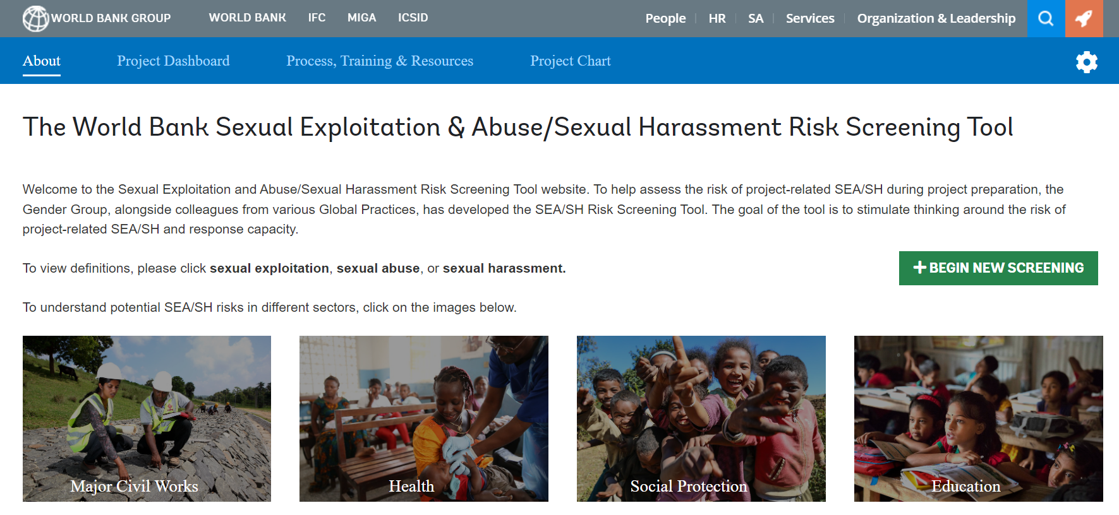

2. Identifying and Assessing SEA/SH Risks
World Bank-Led SEA/SH Risk Screening Tool
25 indicators of risk factors at national and project levels that can be associated with SEA/SH
Guidance note describing the rationale and criteria for scoring each indicator
Score determines whether project presents low, moderate, substantial or high SEA/SH risk
Discussion opener - to be supplemented by ESA and consultations
Tools designed to screen projects with civil works, in education, HNP and SPJ starting from concept stage
Access the risk screening tools at seahscreen/
Notes:
Objectives / Key points:
This WB-led exercise is meant to be a starting point for risk assessment and discussion.
Used early on, the risk screening tool provides a good opportunity to identify and discuss some key drivers of risks within the task team, allowing for the incorporation of key prevention actions in project design.
The tool consists of two sections:
Section A – Country context (13 questions):
Country-level violence background – Prevalence of Intimate Partner Violence, sexual violence, child marriage, trafficking index, etc.
Legal context – Laws on domestic violence, marital rape, sexual harassment, etc.
Gender norms and beliefs – justification of wife beating, help-seeking behaviors.
National level capacity to respond to GBV – GBV working group, national action plan on VAWG prevention and response, referral pathway protocols, etc.
Section B – Project questions (12 questions):
The risk screening tool questions are in the annex to the ESF Good Practice Notes and can be also used as elements and starting points for the Borrower-led social assessment. The tool is a simplification, and is based on national averages, has limitations.
Teams should demonstrate judgment if they feel risks are not sufficiently reflected through the tool and validate the risk level. The risk screening tool has to be completed and confirmed by the Borrower-led social assessment of SEA/SH risks.
Tips for the trainer:
Guide participants to embrace the Risk Screening Tool as a launching pad for risk assessment and team discussion.
Encourage its’ early adoption to uncover key risk factors, empowering teams to integrate preventive actions into project design.

Slide 21
After completing the SEA/SH risk screening tool, is the assessment of SEA/SH risks finished?
NO. The risk screening is a simplification and a discussion opener. It should be expanded and supplemented by the Client-led assessment of SEA/SH risks as part of the project social assessment.

Slide 22








2. Identifying and Assessing SEA/SH Risks
Client-led SEA/SH Risk Assessment
Part of the project social assessment
Information on harmful cultural practices towards women and girls (e.g., early marriage)
Analysis of how contextual risks of GBV could be exacerbated by interaction with project actors under each project component
Includes Gender Analysis or Country Action Plan
Identifies and maps GBV services in area of project implementation and barriers to access them, including for potential partnership
Reviews data on GBV prevalence (such as intimate partner violence or non-partner), e.g., DHS or official statistics
Review national legal framework on GBV, including around behavioral standards and mandatory reporting
Notes:
No! The risk screening tool is a simplification, and a discussion opener. It is not a SEA/SH risk assessment.
As part of the assessment of social risks that each project must undertake, PMUs must gather proportional information on SEA/ SH risks in the country or specific to the project’s sector and the response capacity. This would normally be included in the Environmental-and-Social-Impact-Assessment (ESIA) and would contribute to validate/update the risk level of the project.
It needs to be carried out by someone with the relevant expertise to carry out safe and enabling, participatory GBV assessments, in addition to a component of desk review. If a consultant is mobilized, they need to be sufficiently briefed about project design, and how the project will touch the ground and interact with beneficiaries, to be able to assess risks associated to the impact of the projects in communities.
The project would want to review and update risk assessments during project implementation in case of any changes, or new information becoming available, and once the community is aware of the project and can provide more feedbacks.
This information can come from a variety of sources, some may already exist.
Existing gender country diagnostics/country action plans;
Existing prevalence data on partner/non-partner physical and sexual violence against women;
Demographic and Health Surveys; Gender Sustainable Development Goals (data for over 90 countries)
Creating baseline GBV surveys for risk assessment should be avoided.
Data and/or information on cultural practices vis-à-vis women (early marriage, sexual exploitation, physical practices), including those that can be exacerbated by the project;
Existing GBV services available, quality, accessibility, gaps;
Review of existing national legal frameworks on GBV, including behavioral standards and mandatory reporting,
Other information obtained from consultations, which is in line with ESS10: Stakeholders need to understand the project risks and benefits.
Fragile or conflict-affected environments need to be carefully considered when assessing SEA/SH risks for a project. In such environments, communities may have undergone traumatic experiences, and the social fabric may be broken down. Further, as a result of insecurity and conflict, the required support services and care are often limited.
Tips for the trainer:
Remember participants to ensure effective SEA/SH risk assessment by engaging experts, updating assessments, using diverse data sources, understanding local context, and adapting in fragile environments.

Slide 23
2. Identifying and Assessing SEA/SH Risks
SEA/SH risk category
Assigned at concept in the C-ESRS.
Confirmed at appraisal (A-ESRS) and through implementation (ISR).
Based on risk screening tool and information collected through the social assessment process in preparation and implementation.
Helps inform the social risk rating of the project and, in turn, the ESRC.
Contextual risks of SEA/SH
i.e., prevalence of GBV, social norms that condone and justify VAWG, legal framework and its application, capacity on GBV in country, conflict, etc.
Project related risks
i.e., mainly male workforce, labor influx in small/rural communities, potential for transactional sex, lack of known and trusted reporting mechanisms and standards of conduct, etc.
Client’s capacity
i.e., policies and procedures in place, ability to supervise entire span of project, etc.
Notes:
presence of a predominantely male workforce, labor influx workers, small, rural communities, potential for transactional sex of goods and services, absence of behavioral standards and related training for workers, close proximity of workers to community women, girls, and other groups at risk, living arranegements of workers, etc.

Slide 24
3
Key Proportional SEA/SH Mitigation Measures and Monitoring
Minimum Recommended Mitigation Actions by Risk Level
SEA/SH Action Plan
Codes of Conduct & Accountability and Response Framework
Grievance Mechanism & Awareness Raising
Mapping and Working with GBV Service Providers
Monitoring Mechanisms

Slide 25









3. Key Proportional SEA/SH Mitigation Measures
a. Minimum Recommended Mitigation Actions by Risk Level
Minimum Recommended Mitigation Actions for Projects With Civil Works
01
02
03
04
05
06
07
08
09
Sensitize IA
Assess SEA/SH risks and map service providers
Raise community awareness
Codes of conduct and training for workers
Effective
Grievance
Mechanism
with SEA/SH
pathways
SEA/SH Action
Plan
GBV
specialist in
PIU and
supervision
consultant
team
Third Party
Monitoring
Gap filing provision of GBV
services
LOW RISK
MODERATE RISK
SUBSTANTIAL RISK
HIGH RISK
Notes:
Objectives / Key points:
Explain that these are the minimum recommended mitigation actions for all projects with civil works.
Each block builds on the previous, based on the principle of proportionality. However, a core number of actions needs to be carried out by projects at all risk levels not to create harm – for example, we can’t raise awareness of the GM and GBV, including SEA/SH, if we don’t have a pathway to refer survivors to critical care.
Similarly, codes of conduct and GM wouldn’t be useful if projects and all stakeholders didn’t have functioning and effective accountability and response frameworks that allow them to take safe and ethical action in case of misconduct.
These mitigation measures need to be tailored, and completed, based on each project design, how it hits the ground, how it delivers its services and how workers interact with beneficiaries (for example, risk management measures around living arrangements, or identification of workers in the field, may be appropriate for some projects).
Tips for the trainer:
Remember participants to guide projects with civil works towards effective mitigation by emphasizing progressive, interconnected actions. In addition, stress core measures for harm prevention, the importance of coherent accountability frameworks, and tailor mitigation to project specifics.

Slide 26
3. Key Proportional SEA/SH Mitigation Measures
a. Minimum Recommended Mitigation Actions by Risk Level
Minimum recommended mitigation actions for HD projects
L or M SEA / SH Risk Rating
Codes of conduct or behavioral standards with generic language for all project actors
Sensitization of communities and workers
Effective Grievance Mechanism with SEA/SH pathways
Identification of at least one quality GBV service provider
Accountability and Response Framework
Safe spaces in facilities
Considerations for recruitment of staff
S or H SEA / SH Risk Rating
Codes of conduct or behavioral standards with specific SEA/SH prohibitions for all project actors
Sensitization and training of communities and workers
Identification or mapping of holistic quality GBV service providers
GBV specialist in the PIU
SEA/SH Action Plan
Safety audits of facilities (high risk)
** HD project components with civil works should continue to apply the relevant mitigation measures of the Civil Works GPN, including those related to procurements
Notes:
Objectives / Key points:
Explain the minimum recommended mitigation actions for HD projects.
Remind that while some may not change with INFRA projects, how they will need to be implemented, especially to ensure some level of sustainability, differs significantly. Timelines, intensity, etc. are also proportional to risk level.
In some cases, it may take time (and at times a cycle of projects in the same sector) to implement some key risk mitigation actions in a sustainable manner, but longer-term strategies are important to develop from the offset.
Timing of mitigation measures matters, and drawn from the ESF - risk mitigation measures should be put in place before the implementation of activities creating (or contributing to exacerbating) those risks
When each measure needs to be in place depends on the timing of activities, and it needs to be reflected, for key measures, in the ESCP
Sequencing also matters for do no harm and proportionality – i.e., the ability to refer survivors and information on the referral pathways need to be available before we start mobilizing communities on SEA/SH, create demand for services, etc.
The SEA/SH Action Plan, recommended for M, H and S risk projects, is a great way to discuss, from preparation stage, how will project put in place the necessary protocols and mechanisms to address the SEA/SH risks and responds to incidents that may arise, when, with what resources etc.

Slide 27
3. Key Proportional SEA/SH Mitigation Measures
b. SEA/SH Action Plan
SEA/SH Action plan
Sample templates accessible here
by risk level for HD and Civil Works
Objectives: | How will project put in place the necessary protocols and mechanisms to address the SEA/SH risks and responds to incidents that may arise
When is it prepared and finalized and by whom? | Overview draft plan is prepared by the IA with support by the WB as part of ESMF/P in preparation and finalized in early implementation.
What does it include? | Key risks associated with each project component and mitigation actions to address them, with timelines, responsibilities, budget and monitoring indicators. Modalities for revisions and update
Who implements it? | All project stakeholders
Who monitor? | PIU GBV/social specialist. Supervising engineer monitors contractor's compliance. Third Party Monitor for high INFRA projects
Notes:
Objectives / Key points:
Start by mentioning key features of the SEA/SH Action Plan.
The SEA/SH Action plan is both a mitigation measure, as well as a framework document.
Its good preparation, during the project preparation and at the early stages of implementation, is instrumental to ensure that all the pieces that will constitute the project holistic approach to SEA/SH are considered, accounted for, budgeted, and that timelines are clear, depending on the timelines for implementing the project.
In addition, having a good action plan with associated indicators helps the development of the project E&S monitoring and reporting framework. Assigning responsibility for monitoring is also a key step of the development of the plan.
Its preparation is a responsibility of the IA, and of the PIU social/GBV specialist as soon as onboard, but its implementation, as we saw earlier on, is a shared responsibility, and all project’s stakeholders have a role to play in it.
This plan needs to include measures that are:
Costed and timebound
Prevention and mitigation actions, in line with the minimum recommended actions by the GPN, but also to key features and design of projects, including critically how these interact with beneficiaries.
The project ESMP and other E&S documents should fully describe the SEA/SH risk, and reflect key measures as included in the SEA/SH Prevention and Response Action Plan (i.e., LMP should identify categories of workers and reflect requirements on CoC). Particularly costly activities should also be negotiated and reflected in the ESCP.
Tips for the trainer: Share the importance of prioritizing early preparation for comprehensive alignment with project features.

Slide 28


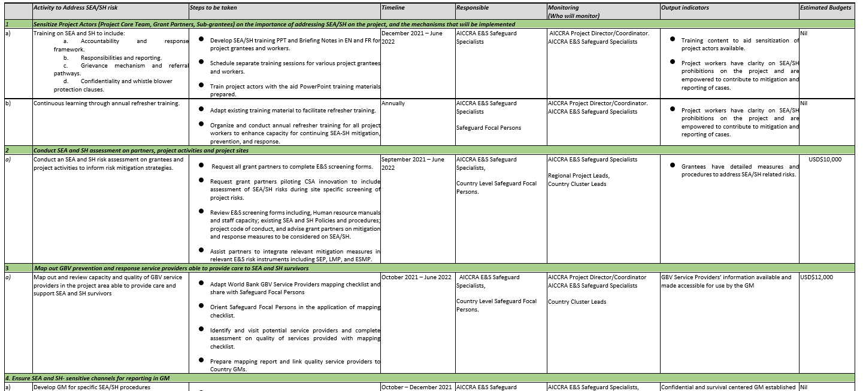
3. Key Proportional SEA/SH Mitigation Measures
b. SEA/SH Action Plan
SEA/SH Action plan AICCRA, P173398
In Annex to the HD GPN
Notes:
ACCELERATING IMPACTS OF CGIAR CLIMATE RESEARCH FOR AFRICA (AICCRA) (P173398)
Moderate SEA/SH risk, regional project
The project, Accelerating Impacts of CGIAR Climate Research for Africa (AICCRA), is a World Bank supported project that seeks to strengthen the technical, institutional, and human capacity needed to enhance transfer of climate-relevant information, decision-making tools, and technologies in support of scaling efforts in International Development Association (IDA) eligible countries in Africa.
Tips for the trainer:
Guide participants to create robust SEA/SH Action Plan using a structured template.
Highlight the essentials: risk assessment, actionable steps, responsibilities, budgets, timelines, and monitoring indicators.
Emphasize customization for projects with varied components. This method strengthens risk management, ensuring safer and more impactful project results.

Slide 29


3. Key Proportional SEA/SH Mitigation Measures
c. Codes of Conduct & Accountability and Response Framework
Codes of conduct and behavioral standards
  Both are methods to implement SEA/SH prohibitions as condition of employment
  Provide a basis for the Borrower or its contractors to take mandatory administrative action against project actors engaged in SEA/SH.
  To be supplemented by sensitization and training
Behavioral Standards:
  Principles and minimum standards of behavior required for the employment of project actors, including civil servants.
  Behavioral Standards may be grounded in legislation, regulations, or rules of the jurisdiction or in existing employment contracts.
Codes of Conduct:
  Document for project actors in Bank-financed projects; outlines core principles and behavior standards.
  Typically used for different categories of project workers (ESS2)
Notes:
Objectives / Key points:
Introduce the significance of codes of conduct and behavioral standards in addressing Sexual Exploitation, Abuse, and Sexual Harassment (SEA/SH).
Both methods provide a basis for the Borrower or its contractors to mandatorily implement disciplinary, HR measures against a project actor who perpetrates SEA/SH (different and distinct, and with different standard of conduct, from criminal action, which remains a viable option to survivors in some cases where acts of SEA/SH may amount to crimes).
Tips for the trainer:
Emphasize the importance of codes of conduct and behavioral standards against SEA/SH.
Highlight their role in safeguarding integrity and promoting accountability.

Slide 30
3. Key Proportional SEA/SH Mitigation Measures
c. Codes of Conduct & Accountability and Response Framework
Codes of conduct and behavioral standards - HD
  Low or moderate SEA/SH risk rating projects
  Existing behavioral standards with general prohibitions may offer sufficient accountability in case of an incident.
  In the absence of Behavioral Standards or their inability to be strengthened, project actors must adhere to a project-specific CoC.
  Substantial or high SEA/SH risk rating projects
  Recommended behavioral standards or explicit SEA/SH prohibitions in CoC:
  When Behavioral Standards lack explicit SEA/SH prohibitions, TT should initiate early dialogue with Borrowers to decide on introducing SEA/SH prohibitions into existing Standards or opting for project-specific CoC.
Borrowers will implement explicit SEA/SH prohibitions in binding contracts before project actors begin activities related to the project.
Notes:
Objectives / Key points:
This slide delineates the approach to handling standards of conducted related to SEA/SH in HD projects and the different recommendations depending on varying risk ratings.
It underscores the need for proportional behavioral standards or a code of conduct (CoC), recognizing the need to focus on strengthening, wherever possible, national frameworks for civil servants, as a more sustainable solutions.
In the absence of a sufficient national framework, or if it’s impossible to strengthen it, project specific CoC should be established.
Tips for the trainer:
Encourage participants on developing CoCs and behavioral standards proportional to risk ratings. Before project activities begin.

Slide 31

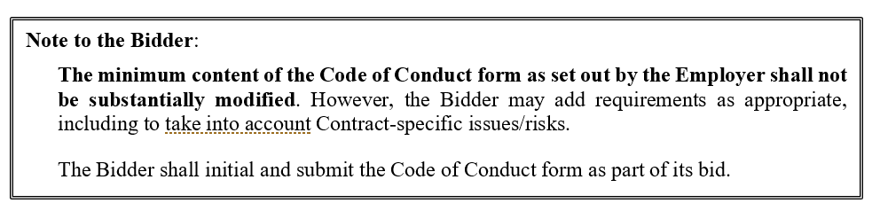
3. Key Proportional SEA/SH Mitigation Measures
c. Codes of Conduct & Accountability and Response Framework
Codes of conduct and behavioral standards – Civil works
  For all risk levels, all project workers should sign Codes of Conduct, where existing codes do not explicitly address risks of SEA/SH.
  Codes of conduct need to:
  Explicitly prohibit SEA/SH and all sexual engagements with children under the age of 18, regardless of age of consent
  Be linked to accountability framework, procedures and sanctions in case of non-compliance
  Need to be socialized among workers
Notes:
Objectives / Key points:
Emphasize that these codes of conduct not only establish clear behavioral expectations but are vital tools for preventing SEA/SH and for enabling action, and potentially sanctions, when non-compliance occurs.

Slide 32
3. Key Proportional SEA/SH Mitigation Measures
c. Codes of Conduct & Accountability and Response Framework
SEA/SH in procurement for works
Clearly define the SEA and SH requirements and expectation in bidding documents (already in ICB; to be integrated in NCB)
Contractor’s SEA/SH proposal assessed as part of bid evaluation – leveraging new rated criteria for SPD
Include provisions on how SEA/SH related costs will be paid for
ESHS Reporting Requirements include (i) immediate notifications of serious incidents (including SEA/SH) and (ii) progress reports metrics
Remedies for failure: include removal of personnel for breach of code of conduct, withholding of payments, forfeiture of performance security
High risk projects need to comply to latest updated guidance on contractor accountability and disqualification
Notes:
Objectives / Key points:
To the extent possible, let's recommend that for in-country training these slides get presented by in-country procurement specialists.

Slide 33
3. Key Proportional SEA/SH Mitigation Measures
c. Codes of Conduct & Accountability and Response Framework
Accountability and Response Framework
What is an Accountability and Response Framework?
Steps for handling allegations
Referral to assistance and information-sharing protocols, including for minors
Procedures for complaint review including administrative inquiry
Disciplinary measures in accordance with CoC
Confidentiality and mandatory reporting
Key takeaways:
Ensure adherence to survivor-centered approach
Build into existing organizational structures and regulatory frameworks
Work with client to map out specific procedures
Assign clear roles and responsibilities
Identify and train relevant GM actors
Adequate budget for training and investigation
Tested and revised through incident response
Reflected in OPS manual
See Annex 8 of HD GPN
Notes:
Objectives / Key points:
An Accountability and Response Framework documents, in a single place, how allegations of SEA/SH will be handled, along with the disciplinary action for violations by project actors. It should include, at a minimum:
Steps for handling and reviewing allegations, including timeframe, and responsibilities for each stage of the process.
Procedures for review of complaints or incident reports, including information on the investigation and verification process.
Confidentiality requirements for dealing with cases (e.g., consent and information sharing protocols).
Internal reporting of allegations, for case accountability. This should include the GM process for capturing disclosure of SEA/SH.
Protocols for responding to survivors, using the survivor-centered approach (see Box 7), and including a pathway to refer survivors to appropriate support services where they exist (see paragraph 70).
Specific protocols to address allegations involving children, incorporating consideration of the best interests of the child, specialist support services, and the role of parents/guardians in the response process (see Box 3 above).
Mandatory reporting requirements, if applicable under national law, including the need to inform survivors (ideally prior to disclosure) of this obligation and any limits on confidentiality.
Disciplinary measures against project actors who commit SEA/SH, including the range of possible disciplinary measures for violation of any CoC or Behavioral Standards (see paragraph 65).
Protocols for protection of whistleblowers and prohibition on retaliation against both complainants and whistleblowers, consistent with the World Bank’s Commitments on Reprisals.
(FROM SEA/SH HD GPN, para. 55)

Slide 34
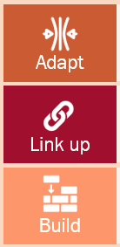
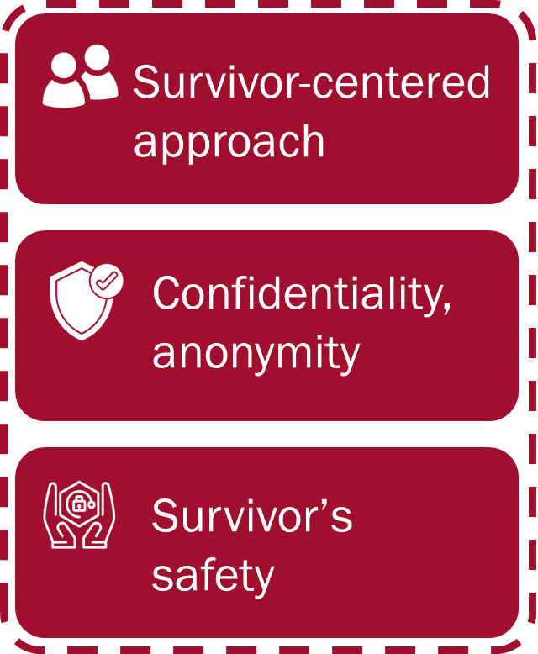
3. Key Proportional SEA/SH Mitigation Measures
d. Grievance Mechanism & Awareness Raising
Grievance Mechanism for SEA/SH Incidents
All projects need to have proportional pathways to ethically receive and handle SEA/SH complaints.
The handling of SEA/SH complaints requires a different approach than other types of complaints raised through project-level grievance mechanisms.
This is due to the sensitive nature of the issue; the likelihood of a survivor suffering stigmatization, rejection, or harm; and the overall evidence suggesting that most survivors do not file complaints.
Teams select a model proportionally to risks and based on existing expertise and resources
See Technical Note on SEA/SH GM
Learn more here
Notes:
Objectives / Key points:
Introduce the importance of establishing a grievance mechanism specifically designed to address SEA/SH.
Discuss the key elements of an effective SEA/SH grievance mechanism, including accessibility, confidentiality, impartiality, and survivor-centeredness.

Slide 35





3. Key Proportional SEA/SH Mitigation Measures
d. Grievance Mechanism & Awareness Raising
Survivor-centered GM value chain
Learn more here
UPTAKE
SORTING AND PROCESSING
ACKNOWLEDGEMENT AND FOLLOW UP
VERIFICATION, INVESTIGATION AND ACTION
MONITORING AND EVALUATION
FEEDBACK
Are there multiple channels where grievances can be submitted ensuring that no group is excluded? Does the project have tools and protocols (i.e., coding) to safely document and store incident information?
Are there processes and tools to keep the identity of the survivor (and others) protected at all times? Are cases safely and confidentially logged and secured?
How will survivors be reached and contacted to safely be updated on progress or updates? How is consent continually gathered throughout the process?
How are decisions made with the survivor’s rights, wishes, and choices respected? How’s survivor’s safety assessed and protected?
How and when is follow up done with the service provider?
How is the survivor provided with feedback and results on a resolution? What additional safety measures are put in place to prevent further harm or retribution?
Consult with women and girls to confirm
Notes:
Objectives / Key points: What questions shall projects try address, when designing GM’s that are SEA/SH sensitive and put women’s and girls’ rights and experiences at the forefront of all actions?
Review some of the key questions that GM SOPs should be addressed at each step of the GM value chain, while flagging this slide as resource for later use (do not try to go through all the questions):
Uptake - Are there multiple channels where grievances can be submitted? Have women and girls and other groups at risk been consulted to identify safe, trusted, and accessible ways to report SEA/SH? Can survivors be referred to at least one quality service provider that has already been identified or contracted? Does the project have tools and protocols (i.e., coding) to safely document and store incident information? Has the operator received training on how to react to SEA/SH complaints, including referrals? How can mandatory reporting requirements be communicated (if relevant) so survivors can make informed decisions?
Sorting and Processing –Are there processes and tools to keep the identity of the survivor (and others) protected at all times? Are cases safely and confidentially logged and secured? Are there clear procedures to ensure that SEA/SH incidents are immediately escalated to a level where they can be safely addressed? What are mandatory reporting requirements (if relevant)?
Acknowledgement and Follow Up – How will survivors be reached and contacted to safely be updated on progress or updates? How is consent continually gathered throughout the process? What to do in case of third-party complaints?
Verification, Investigation and Action –How are decisions made with the survivor’s rights, wishes, and choices respected? How is the survivor’s safety assessed and protected? How is the privacy of all parties ensured and kept within the GBV Committee? How will coordination with the employer work? How will the required expertise for SEA/SH administrative inquiry mobilized? How will actions taken upon investigation monitored and documented by the GM? What training is needed?
Monitoring and Evaluation –How and when is follow up done with the service provider? When is a case considered closed?
Feedback –How is the survivor provided with feedback and results on a resolution? What additional safety measures are put in place to prevent further harm or retribution? Are there ways to safely receive feedback, identify trends, or fix issues in the system over time.
Tips for the trainer:
Remember participants to strategically design SEA/SH-sensitive GM procedures and consult when women and girls when in doubt on how to make something accessible, or trusted.

Slide 36

3. Key Proportional SEA/SH Mitigation Measures
d. Grievance Mechanism & Awareness Raising
Awareness raising strategy
For staff and local communities:
SEA/SH risks (messages tailored based in risks identified by target population)
Staff responsibilities, expected and prohibited behaviors
How to report breaches of CoC to the GM and what happens next
GBV services available and how to access them
Notes:
Objectives / Key points:
Once the GRM is established, the CoCs are signed, and GBV services are available for referral, the awareness raising strategy should ensure that project staff and the local communities are aware of what behaviors are not acceptable, and the consequences of inappropriate behavior.​ They should be informed how to file complaints both if they are survivors of prohibited behaviors or if witness such violations.
In addition, awareness raising strategies should include information on GBV services available and on mandatory reporting regulations that may apply to the GM/project, as relevant.
Borrowers should plan to incorporate sensitization and or training on SEA/SH as appropriate for different parties, including project actors, project-affected people and others involved in service delivery.
Sensitization is not a one-time requirement; rather, it is a continuing process throughout project implementation that is informed by the project activities, contextand feedbacks recieved.
Sensitization methods may include communications such as posters, flyers, emails, meetings and communications campaigns.
All sensitization and training efforts should include information about prohibited behavior, detils on how to report allegations of SEA/SH, and how to access GBV service providers.
Sensitization and training should adopt a right-based approach, not be victim blaming or re-traumatizing. Should be carried out by actors with sufficient expertise and at a frequency that is proportional to the risk level.
Tips for the trainer:
Facilitate effective awareness by informing project staff and local communities about unacceptable behaviors, consequences, filing complaints, accessing GBV services, and reporting channels.

Slide 37
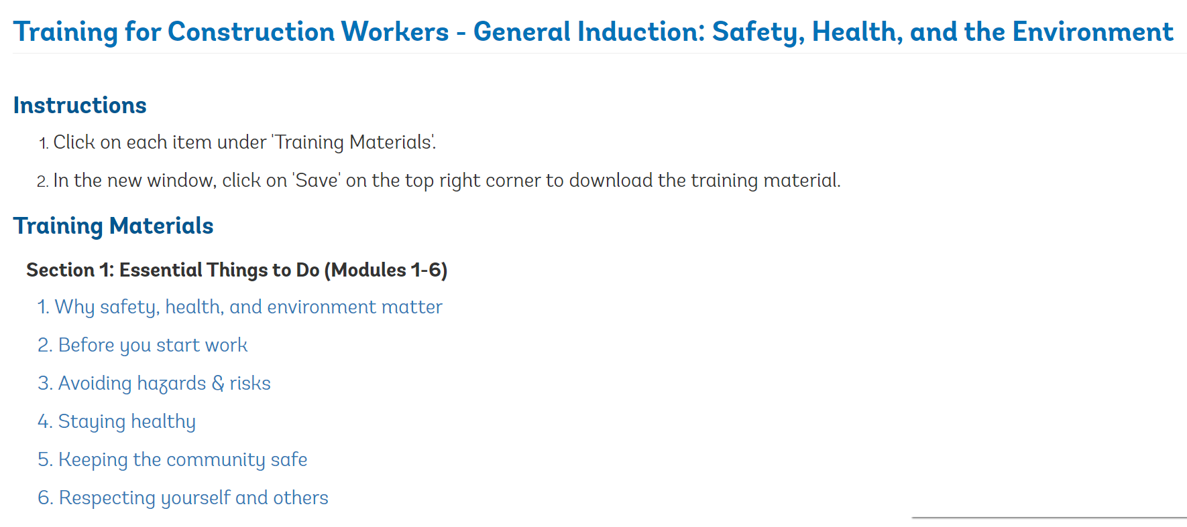
3. Key Proportional SEA/SH Mitigation Measures
d. Grievance Mechanism & Awareness Raising
Awareness raising and training examples
WB developed Inception Training for Construction Workers, available here
Uganda Transport Sector Development Project (P092837)
Notes:
Notes:
Adapt note as possible using relevant regional examples:

Slide 38

3. Key Proportional SEA/SH Mitigation Measures
e. Mapping and Working with GBV Service Providers
Mapping and working with GBV service providers
Identifying GBV Service Providers:
All projects should identify GBV service providers in all areas of project implementation to refer survivors who disclose GBV and SEA/SH incidents to the project
Efforts to identify or map GBV service providers should be proportionate, and include questions on quality, including for children
To take place prior to project activities commencing, relying on what already exists in the country
Portfolio solutions (with duty bearer ministries) may be efficient
Gap-filling GBV Services
If no quality GBV service providers are available, HD and high-risk Civil works projects should take actions to support SEA/SH survivors, ensuring adequate resources. Actions should be adapted to the project’s risk level, social and security context, and activities, and should be adequately resourced.
Notes:
Objectives / Key points:
Highlight the importance of mapping available services to support survivors and ensuring a coordinated response.
Discuss specific examples showcased in the slides, such as regional georeferenced databases, country-specific mappings, and global initiatives, to demonstrate the various approaches and efforts in mapping GBV services.
Encourage participants to reflect on the significance of these mapping exercises and consider how they can be applied or adapted in their own contexts.
Mapping available services are essential to enable projects to support survivors that disclose incidents in a safe and timely manner by referring them to local, quality service providers and providing them accurate information on how to access them, what to expect, etc.
The Borrower is responsible for identifying a quality GBV service provider or mapping services available in all areas of project implementation to develop a localized referral protocol prior to commencing project activities and any mobilization on SEA/SH and the GM.
The Bank can provide technical assistance to help the Borrower. In some cases, the PIU may have internal capacity to screen and identify a GBV service provide. In other cases, the PIU may need to hire an external consultant, NGO, or firm with expertise on collecting data on GBV services as part of project preparation. In such cases, the PIU prepares the TOR for service provider identification or mapping as part of the social assessment. The Bank task team may review the TOR and provide support to the PIU in reviewing the scope and findings of the identification or mapping exercise. Mapping should always start by identifying and analyzing what already exists in country.

Slide 39
3. Key Proportional SEA/SH Mitigation Measures
e. Mapping and Working with GBV Service Providers
Mapping and working with GBV service providers
HD projects:
  Low or moderate SEA/SH risk: PIU to identify a quality GBV service provider that is accessible to complainants in all project implementation areas
  Substantial or high SEA/SH risk: PIU to identify more than one GBV service provider or to conduct a more in-depth mapping
Civil works projects:
  All projects to identify at least psychosocial, medical and legal aid service providers in areas of implementation
Check out the last clinic on GBV service mapping, accessible here
Hiring GBV service providers for TA
GBV service providers should be considered critical partners to support the implementation of key mitigation actions, including consultations, training, community awareness-raising, and GMs.
Notes:
Objectives / Key points:
Highlight the importance of mapping available services to support survivors and ensuring a coordinated response.
Discuss specific examples showcased in the slides, such as regional georeferenced databases, country-specific mappings, and global initiatives, to demonstrate the various approaches and efforts in mapping GBV services.
Encourage participants to reflect on the significance of these mapping exercises and consider how they can be applied or adapted in their own contexts.
Mapping available services are essential to enable projects to support survivors that disclose incidents in a safe and timely manner by referring them to local, quality service providers and providing them accurate information on how to access them, what to expect, etc.
The Borrower is responsible for identifying a quality GBV service provider or mapping services available in all areas of project implementation to develop a localized referral protocol prior to commencing project activities and any mobilization on SEA/SH and the GM.
The Bank can provide technical assistance to help the Borrower. In some cases, the PIU may have internal capacity to screen and identify a GBV service provide. In other cases, the PIU may need to hire an external consultant, NGO, or firm with expertise on collecting data on GBV services as part of project preparation. In such cases, the PIU prepares the TOR for service provider identification or mapping as part of the social assessment. The Bank task team may review the TOR and provide support to the PIU in reviewing the scope and findings of the identification or mapping exercise. Mapping should always start by identifying and analyzing what already exists in country.

Slide 40
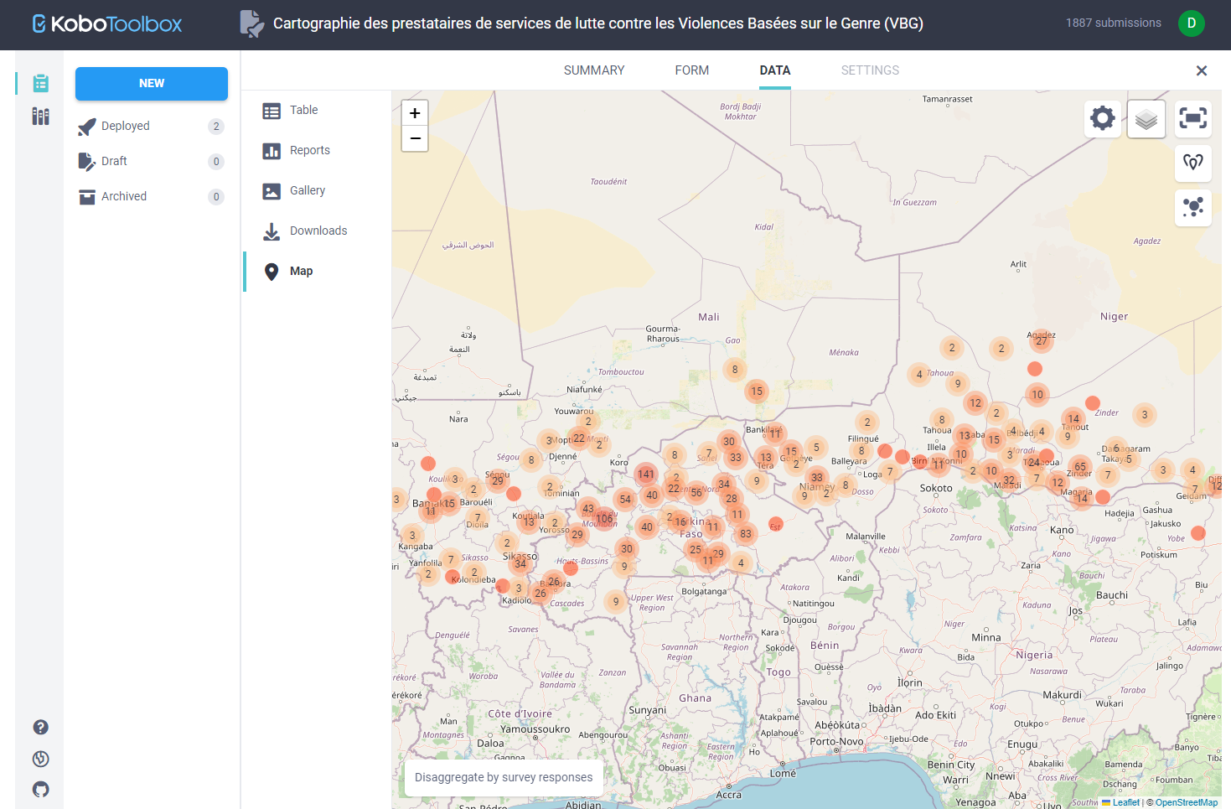
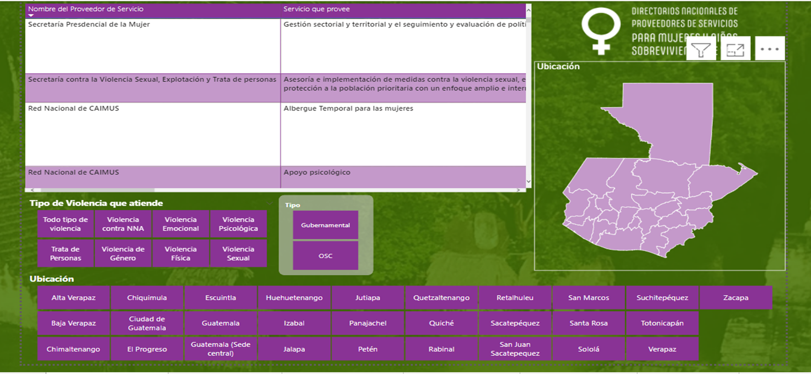
3. Key Proportional SEA/SH Mitigation Measures
e. Mapping and Working with GBV Service Providers
Mapping GBV service providers – Different solutions
Example of project-led coordinated GBV service mappings – AFW (Mali CMU, Nigeria, and others) use of Kobo Toolbox
Examples of WB-led country level GBV service mappings – LAC and SAR
Notes:
Objectives / Key points:
Discuss specific regional examples (adapting the slides as needed), such as regional georeferenced databases, country-specific mappings, and global initiatives, to demonstrate the various approaches and efforts in mapping GBV services.
Discuss portfolio opportunities to carry out the mapping in a more sustainable manner, contributing to strengthening country systems, and preventing redundancies and duplications. Clarify that, in the absence of these solutions, the responsibility to map services remains at the project level.
Explain that mapping can happen at the country level, and at the project level. Ultimately, mapping at the project level is needed to enable localized referrals of survivors that report GBV and SEA/SH cases.

Slide 41
3. Key Proportional SEA/SH Mitigation Measures
f. Monitoring Mechanisms
Who Monitors SEA/SH commitments
SEA/SH monitoring plan integrated into the project E&S monitoring and reporting
Supervising engineer in charge of monitoring and reporting on SEA/SH compliance by contractors – need of right expertise and tasks assigned in its team
PIU social/GBV specialists reports on implementation of SEA/SH actions as part of E&S reporting, including on ESCP commitments
In high-risk projects with civil works Third Party Monitoring independently monitors and reports on compliance and effectiveness of the SEA/SH action plan implementation
    The role is not to track, investigate, or follow up on individual cases
    Reports to the IA
    Required to have experience with monitoring of GBV or SEA/SH activities
    Can provide early warnings of problems that may surface
TT monitors and documents progress in the ISR
Reporting and indicators needed in the action plan and reflected in TOR/contracts, along with provisions for the review of risks and of the mitigation measures
Notes:
Objectives / Key points:
Introduce the slide as a discussion on the importance of ongoing consultations in addressing SEA/SH within projects as well as monitoring of SEA/SH mitigation measures and the entities responsible for monitoring SEA/SH commitments.

Slide 42

3. Key Proportional SEA/SH Mitigation Measures
f. Monitoring Mechanisms
Ongoing Consultations
Consultations on SEA/SH should continue throughout the entire project cycle in safe and enabling spaces, relying on culturally appropriate and qualified same sex facilitators, etc. as part of the Stakeholder Engagement.
They should target women and girls, and groups particularly at risks, and organizations advocating for their rights, and be carried out by the right expertise.
These consultations should facilitate periodic reviews of the project's action plan and risk levels, ensuring that responses to SEA and SH remain relevant and effective throughout the project's lifecycle.
Notes:
Objectives / Key points:
Introduce the slide as a discussion on the importance of ongoing consultations in addressing SEA/SH within projects as well as monitoring of SEA/SH mitigation measures and the entities responsible for monitoring SEA/SH commitments.

Slide 43
Questions
& Answers
Notes:
Notes:
Involve the audience by asking if they have any questions or if they want to share something related to the content

Slide 44
4
Resources available

Slide 45









Available Resources
TEMPLATES
Available templates of SEA/SH Action Plans, TOR for PIU specialist, GBV service providers, workers inception training, etc.
WORLD BANK ESF GOOD PRACTICE NOTES ON SEA/SH
AFW: Aida Diop Keenan and Pamela Tuiyott Chebiwott
AFE: Elizabeth Graybill and Michael Mahrt
SAR: Erisha Singh Suwal
MENA: Niyati Shah
EAP: Sama Khan
LCR: Diana Jimena Arango
ECA: Ferdous Jahan
GLOBAL: Manuel Contreras Urbina (Gender) and Daniela Greco (OPCS)
Addressing SEA/SH in Human Development Operations, 2022
Addressing SEA/SH in IPF involving Major Civil Work, 2022
NON-DISCRIMINATION AND DISABILITY
REGIONAL GBV FOCAL POINTS
Available in English Arabic French Chinese Portuguese Russian Spanish
SEA/SH SCREENING TOOLS
Available here
TECHNICAL NOTE ON SEA/SH SENSITIVE GM
Available here
REVISED ESIRT TOOLKIT
Available here
RELEVANT TRAININGS
Training on ESIRT and SEA/SH incident response, HD GPN for TTLs, and HD GPN for SDSs
OTHER RELEVANT RESOURCES
GBV Experts roster and VAWG Resource Guide & Sector Briefs
Notes:
Notes:
Review these available resources with the participants and invite them to explore them.
Invite the participants to reach out to their Regional GBV FPs for samples of ToRs for investigations and further guidance.

Slide 46
Thank You!

