Slide 1

BRIDGING EVIDENCE AND PRACTICE IN ADOLESCENT HEALTH
AdLAB-GYP Webinar Series: Part I
April 3, 2025

Slide 2
Webinar agenda
Welcome and getting connected
Introduction to the learning series
Introduction to AdLAB & implementation research
Experience from the Cambodia Youth Leadership Program
Small group discussion
Plenary & what’s next

Slide 3

Getting to know each other

Slide 4
Introduction to the webinar series
Webinar Objectives
  Introduce AdLAB and implementation research concepts to GYP members, Young Leaders, Youth Researchers and Global Health Advocates.
  Learn about adolescent health policy, frameworks, & research tools.
  Demonstrate youth-led research translating to adolescent health policy change.
Three-session series
  1. Introduction to AdLAB & implementation research
  2. Connecting research and policy
  3. Translating research insights into actions

Slide 5







The AdLAB – GYP team: adlab@worldbank.org
Arafat Kabugo
Co-Chair GFF GYP
Programs Manager,
Naguru Youth Health Network (NYHN)
Christina Chilimba
Co-Chair GFF GYP
Founder, Youth for All
Emmanuel Adebayo
Adolescent Health and IR Specialist,
DECRG/GFF
Wei Chang
Health Economist,
GFF
Pascal Hildebert
Learning Manager,
GFF
Aimee-Fidele Mukundu Community manager and Communities of Practice expert, GFF
Kirsten Zindel
CSO and Youth Engagement, GFF

Slide 6
Introduction to AdLAB
Adolescent Learning, Action, and Benchmarking (AdLAB): An initiative for learning and action focused on adolescent health and wellbeing
Objectives
Strengthen the evidence and learning on what works and how
Facilitate use of evidence and learning, particularly delivering at scale
Redefine how we measure and learn about adolescent health and wellbeing in a more comprehensive, holistic way

Slide 7
AdLAB Key Functions
Priority setting
Identifying country driven evidence needs and implementation science priorities
Evidence generation
Conducting implementation research
Evidence dissemination, translation, and use
Supporting the sharing, understanding, and use of evidence in policies and programs

Slide 8
Priority Setting
GFF country engagement and WB projects
Country platform
AdLAB Steering Committee and other global and regional initiatives
Clear opportunity to engage youth meaningfully in process
There is a functional multi-stakeholder platform with representation from youth and adolescents
Youth and adolescent groups are well organized or there is momentum to build/strengthen organization
Youth and adolescent groups have a base level of capacity/experience to be engaged in research projects or strong interest in developing this capacity
There is an appetite to engage youth and adolescents in country-led research
Clear opportunity to influence programming or policies
Strong govt commitment to adolescent health
Existing or upcoming WB or partner projects
Notes:
Grounded in GFF country engagement model, ADLAB is prioritizing more of a bottom up approach for identifying IR opportunities, countries, etc
Country platform
A country platform (support by GFF focal point and liaison officer) may conduct an adolescent health and wellbeing consultation meeting/workshop to discuss and prioritize evidence needs related to adolescent health and wellbeing
Prioritize this approach in countries with strong youth engagement in CP
Through GFF country engagement and WB projects
Capture and respond to IR questions that arise during implementation of projects with adolescent health components
Validate these priorities/opportunities through country platform (including youth input)
Global Steering Committee and global/regional initiatives
Bring knowledge and perspectives from global initiatives, as well as individually as recognized experts, to inform priority setting
Validate these priorities/opportunities through country platform (including youth input)
Make linkages with existing Botnar projects, investments in youth groups (health cities, technologies, ), can we leverage/build on this

Slide 9
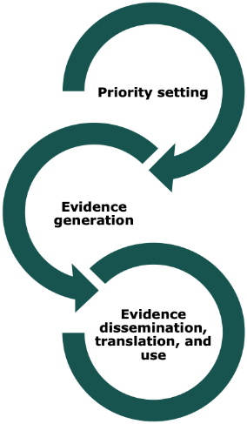
Youth Engagement in AdLAB
The ADLAB youth engagement strategy leverages the broader GFF youth engagement strategy and is anchored through country platforms and the GFF governance bodies, including working with the GFF Global Youth Platform
Youth engagement in priority setting can occur through:
Project Advisory Committee
Leveraging existing youth representation in Country Platforms
Consultations with youth and youth-serving organizations (explicit, intentional, and meaningful, incl marginalized / hard to reach groups and minors)
Youth engagement in evidence generation will include:
Identifying ways to include youth and adolescents in study design and data collection
Contributing to developing and validating methods that collect data directly from adolescents on experience of care and wellbeing
Providing technical and financial support to youth/adolescent-led participatory research
Consulting youth and youth-serving organizations for interpretation and validation of findings
Youth engagement in evidence dissemination, translation, and use will:
Leverage existing youth networks In-country networks and the GFF Global Youth Platform
Centralize role of youth advocates in dissemination and evidence translation plans Build skills in data interpretation and using data for advocacy

Slide 10



Introduction to Implementation Research (IR)
WHAT IS IR?
WHAT QUESTIONS CAN IR ANSWER?
HOW DOES AdLAB CONDUCT IR?

Slide 11
What is IR? Most cited definition
IR is “the scientific inquiry into questions concerning implementation – the act of carrying an intention into effect, which in health research can be policies, programs, or individual practices (collectively called interventions).”
The goal of IR is to understand what, why, and how interventions work in “real world” settings and to test approaches to improve them.
CORE ELEMENTS OF IR
Study and use of scientific methods
Uptake and integration of evidence-based practices, interventions, and policies
Into health care, public health, community settings
Peters, D. H., Adam, T., Alonge, O., Agyepong, I. A., & Tran, N. (2013). Implementation research: What it is and how to do it. BMJ, 347, f6753. https://doi.org/10.1136/bmj.f6753

Slide 12
What is IR? Another way to understand it
When defining implementation science, some “very non-scientific language” can be helpful…
The intervention/practice/innovation is THE THING
Effectiveness research looks at whether THE THING works
Implementation research looks at how best to help people/places DO THE THING
Implementation strategies are the stuff we do to try to help people/places DO THE THING
Main implementation outcomes are HOW MUCH and HOW WELL they DO THE THING
Curran, G. M. (2020). Implementation science made too simple: A teaching tool. Implementation Science Communications, 1(1), 27. https://doi.org/10.1186/s43058-020-00001-z

Slide 13
What is IR? An example
THE THING: a community-based program promoting healthy eating habits among adolescents
Effectiveness research: does the program improve nutrition & dietary habits in adolescents?
Implementation research (IR): how to support communities to better implement this program?
Implementation strategies: (examples)
    Training community healthcare workers to promote the program
    Recruit adolescents through social media
    Distribute program information in schools
Implementation outcomes: (examples)
    Acceptability of the program among adolescents and their families
    Consistency and quality of program delivery
    Long-term sustainability of program

Slide 14
What questions can IR answer?
IR can be used to Explore, Describe, Influence, Explain, & Predict
  Understand context
  What are the factors and agents that may influence the introduction of an HPV vaccination?
  Assessing performance
  How can a life skills training program routinely collect and incorporate feedback from adolescents to ensure the program addresses the evolving and diverse needs of adolescent girls?
  Informing adaptation & scale-up
  How can a digital tool designed to improve maternal health outcomes be adapted to the needs of adolescent mothers while being scaled across different regions?
  Facilitating systems strengthening
  What strategies can be implemented to enhance the integration of nutrition and health services for adolescents in primary healthcare settings?

Slide 15
How to conduct IR?
Questions
Frameworks
Designs
Methods
IR questions are based on implementation constraints and focus on implementation strategies, processes, contexts, outcomes.
  Why is an intervention/approach not working?
      Is it not being implemented as designed or planned? Is it being implemented with poor quality? (fidelity)
      Is it being implemented well but people don’t like it? (acceptability)
      Is it the right approach for the setting and target population? (appropriateness)
  What implementation strategy to use?
      How do we most effectively recruit health providers to certain regions?

Slide 16
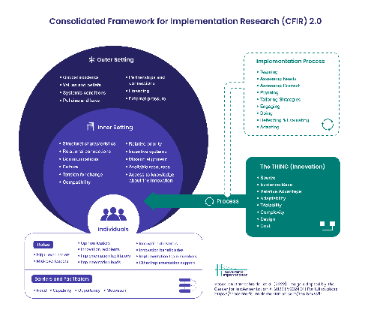
How to conduct IR?
There are many frameworks in IR:
Consolidated Framework for Implementation Research (CFIR)
Exploration, Preparation, Implementation, Sustainment (EPIS)
Reach, Effectiveness, Adoption, Implementation, and Maintenance (RE-AIM)
…
Questions
Frameworks
Designs
Methods
Notes:
General information on IR frameworks : Theories, Models, & Frameworks | Implementation Science at UW (impsciuw.org)
CFIR: The Consolidated Framework for Implementation Research – Technical Assistance for users of the CFIR framework (cfirguide.org)
EPIS: EPIS Framework
RE-AIM and PRISM: RE-AIM – Home – Reach Effectiveness Adoption Implementation Maintenance

Slide 17
How to conduct IR?
Questions
Frameworks
Designs
Methods
  Research design and methods selected based on IR questions.
  Both quantitative and qualitative methods are often employed, with mixed methods being common.
  Descriptive or observational methods are useful for exploring processes, contexts, barriers, and facilitators.
  Experimental or quasi-experimental designs are used for testing implementation strategies and examining effectiveness outcomes together.

Slide 18
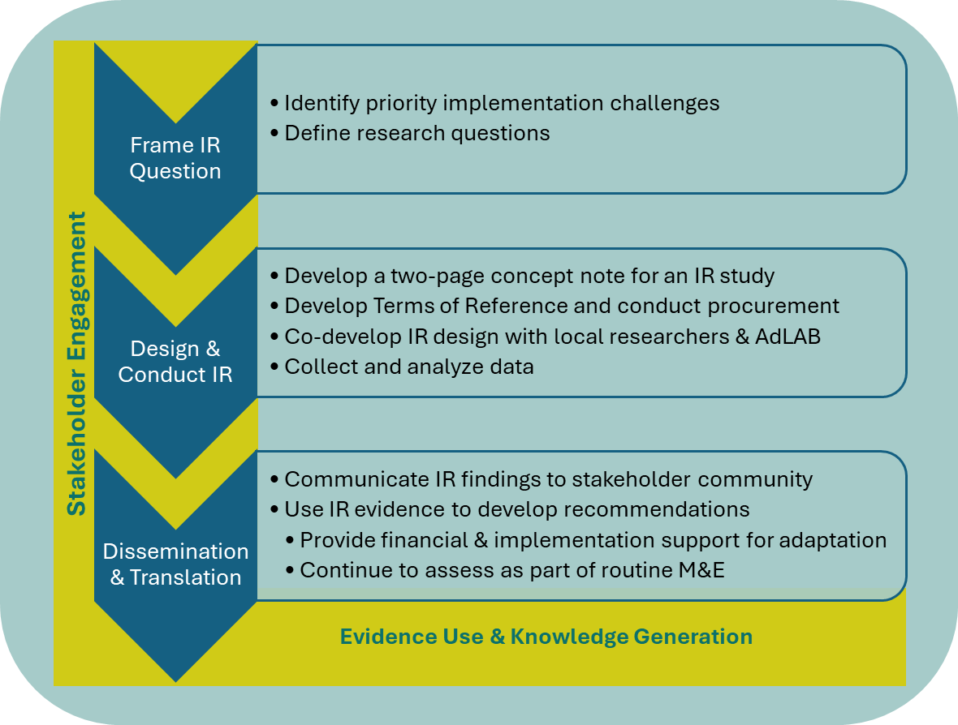
How do we do IR at AdLAB with World Bank projects?

Slide 19
IR and adolescent health
How is IR relevant to adolescent health?
What are the roles of young people in IR?

Slide 20
How is IR relevant to adolescent health?
Explain key contributions of IR to adolescent health…
Identifying and understanding contextual factors
Enables deep diving and better understanding the gaps while testing new models and getting feedback from stakeholders.
Informs evidence-based programming and resource allocation
Improving the quality of adolescent health service delivery by making sure adolescents bring valuable data to the table

Slide 21
How is IR relevant to adolescent health?
Examples
Policy
Development of the GAMA indicators, a set of evidence-based indicators for measurement of adolescent health globally (i. Collection and synthesis ii. Review and piloting in 12 countries and iii. Final approval, launch and implementation)
Program
Youth Friendly Services in Uganda. First piloted in 10 districts with support from Red Cross and UNFPA leading to adoption. YFS will be implemented (as directed by MoH in the Adolescent Health Strategy) in all Regional Referral Hospitals
Malagasy youth involvement in the Adolescent strategy development. The perspective of IR by youth and adolescent strengthened their position in taking part to the discussion for the realization of this plan.

Slide 22
What are the roles of young people in IR?
Providing feedback on research findings or interventions.
Engaging in data collection, analysis, and dissemination to strengthen research processes.
Using evidence to engage and influence decision-makers for better policy and practice.
Monitoring implementation and scaling up of evidence-based interventions.
(and more…)

Slide 23

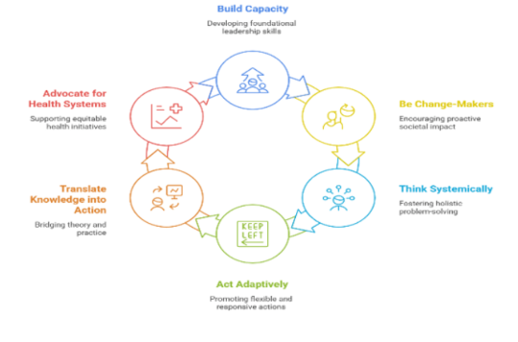
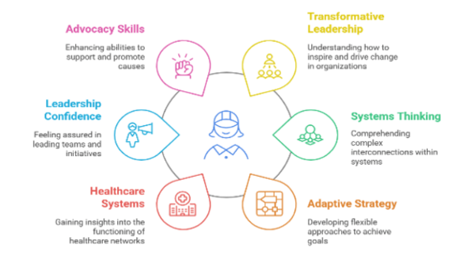
Building Capacity for Meaningful Engagement:
Young Leaders Program Cambodia

Slide 24
Building Capacity for Meaningful Engagement: Young Leaders Program Cambodia

Slide 25
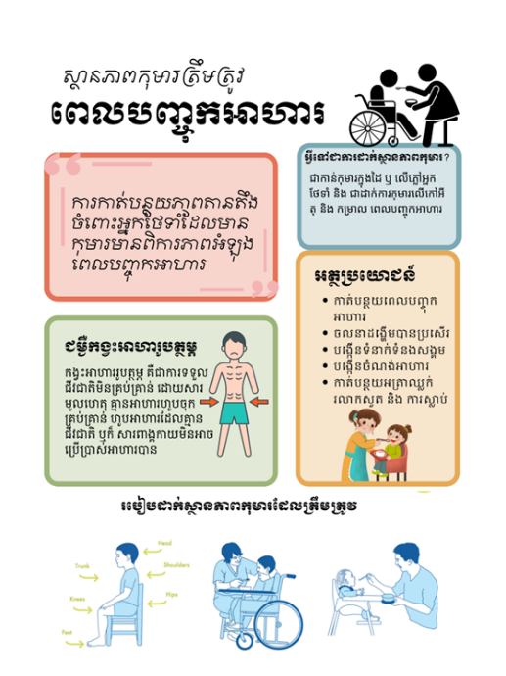
Guideline to Appropriate Feeding Position
Observation
Consultation
Trial
Learning
Adapting/Improving

Slide 26

Continuous quality improvement (CQI) project - Cambodia
Trans Healthcare in Cambodia
Pi Say (he/him)

Slide 27
Content
Self-introduction
CQI and project
Lessons learnt

Slide 28

About Pi
Advocacy and Research
CSO and the government
Pi Say (he/him)

Slide 29


CQI on hormone use
Existing research:
  Feasibility Study for Transgender Project in 2018 (Rainbow Community Kampuchea),
  Transgender size estimation in seven cities in Cambodia in 2013 (Ngak, Penfold, Lui, Chhim, & Kongelf, 2013),
  UPR 3rd Circle (Rainbow Community Kampuchea)
Project aims to explore the practical and safe use of hormone
  On-going consultation
  Lessons learned from friends in the regions
  Empower the community to take in the process
Plan
Do
Act
Check
Notes:
Why trans healthcare important: even cis-gender also need some hormone therapy or gender-affirming care. This is NOT a special treatment. It’s not unique or exclusive treatments; they are vital components of comprehensive medical care that can benefit individuals across the gender spectrum.
Lack of promotion on available information and services, high costs, lack of trained health professionals
No insurance scheme cover
Limited options of hormone type/medicine: pill, injection or patches + Online sale of hormone products, and Peer advice or experience sharing on social media on how to use hormone.
But why we need to do this project? We aim to explore what works in Cambodia that allow people to have access and use hormone safely.

Slide 30



Final thoughts on cqi
Collaboration amongst stakeholders & community
Increase in community engagement
Innovation and new approaches to complex issues
Notes:
Lack of promotion on available information
Lack of available services and high costs
Lack of trained health professionals
No insurance scheme cover
Limited options of hormone type/medicine: pill, injection or patches
Online sale of hormone products
Peer advice or experience sharing on social media on how to use hormone

Slide 31
Small Group Discussion
Process
Can you introduce yourself?
How does the Cambodian experience resonate with you and why? How does it relate to your work and what you are most proud of?
What are your expectations for this webinar series?
Prepare to share your expectation in the chat!

Slide 32
Plenary & what’s next
Share your expectations for the webinar series in the chat!

Slide 33
What’s next?
Upcoming webinars:
Part II: Connecting research and policy
Part III: Translating research insights into actions
Interested in presenting your work? Reach out to adlab@worldbank.org!

Slide 34

Summary of Key Concepts
Understanding adolescent health and wellbeing is crucial.
Implementation research plays a key role in policy change.
Youth engagement is vital for effective health interventions.
Evidence generation helps in addressing real-world health challenges.
Collaboration across sectors enhances health outcomes.
Notes:
This summary highlights the main topics discussed throughout the presentation. It emphasizes the importance of understanding adolescent health, the role of implementation research, and the significance of youth engagement. Collaboration and evidence generation are key to addressing health challenges effectively.

Slide 35
Webinar summary
Introduction to AdLAB and Implementation Research: AdLAB focuses on adolescent health and wellbeing through evidence generation, dissemination, and use. It aims to strengthen evidence on what works, facilitate evidence use, and redefine measurement of adolescent health.
Youth Engagement in AdLAB: Youth engagement is integral to AdLAB, involving youth in governance, strategy, research, and dissemination. Youth organizations in Mozambique, Madagascar, Nigeria, and Liberia actively participate in consultations and workshops.
Introduction to Implementation Research (IR): Implementation research studies methods to promote the adoption and integration of evidence-based practices into routine health care. It addresses barriers and enablers of effective global health programming.
Relevance of IR to Adolescent Health: IR contributes to adolescent health by identifying contextual factors, informing evidence-based programming, and improving service delivery. Examples include the development of GAMA indicators and youth-friendly services in Uganda.
Roles of Young People in IR: Young people provide feedback, engage in data collection, use evidence to influence decision-makers, and monitor implementation. They play crucial roles in strengthening research processes and policy advocacy.

