Slide 1
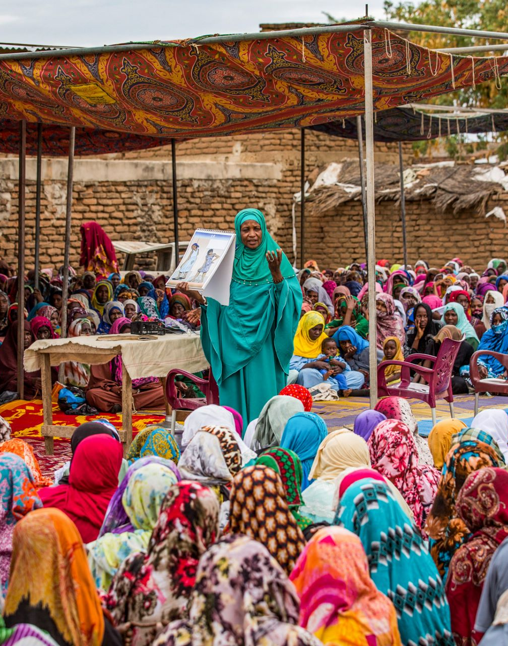

In-country
GFF visibility session
Cape Town May 5, 2025

Slide 2

Moving
From:
To:
Lack of intentional visibility of the GFF, which hinders ability to raise resources to provide to countries to support their priorities to increase impact
Improved and targeted visibility and understanding of the catalytic role played by the GFF model, enabling the GFF to mobilize resources for countries to drive impact for women, children and adolescents

Slide 3
Why This Matters – The “Why” Behind Visibility
Visibility → Credibility → Support → Impact​
Sustaining current donor interest and trust in GFF demands visibility, also at country level
Mobilizing new investment requires brand recognition of GFF and its impact
Major shifts in ODA landscape

Slide 4
RMNCAH-N global funding from the top 10 sovereign donors is expected to fall by at least 37% over 5 years
Funding from top 10 sovereign donors to RMNCAH-N
$B, constant 2022 prices
8.98
8.38
8.38
5.90
5.65
5.29
5.30
0.25
5.30
0.57
2023
2024
2025
2026
2027
2028
2023
Others*
Japan, Canada
2028
Projected funding
Source: 2023: Institute for Health Metrics and Evaluation (2024). Development Assistance to Health Database. 2024-2028: SEEK‘s estimates extrapolated based on overall ODA projection and expected prioritization of global health and RMNCAH-N within development funding. ODA projections are based on OECD, IMF, and government sources. See Methodology in Annex for more information. *Others: UK, Germany, France, Netherlands, Norway, Sweden, Australia

Slide 5

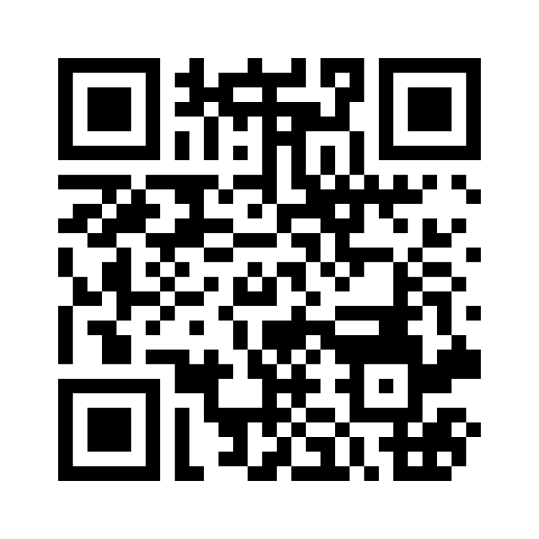

Interactive Activity
How to Join Mentimeter
Go to: www.menti.com
Enter the code: 7673 645
Submit your response and see it appear in real time
You can join from your phone, tablet, or laptop.
We’ll activate the Mentimeter shortly

Slide 6
Group discussion
At your tables, discuss the following questions:
What is needed to increase GFF visibility in your countries?
What can you commit to doing now —assuming you have the resources?
Take 10 minutes for your discussion at your table, focusing on the short and longer term opportunities you see that will enhance GFF's country level visibility. At the end, choose one person from your table to briefly report back to the larger group with your key takeaways

Slide 7

Group discussion- Read out
Action Steps
Concrete, role-based suggestions over the next 6-12 months.
1 minute per table

Slide 8

Making It Work – Our Roles
  Government Focal Points - support communication on GFF's contribution to country priorities.
  GFF Country Coordinators – leveraging country platforms, foster and strengthen local relationships, including with GFF development partners.
  WB Task Teams and CMUs – integrate GFF into missions and events, and ensure visibility of GFF contribution in reports, communications and events.
  GFF Secretariat External Relations Team – enhance the dissemination of key information on GFF partnership and donors, strategy and resource mobilization.
  GFF Secretariat Focal points: stronger communication to Government focal points and coordinators and WB teams on core donors and key priorities to meet

Slide 9
  Looking Ahead: 6 Months and 1 Year from Now
The GFF is referenced in government and donor meetings and relevant planning discussions.
The GFF’s role is reflected in relevant national reports and local media.
Progress stories are shared with national stakeholders, partners, and donors.
Donors in-country are kept informed of GFF activities and progress.
Line ministries, key partners, and technical teams share a common understanding of GFF’s role

Slide 10
Closing Reflections
Questions?

Slide 11
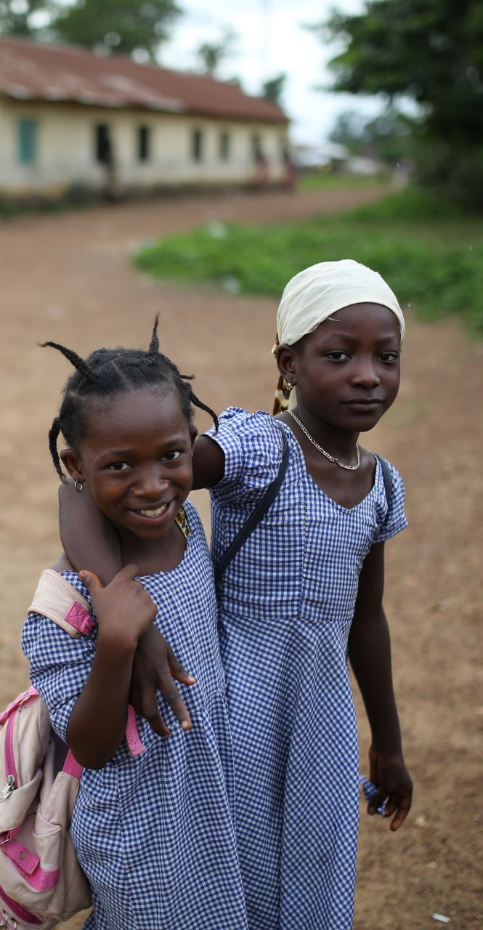




THANK YOU
www.globalfinancingfacility.org
gffsecretariat@worldbank.org
@thegff
linkedin.com/company/thegff

