Slide 1
Somalia Health Sector Alignment and Coordination experience
Dr Guled Abdijalil Ali, Director General Federal Ministry of Health
GFF –Government Focal point Workshop
5-7 May -2025

Slide 2
A Unique Challenge:
  Until recently, all health services were financed by external resources though off-budget mechanisms, with limited government engagement
  Limited coordination across the donors, who directly engage with service providers (largely NGOs)
  Weak health system capacity
  Limited support for system strengthening and institutional capacity building
    External resources have been largely focused on humanitarian needs or driven by global earmarks (e.g., for vaccines, TB drugs)
2% on-budget
98% off-budget
Notes:
OOP 46%

Slide 3
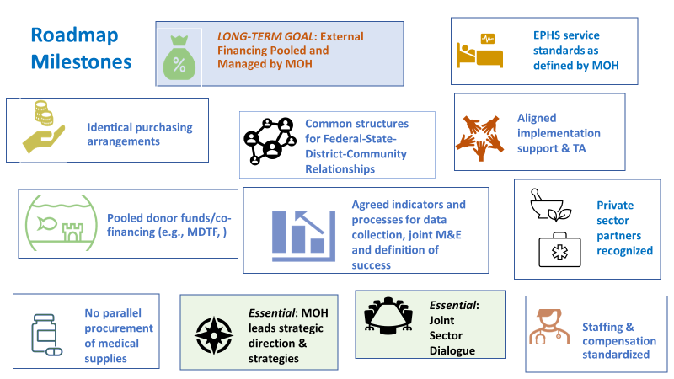
Alignment Initiative Roadmap
Bottleneck assessment of 2022 identified short, medium and long-term milestones
Short term:
Mile Marker 1: Onboarding Partners
  Convene Workshop on Alignment
  Joint Statement of Commitment to Alignment
  Establish structures to Dialogue and Coordinate
Mile Marker 2: Align M&E
  Align indicators
  Agree on TORs & Dates for Joint Annual Review
Mile Marker 3: Demonstrate Harmonization
  Initiate Joint Missions
  Employ MOH structures & systems more often
  Participate effectively with alignment architecture (Health Coordination Mtg, TWGs, JAR)
Medium to long term:
Marker 4: EPHS and Purchasing Alignment
Mile Marker 5: Financial Alignment
Notes:
we have identified some key milestones to strive towards. The long term goal should be recognized – it is about reaching a point where external financing is largely managed through government systems. Even while we appreciate that is a much longer term ambition
Key foundation milestones are recognizing that the FMOH and FMS MOHs lead strategic direction and national and state level strategies, and that we convene partners to hold sector dialogue.

Slide 4
Year-2023
Alignment initiative launched
Engaged over 43 partners
Year-2024
Resource mobilization for these structures (TWGs & HSC)
Year-2025
Operationalization of these structures
Establishment of the coordination structures
Partnership Principles formally endorsed
Alignment Roadmap
Accountability by FMOH for supporting alignment structures (e.g., joint mtgs convened, promised reports delivered, etc.
Measuring adherence by government and DPs to Principles

Slide 5
Partnership Principles in Health
Key Principles for Effective Partnerships:
  Ownership: Somali leadership in health policy and decision-making.
  Mutual Accountability: Shared responsibility for outcomes among all stakeholders.
  Transparency: Open exchange of information and resources.
  Coordination: Ensuring DP efforts are complementary, avoiding duplication & reducing costs of assistance.
Endorsed Principles
INVESTING IN GOVERNANCE AND STEWARDSHIP
ENGAGE IN STRUCTURES TO FACILITATE ALIGNMENT
UNIFIED MONITORING AND REPORTING
SUPPORTING ONE COUNTRY-LED PLAN
ALIGNING FINANCING

Slide 6
Somali Health Sector Coordination Platforms
Health Sector Coordination Committee
JAR
HIS/M&E
Supply Chain
EPHS
Epidemic Preparedness
EPI
AIDS&TB
PMNACH
Nutrition
Task force
Health Financing
Public Private Dialogue
HRH
Technical Working Groups
Cross-Cutting Thematic Working Groups

Slide 7
Challenges
Multiple parallel health authorities (federal and state-level)
Despite progress, a significant portion of health financing remains “off-budget”
Lack of presence of most of DPs in the country challenges coordination and regular dialogue
Competing interests among donors and a history of bypassing the government's stewardship role hinder alignment
Development partners continue to hold bilateral discussions, and do not yet fully employ the TWGs as platforms for coordinating technical inputs and financial allocations
Coordination mechanisms need strengthening and cascading to FMS/regional levels
Partner-specific reporting requirements impede M&E alignment
Much more can be accomplished if multilateral institutions (GFF, Bank, Gavi, Global Fund, UN) and bilateral partners could make a greater effort to reduce their parallel initiatives and align their demands.

