Slide 1
Health Sector Alignment
Experience from Ethiopia

Slide 2
Background
Adopted the Paris declaration (2005),Health harmonization manual (2007), signed IHP+ Compact (2008).
Implemented Joint Financing Arrangement (2009), JANS (Joint assessment for national strategies)(2010).
One Plan One Budget One Report approach institutionalized.
pooled funding( 2005).

Slide 3
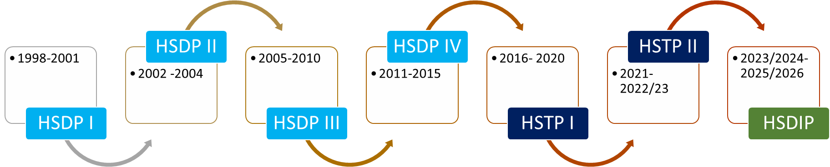
One Plan –Overview
One costed and monitored plan at all levels.
Strategic plan and Annual operational plan- development engages all stakeholders, bottom-up and top-down approach.
National strategy cascades into annual plans.

Slide 4
One Budget – Overview
All funding sources included in one document/account
Budget harmonized with national fiscal year and chart of accounts
Different Channels - 1,2,3
Pooled funding mechanism ( SDG-PF)
Resource mapping and expenditure tracking – led by the Ministry of Health

Slide 5
One Report – Overview
Unified M&E framework with defined indicators.
Streamlined reporting to reduce duplication.
Supports Mutual accountability and decision making.
District health information system ( DHIS), Quarterly and annual report evaluation,JRMs and ARMs held regularly.

Slide 6
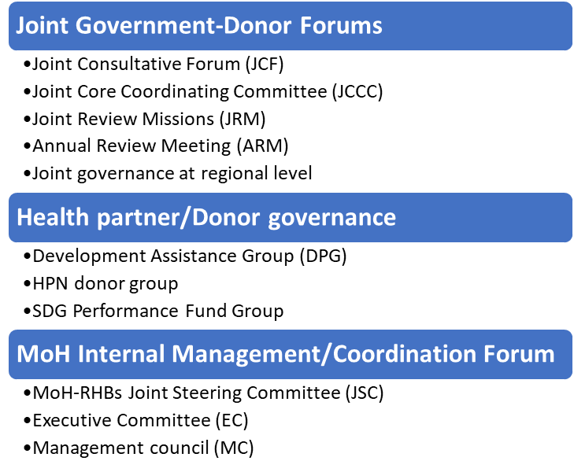
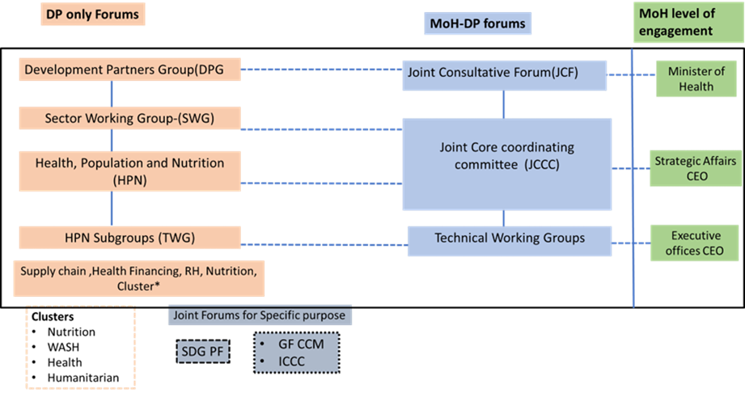
Coordination platforms

Slide 7
Observed challenges over time
Fragmentation due to vertical sub-sector strategies.
Fragmented resource data, low predictability, weak accountability.
Data quality, private sector reporting gaps, parallel donor tools.
Decreased engagement in the coordination platforms.
Inconsistency in conducting the different coordination mechanisms.
Decreased financial commitment to pooled funds

Slide 8
Alignment Diagnostic Assessment
In recognition of the challenges, to create a better understanding of where we are after several years of implementation of the alignment principles,
Conducted in 2022 with all sector stakeholders,
Average score: 3.41/5 | One Plan: 3.91 | One Budget: 3.29 | One Report: 3.16.

Slide 9
Key Gaps
One Plan | One Budget | One Report
•The participation of the NGOs and CSOs is low •The effectiveness of the Multi-Stakeholders forums (JCCC and JCF) has declined •The engagement of sub-national bodies in the planning becoming weak (woreda plan) •Increasing Number of sub-sectors strategies and plans | •Fragmented and Lack of comprehensive health financial data including weakness in systematic tracking of funding's of development partners. •Less predictability of development partners funding and inflexibility of channel 3 partners in supporting government priorities •Declining trend of external resources including funding going through government systems aggravated by Weak PFM. | •Data quality and completeness still remain a concern. •Some development partners adhere poorly to the countries reporting system •Data from Private Sector health services providers not fully captured . •There are no joint accountability mechanisms to track the behaviors of stakeholders.

Slide 10
Key Recommendations
Revise HHM to dynamic HHAG with accountability tools.
Revitalize and strengthen the coordination platforms.
Enhance predictability, disbursement and expenditure tracking of funds.
Develop mechanisms for joint decision-making process in budget allocation.
Improve PFM and link budgeting with MoF.
Enforce systematic resource mapping.
Strengthen mechanisms to enhance data quality and use of information for decision making.
Develop mechanisms of enforcing private facilities fully report through the DHIS2 system.
Develop and implement systematic mechanisms of tracking implementation of the recommendations of sector review reports and enhance the follow up.

Slide 11
Opportunities
The changes in the global health funding landscape demands efficiency more than any time.
Lusaka agenda introduced five shifts
Ethiopia has been part of the Lusaka agenda development process

