Slide 1
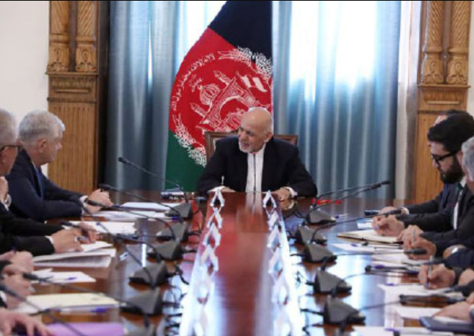
Afghanistan: A country that, half a decade ago, had an internationally recognized government.

Slide 2
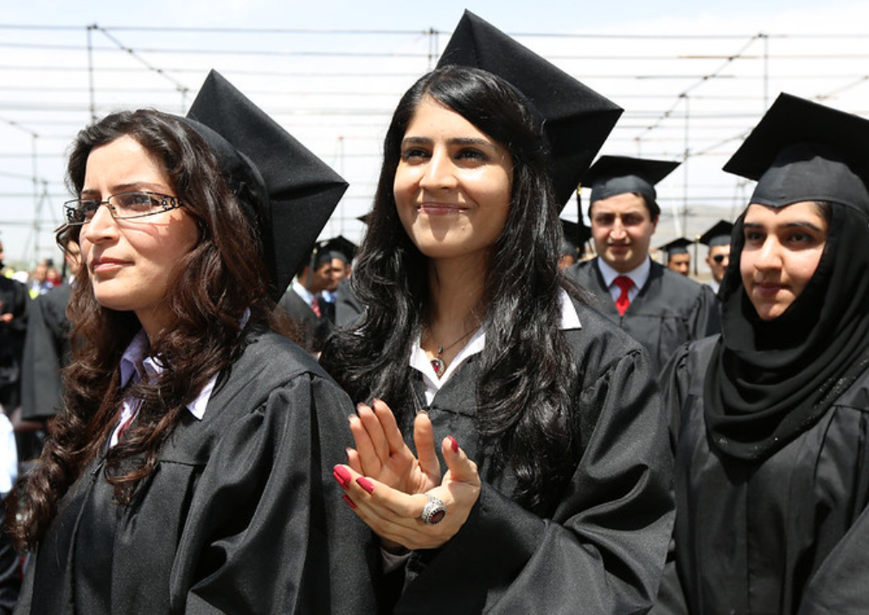
Girls had the opportunity to pursue their dreams and become a physician, nurse, midwife, etc

Slide 3
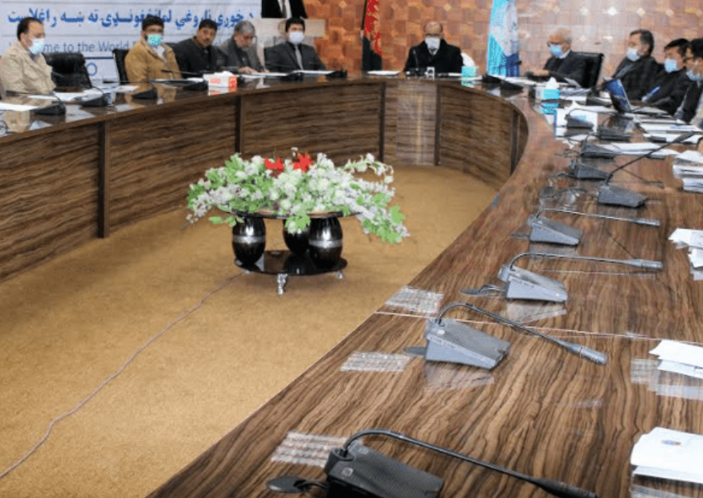
A health sector with a strong Country Platform led by the Deputy Minister of Health

Slide 4
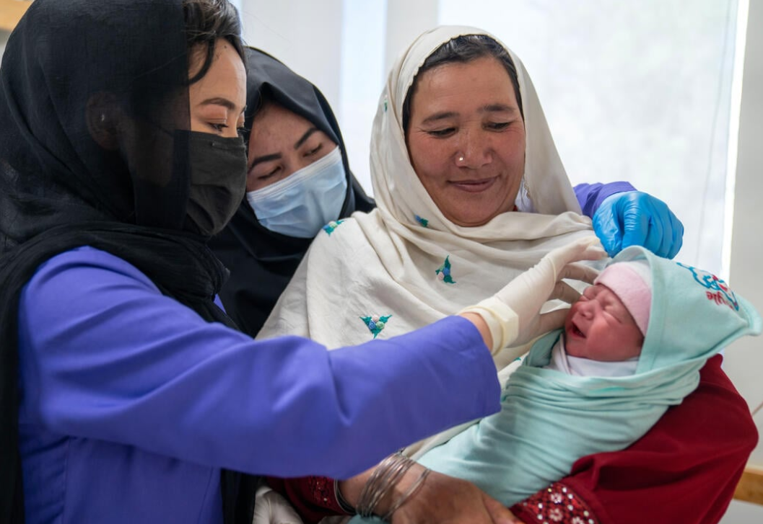
The health sector was financed by the Government and donors.
The health sector leaders strongly believed in the GFF resource mobilization and alignment agenda.

Slide 5
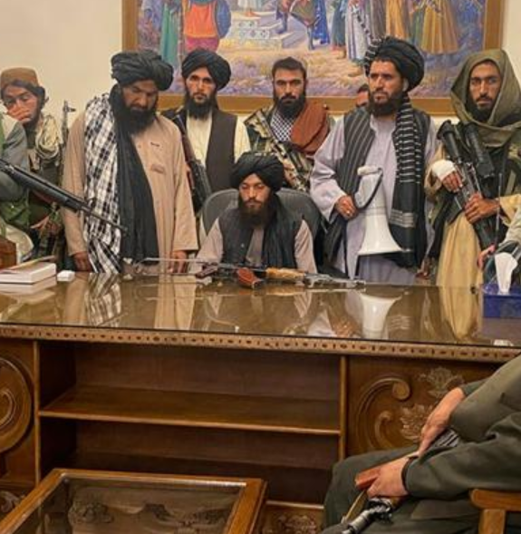
On August 15, 2021, the Afghan government collapsed, and the Taliban took control.
The current government is not recognized internationally.

Slide 6
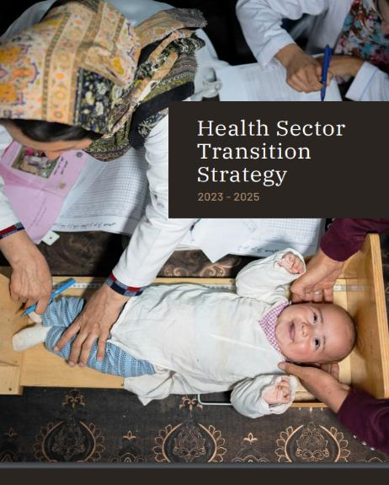
Country Investment Case
In January 2022, donors agreed to establish a joint framework or strategy to support and finance the health system of Afghanistan.
GFF took the lead as a penholder and collaborated closely with technical donors and UN agencies on the ground assisting them to draft the Afghanistan Investment Case or Health Sector Transition Strategy (HSTS) 2023-2025.

Slide 7
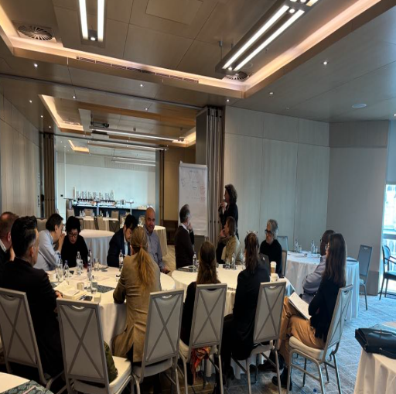
Country Platform
The H-STWG holds regular meetings
Members are development and humanitarian donors, UN agencies, and NGOs.
GFF plays the role of the secretariat.
The CP has successfully brought together donors and key actors on the ground to understand who is doing what and how to align resources to enhance allocative efficiency.

Slide 8
Total available funding for the IC
Funding (donors + government)
  Total: $2.67 billion (85% donor; 15%: government)
  Per capita per year: $21.07 ($17.86 donor; $3.21 government)
Humanitarian Aid represents 10% of total resources.
Notes:
Message: Only 16% of Total funding is going through pooling mechanism, one way to improve donor coordination and reduce duplication could be through an increase use of pooling mechanisms.

Slide 9
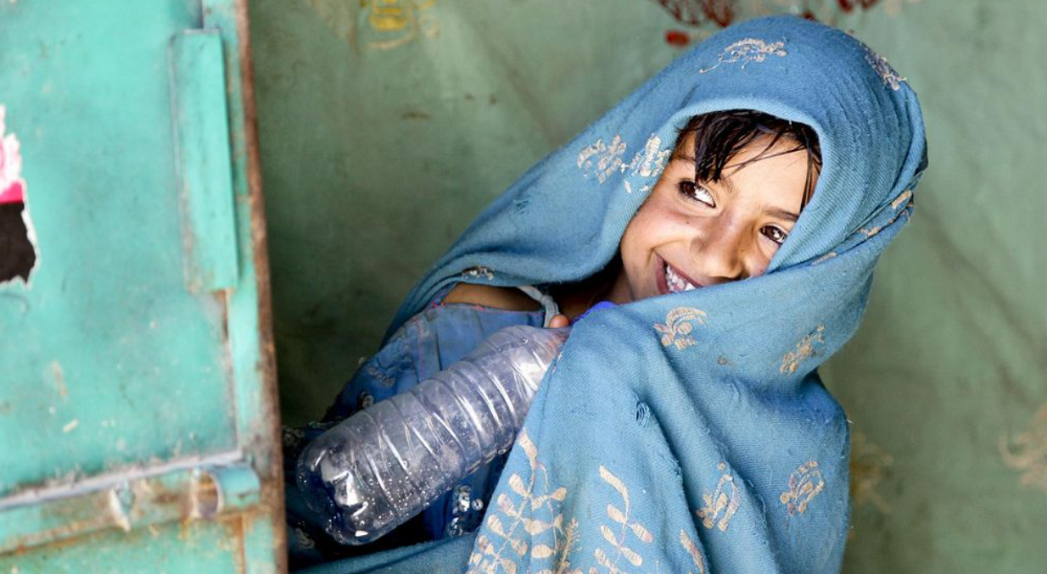
Thank you

