Slide 1

Goal? Rapid cycle analytics accelerates improvements in RMNCAH-N outcomes by increasing the systematic and timely use of data for decision making
In person surveys
In person surveys
Timely, rapid-cycle data
Year 5
Year 5
Continuous data use

Slide 2
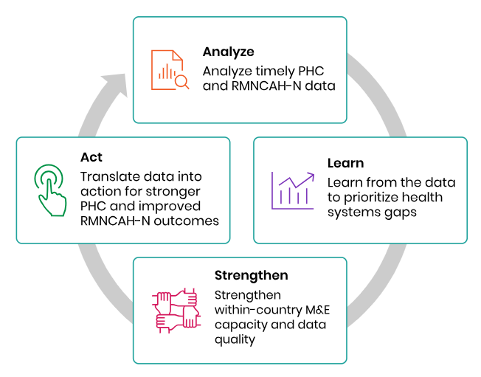
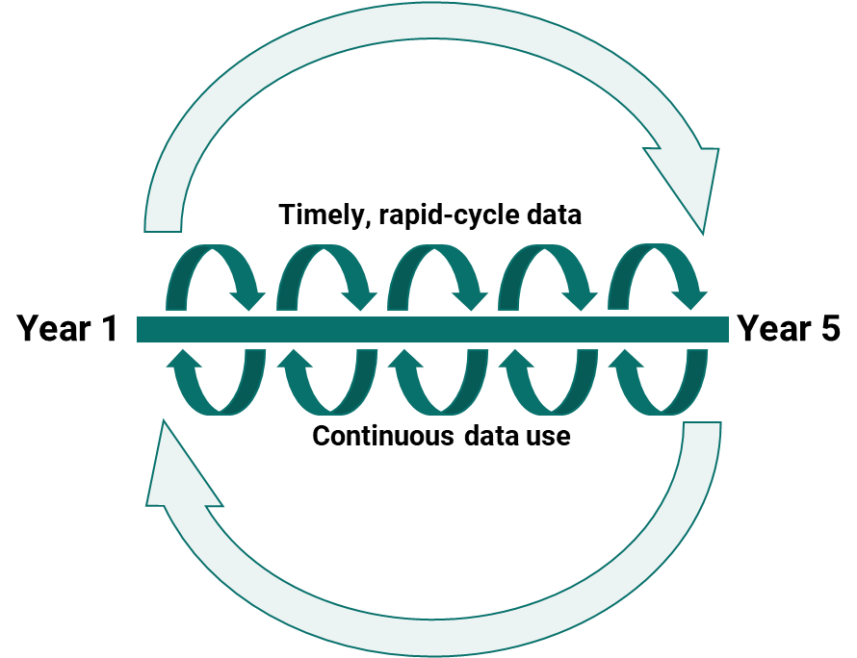
What is
FASTR?
An approach to catalyzing continuous ‘analyze, learn, strengthen, act’ cycles to drive the systematic use of timely data for decision making which can inform ongoing prioritization efforts

Slide 3




How do we do it? Supporting countries with timely, rigorous, and low-cost approaches to monitoring PHC systems. Results and learnings feed into ongoing prioritization discussions
RMNCAH-N Service Use
Leverage HMIS data to routinely monitor changes in the coverage of health services during reforms, shocks, or within vulnerable populations, while identifying and addressing data quality challenges.
Health Facility Surveys
Assess gaps in primary health care service delivery; understand the impact of health reforms or shocks on PHC performance.
HH & Client surveys
Provide snapshots of health service utilization, foregone care, and community perceptions of service quality
Digging Deeper with follow-on analysis
Gain a richer understanding of emerging health systems issues through rapid and adaptable mixed-methods approaches.
Build capacity + data use support Building within-country capacity for data collection, analysis, and use, with focus on Ministry of Health leadership and partner alignment.

Slide 4





RAPID PHONE SURVEY ON THE OPERATIONAL CAPACITIES AND RESILIENCE OF BASIC HEALTH CENTERS (CSB) IN MADAGASCAR
MINISTÈRE DE LA SANTÉ PUBLIQUE
Round (April 2024) and Round 2 (Nov 2024)
Round 3 in preparation, to begin on June 2025
Sample of650 CSB
Investigateur :
Partenariat technique et financier

Slide 5
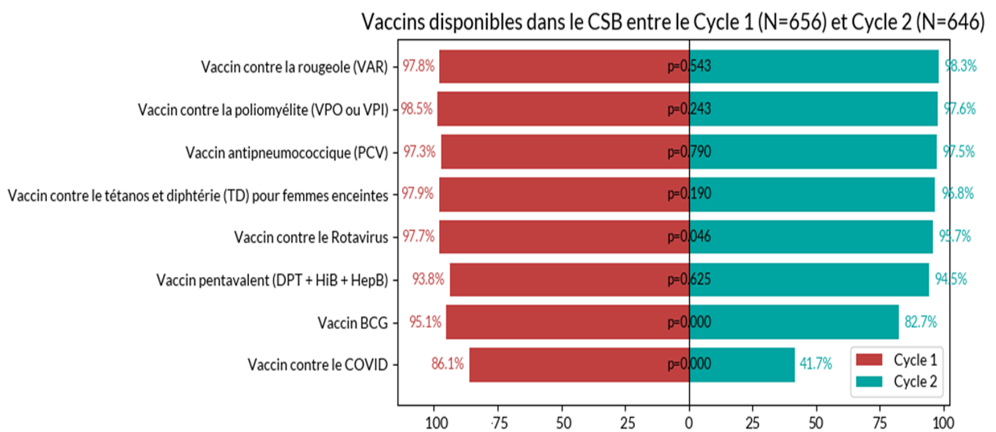
Overview
Main objective: To provide essential evidence on the availability, accessibility and use of primary health services, with a view to improving resilience and the quality of care on the front line: Essential services, Major obstacles, Available resources, Leadership and management, Services for vulnerable populations
Figure : Comparaison des resultats sur la disponibilite des vaccins dans les CSB en 2024
Notes:
Objectifs specifiques
Permettre l’évaluation et le suivi continu des capacités opérationnelles des CSB.
Identifier les difficultés principales auxquelles les CSB font face dans la prestation des services.
Évaluer l’impact de chocs externes éventuels sur l’offre de services et la capacité de réponse des CSB, afin d’identifier les mesures nécessaires pour accroître leur résilience.
Développer des recommandations pour la prise de décision par les programmeurs et décideurs basées sur l’évidence fournie par les données de l’enquête téléphonique.
Décrire la mise en oeuvre/les progrès des réformes et les ressources mobilisées
Suivre la réalisation des recommandations émises lors des cycles d’enquête antérieurs.

Slide 6
Leçons tirées et perspectives
Collaboration, exchange, and learning from FASTr achievements: MSANP - GFF – WB – GAVI integration of data to be collected ⎝
Further exploitation and triangulation of information: DHIS2 – FASTr – Service Delivery
Maintain two cycles per year to allow for corrective action between cycles
Need to change the CSBs in the sample to avoid data collection bias
Adoption and Institutionalization of FASTr:
FASTr CSB: Use of the telephone survey for specific program monitoring and evaluation: PARN project, decentralized financing.
FASTr Root Cause Analysis – Analysis of the Supply Chain of RMNCAH-N inputs
ACCESS PDC: complements DHIS2 information
Countdown 2030 and Progress Review: joint progress monitoring, SIS Subcommittee, single coordination by MSANP.

