Slide 1
ALIGNMENT IN PRACTICE:
REFLECTIONS FROM Nigeria
LESSONS,OPPORTUNTIES,CHALLENGES

Slide 2
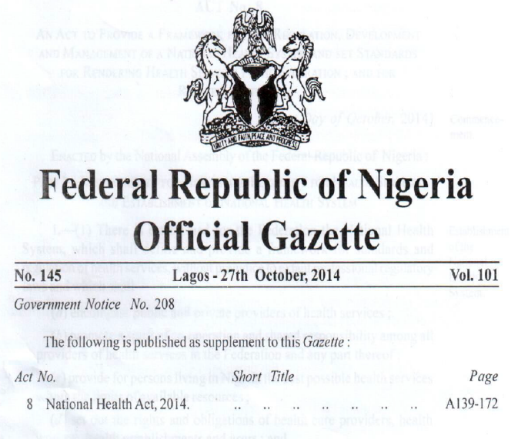
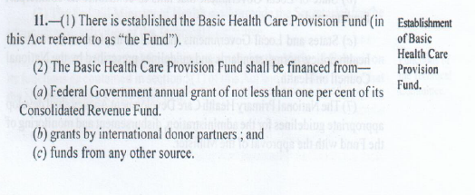
2014: NHACT WAS SIGNED INTO LAW.

Slide 3

2015: WB FINANCED SOML PFOR APPROVED

Slide 4
2018: NHACT IMPLEMENTATION COMMENCED

Slide 5


Slide 6

2023: SWAP COMPACT WAS SIGNED BETWEEN FEDERAL AND STATE GOVERNMENTS AND DPS TO IMPROVE HEALTH OUTCOMES
COMMITTING to the redesign of the Basic Health Care Provision Fund, comprising at least 1% of the Consolidated Revenue Fund, provided by the National Health Act (2014)
COMMITTING all State Governments and FCT to complement the Federal Government by undertaking the following key policy actions

Slide 7
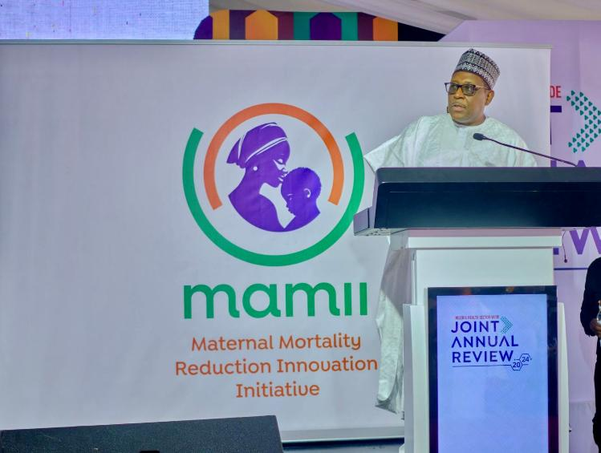
2024: LAUNCH OF MAAMI

Slide 8

2024: LAUNCH OF THE STATE OF HEALTH OF THE NATION

Slide 9
WHAT HAVE WE LEARNT ?
LESSONS,OPPORTUNTIES,CHALLENGES

Slide 10

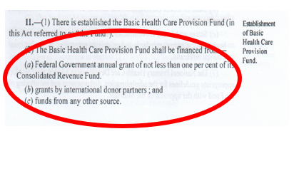
#1 {LESSON}: GOVERNMENT OWNERSHIP IS A NECESSARY CONDITION:
LEGISLATION: NHAct of 2014.
SWAp COMPACT: Not backed by force of law but effective in bringing all orders of government to align behind a common purpose. Local context matters.

Slide 11

#2 {LESSON}: ALIGNING PARTNER FINANCING BEHIND GON PRIORITIES IS ONE THE SUFFICIENT CONDITIONS.
2018: GFF PROVIDED GRANT TO KICKSTART BHCPF AND LEVERAGED 150M USD OF DRM.
2024: GFF AND OTHER PARTNERS HAVE MOBILIZED OVER 1BILLION USD
GFF: 50M USD
FCDO:
CIFF:
JICA:
CANADA:
GFF 20M USD

Slide 12

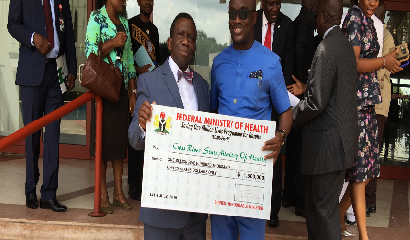
#3{LESSON}: ALIGNING AND TIMING OF WB FINANCING CRUCIAL.
SOML PforR not anchored to the NHAct in 2016.
Ngr’s Evolution from RESULTS FRAMEWORK; BUDGET PLANNING; and full SWAP.
GFF: 50M USD
FCDO: 11M
CIFF: 12.5
JICA: NA
CANADA: NA
GFF 20M USD
SOML PforR: 500M USD

Slide 13
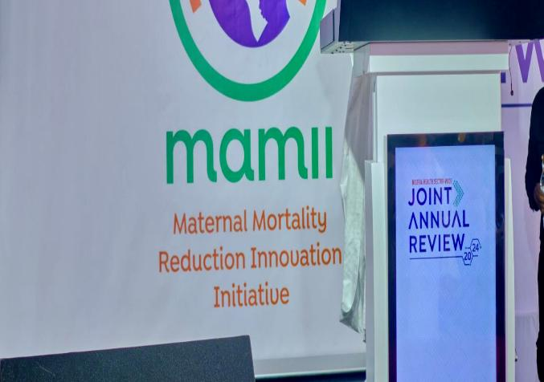

#4{OPPORTUNITY}:
ONE REPORT: ONE SOURCE OF TRUTH
ONE CONVERSATION

Slide 14
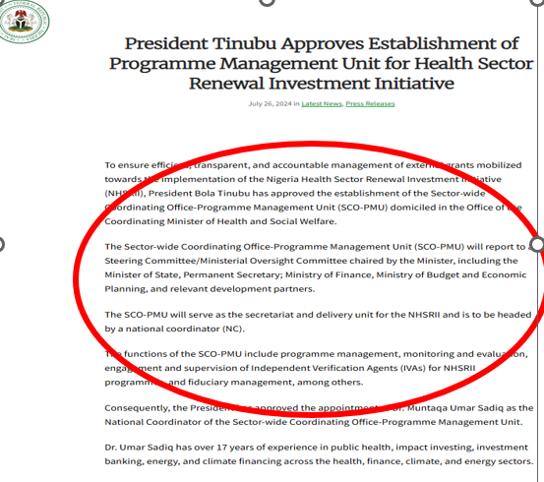
#5 {OPPORTUNITY}:GOVERNANCE ARRANGEMENTS ONE STOP SHOP: NO PARALLEL WB PCU.
SCO SERVING BOTH AS THE SECRETARIAT FOR THE HEALTH REFORM AGENDA & THE PMU.
AT THE STATE LEVEL, BHCPG MOC RESPONSBLE FOR MANAGING THE HOPE Pfr.

Slide 15
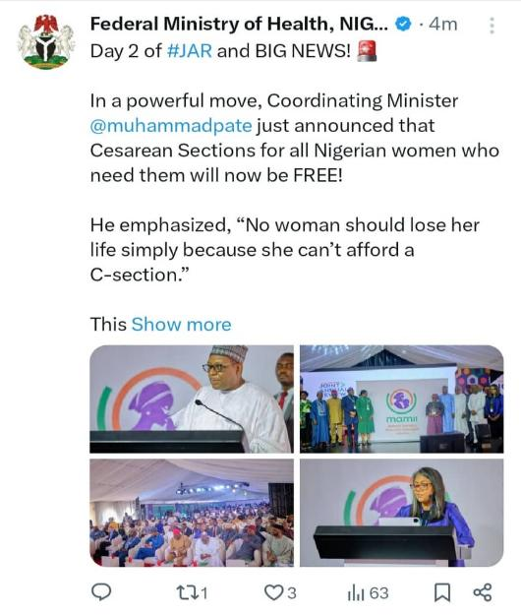
#6: {OPPORTUNITY}: TO ALIGN PRIORTIES:
Maternal Mortality Reduction Investment Initiative (MAMII): A national strategy to crash maternal mortality in Nigeria identifying 172 LGAs that contribute 50% of Nigeria’s Maternal Mortality and Using an integrated approach to coordinate multiple interventions across multiple MDAs

Slide 16
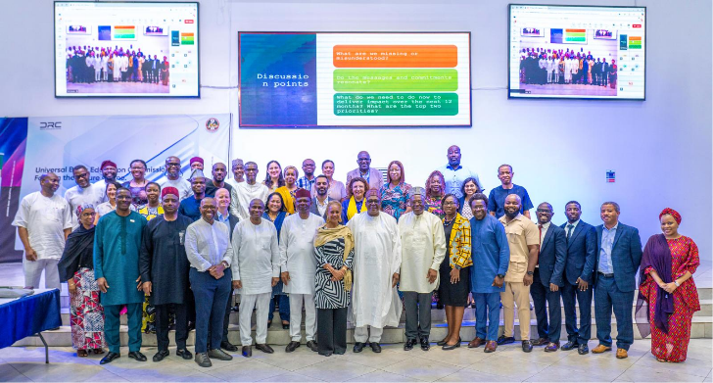
#7 DPG COORDINATION
OPPORTUNITY:DPG COORDINATION
LESSON: RESPONSIBLE FOR LEADERSHIP & READY TO DEDICATE TIME FOR BEHAVOURIAL CHANGE
CHALLENGE: CHANGE IS DIFFICULT

Slide 17
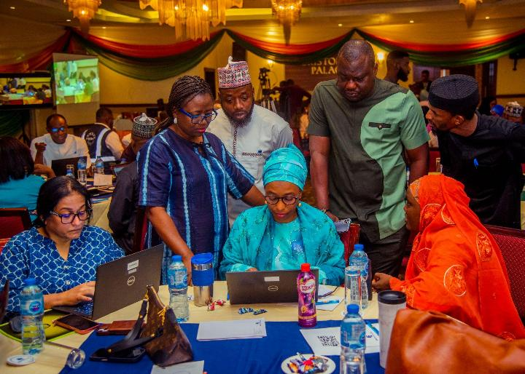
#8:{CHALLENGE}COORDINATION OF TA SUPPORT TO STATES
AOP DEVELOPMENT
MULTISECTORAL THINKING.
LEADERSHIP CAPABILITY
DWINDLING TA POOL.

Slide 18
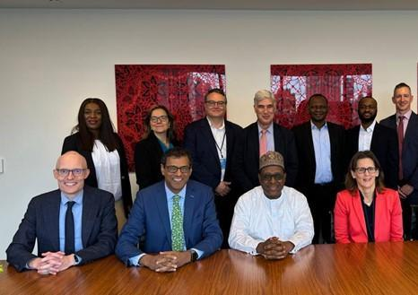
#9:
CHALLENGE
VS
OPPORTUNITY
? PARALLEL FINANCING
VS
? CO-FINANCING

Slide 19
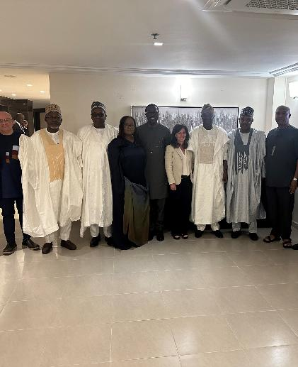
#10:{CHALLENGE}
PUBLIC FINANCIAL MANAGEMENT
Reporting requirements
? GON systems including audits
? DP reporting requirements

Slide 20
NIGERIA: SUMMARY OF HEALTH SECTOR ALIGNMENT AND MATURITY LEVEL MODEL
ALIGNMENT DOMAINS | RATING BY STAKEHOLDERS |  |  |  | AV STAKEHOLDER’ RATING | WEIGHT | AVERAGE RATING
 | DPS | PUBLIC SECTOR
 |  | GOVT | MDAS | CSOS & PS
One- Plan | 3.2 | 4.1 | 3.3 | 2.1 | 3.2 | 25% | 0.79
One-Budget | 2.5 | 3.3 | 3.1 | 1.9 | 2.7 | 40% | 1.07
One-Report | 2.4 | 3.1 | 3.1 | 1.4 | 2.5 | 35% | 0.87
Nigeria's Alignment Maturity Level |  |  |  |  | - | 100% | 2.73/5.0
The maturity rating of 2.73 on a 5-point scale indicating systems are still largely ad hoc and require better partnership to enable all stakeholders collaborate.
The government and parastatal scores were very comparable when looked at in relation to other stakeholder categories.
The lowest ratings were recorded from the CSO and private sector categories

Slide 21
CEMONC
BEMONC

