Slide 1
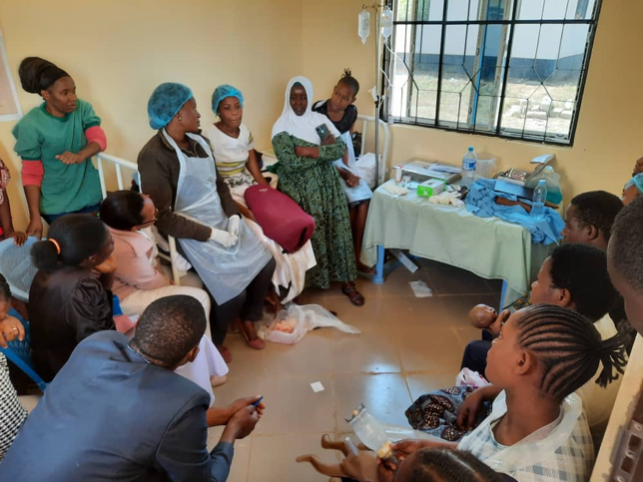
Safer Birth Bundle of Care (SBBC)
GFP retreat
May 2025

Slide 2

Outline – who
Film on SBBC
Overview of SBBC
Discussion and practice

Slide 3


Slide 4

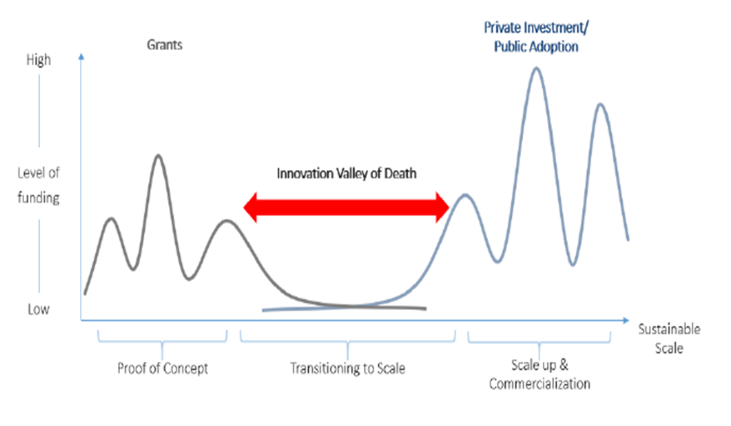
Transition to scale is where innovations stall
Credit: WHO 2022

Slide 5









Training innovation
In-service simulation training for Helping mothers and newborns survive.
Clinical innovations
Fast and reliable fetal and newborn
heart rate monitoring, efficient bag-mask ventilation and improved maternal care.
MamaNatalie
MamaBirthie
NeoNatalie Live
Moyo
NeoBeat
Upright Penguin
Sustainability
Supported by strong MoH ownership, regular mentorship, supportive supervision and local facilitators trained in simulation methodology.
Continuous QI
Local training and clinical data used for weekly QI discussions and guiding low-dose, high-frequency training at the worksite.
Notes:
SBBC’s training innovations are designed to integrate with simulation scenarios, focusing on key maternal and newborn lifesaving skills. This bridges the gap between clinical theory and care. The local facility champions facilitate regular simulation training on labor management, postpartum bleeding, newborn resuscitation, and essential newborn care. The training sessions are guided by the Helping Mothers and Babies Survive programs. The local facility champions receive weekly feedback on their own facility’s clinical data (key performance indicators and perinatal outcomes) and adjust ongoing trainings to address identified gaps. The clinical innovations are designed to ease the job of the health workers in fetal heart rate monitoring and newborn resuscitation.
Continuous QI is integrated through regular on-the-job, low-dose, high-frequency simulation-based training. Targeted training is done by utilizing local data and feedback loops, to visualize gaps in clinical care and guide areas for improvement. Adequate training of local facility champions who can facilitate CQI simulation training is considered essential for these processes to happen to stimulate a gradual and sustainable culture change. To implement SBBC in a sustainable way, it is also important that the program is incorporated into national systems.

Slide 6
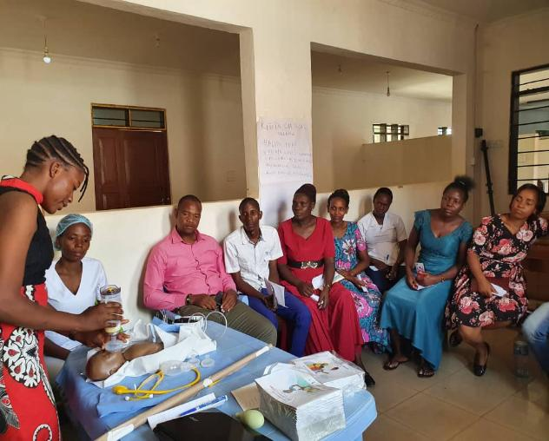
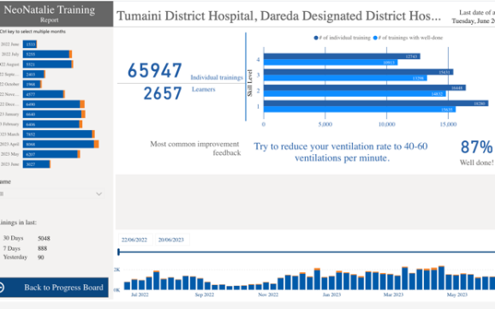
SBBC Simulation-Based Low-Dose-High-Frequency Training in facilities facilitated by champions

Slide 7
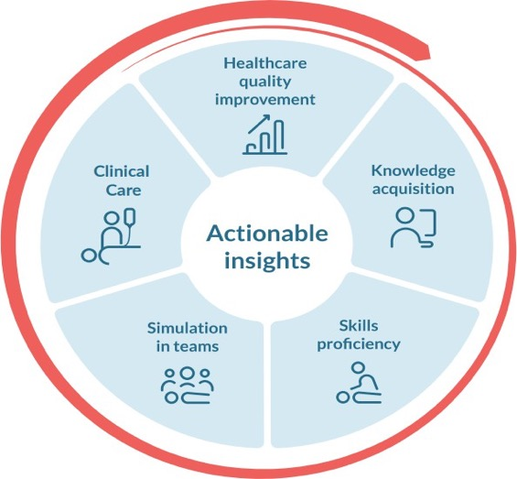
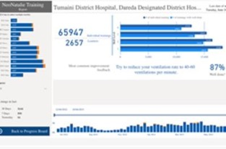
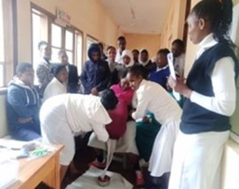
Circle of Learning
Identified procedure – practice
gap
Use of local data for local QI
Learning needs
Individual independent skills training
Facilitator-led in-situ team scenario simulation
125,758 trainings
5,880 trainings

Slide 8

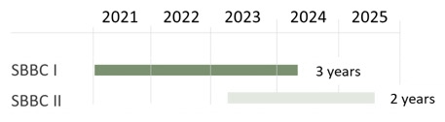
SBBC study in Tanzania
  Phase I
    30 hospitals,
    Five regions
    Estimated 300,000 births over 3 years
    Phase II
    142 hospitals
    Estimated 600,000 over 2 years

Slide 9
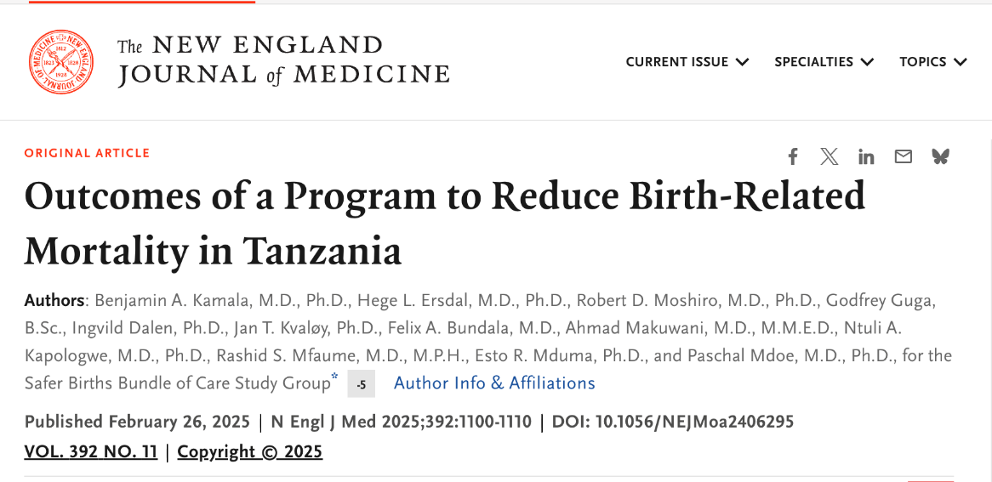
Results

Slide 10
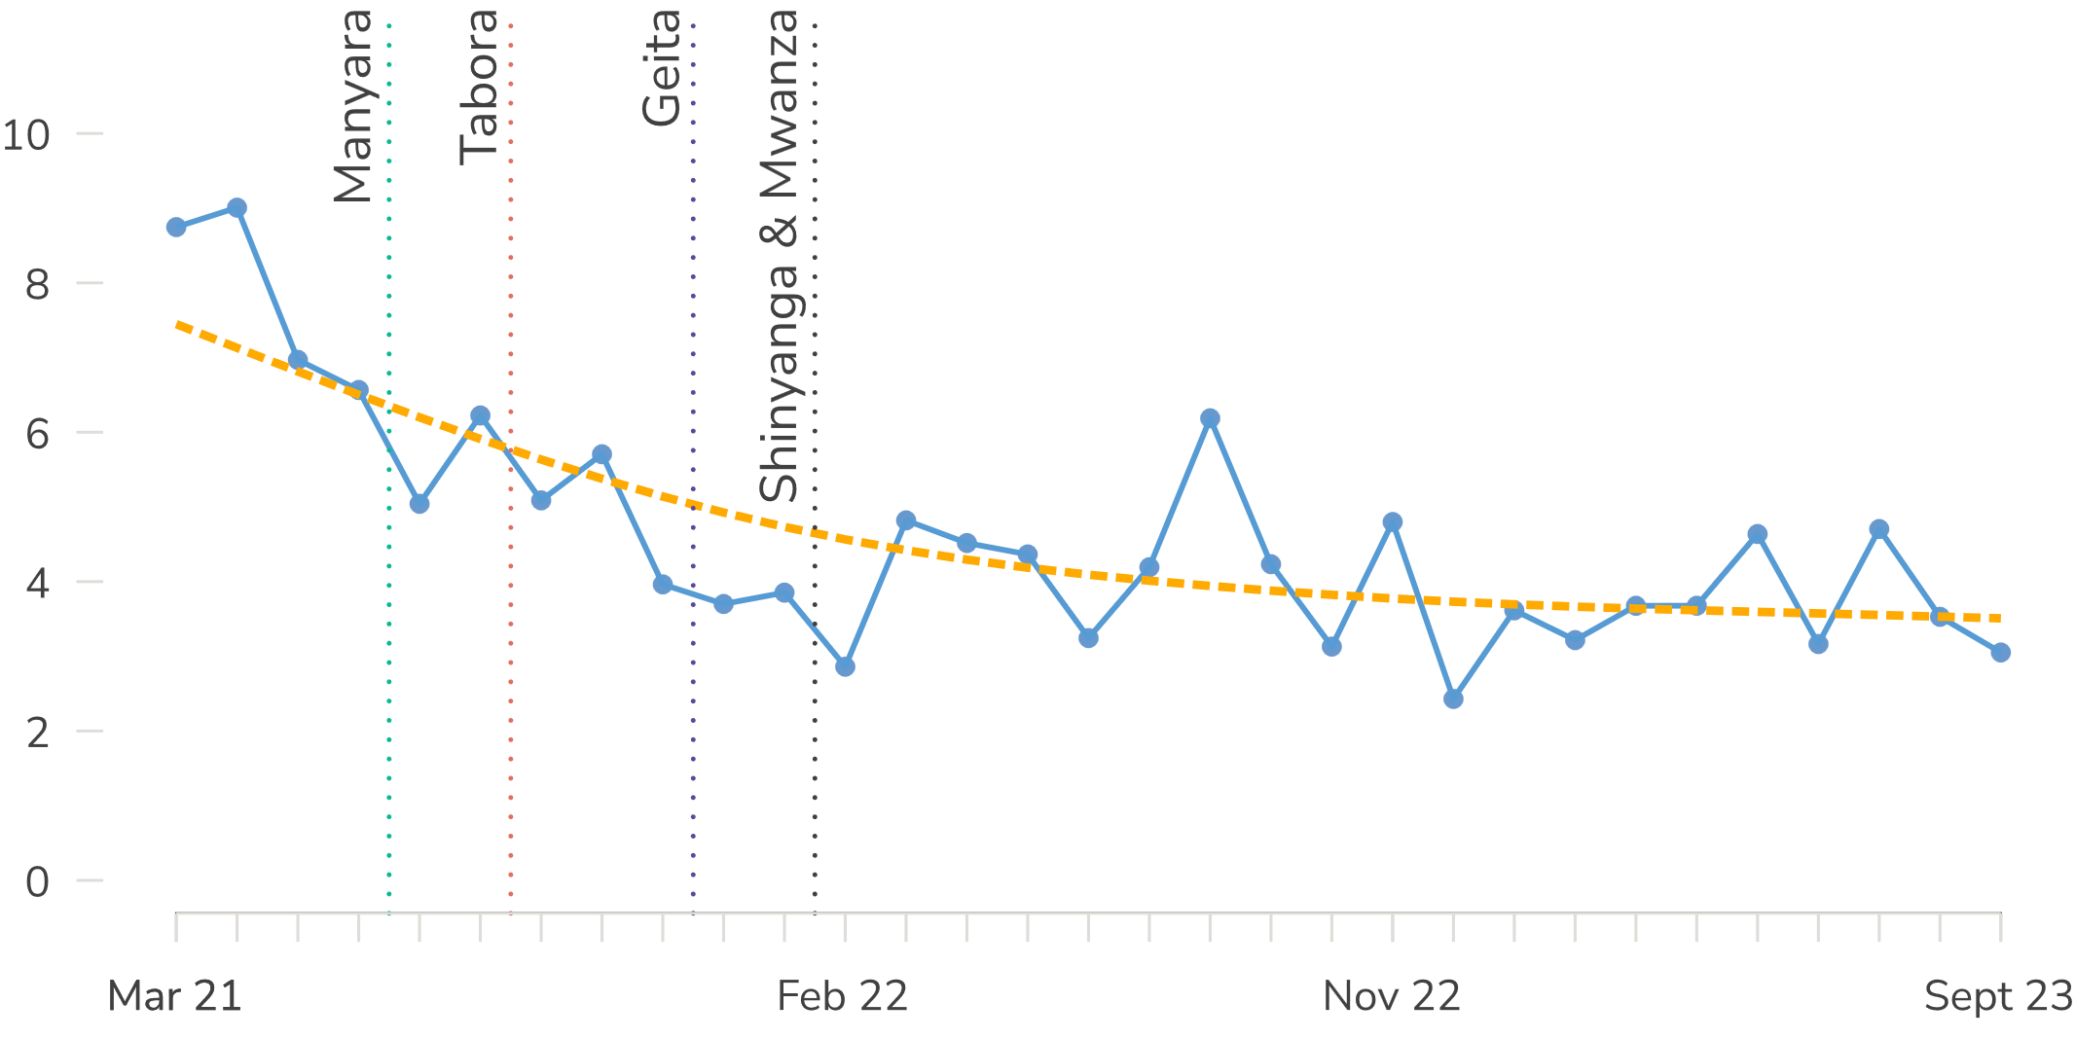
24-hours newborn deaths
per 1000 live births
|
40%
reduction
Notes:
So, what has been the impact of the Safer Births Bundle of Care?
This graph shows the combined number of newborn deaths from March 2020 to October 2023. ​
The bundle was implemented in a stepped-wedge manner, and the vertical lines show when the different regions started.
You see how the mortality is steadily decreasing.​
During this period, newborn morality rate dropped by 45%. ​
Please be aware this is unpublished preliminary data, not adjusted for time and other factors.

Slide 11
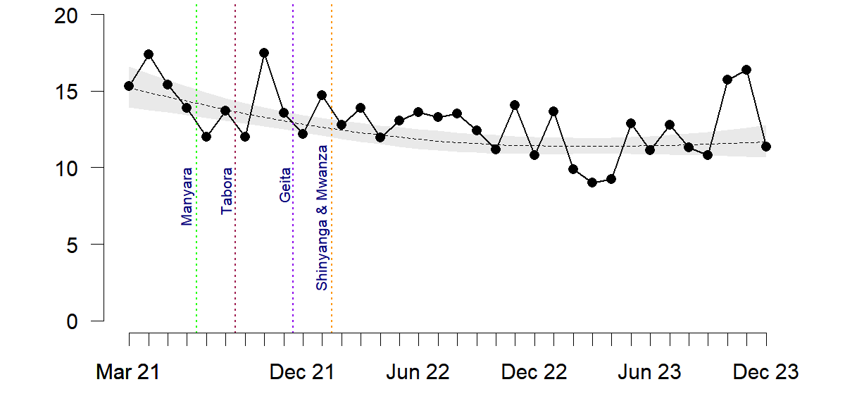
1-day perinatal deaths(including Fresh SB)
per 1000 live births
18%
reduction
|

Slide 12
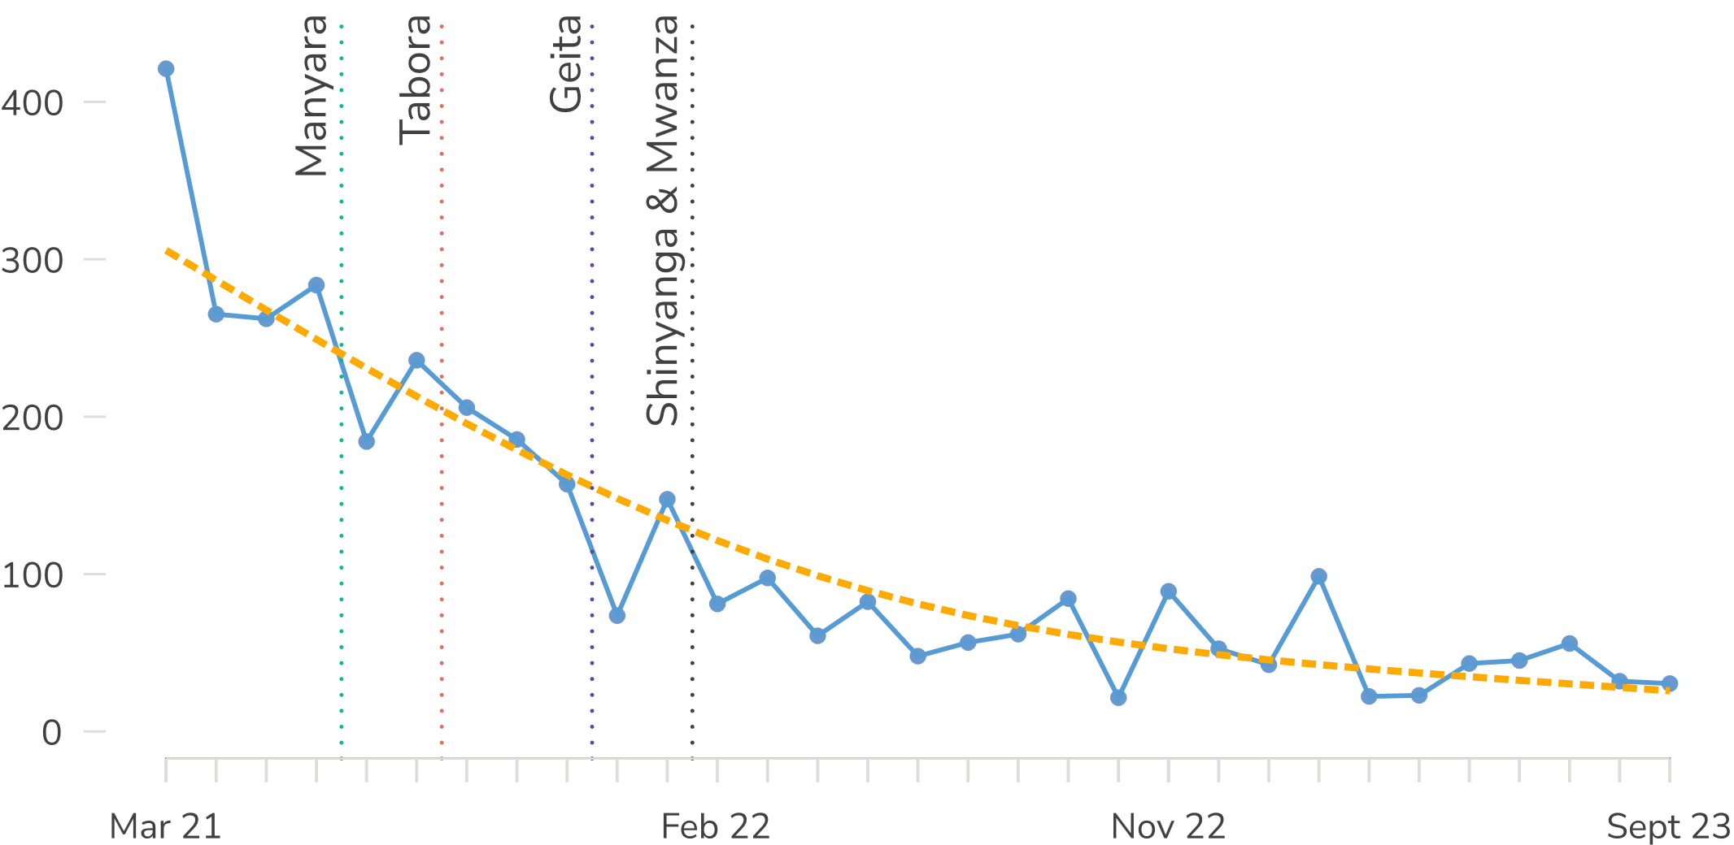
Maternal deaths
per 100,000 births
|
75%
reduction
Notes:
The really BIG surprise is related to maternal mortality. ​
We hypothesized a 10% reduction, but we saw a MUCH bigger reduction​.
Starting at around 300 deaths per 100,000 births in baseline – down to 60.
Overall, an absolute 70% reduction in maternal mortality!​
Well-trained and competent nurse midwives save lives!!

Slide 13
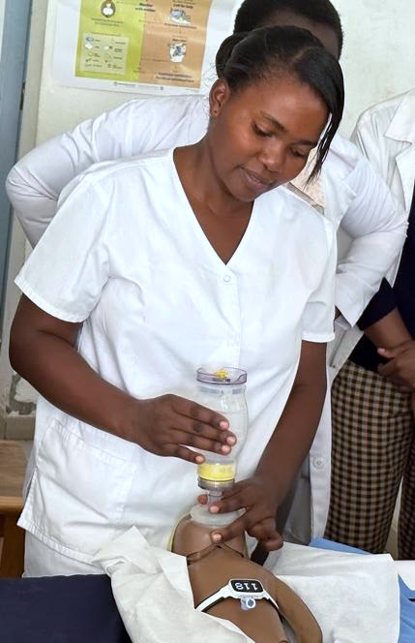

Main lessons learned
Co-creation and implementation of innovative intervention
Focusing on cost-effective and relatively simple interventions
The focus of diffusion of innovation needs to be healthcare workers-centered
Human resources for health (quality)
  A well-trained, supported, and equipped healthcare workforce is also critical
Use of local data for local decision-making
  The key to quality improvement
Collaboration among partners
  Local and international
  Public and private
  Professional associations
Notes:
The Safer Birth Bundle of Care has been very well received – and much in demand for additional scale up.
National ownership (MoH) and facility ownership is crucial - from early planning, through implementation.
Although the results so far are highly encouraging, they differ much among participating hospitals and regions: It is essential to leverage best-practice implementation.
Unreliable baseline data and missing data on poor outcomes. Changing this culture and fear for “blame and shame” takes time, but the reflection-based simulation methodology is helping drive this change.
Local clinical data is used on a weekly basis for regular quality improvement discussions and data-guided simulation scenarios – this is critical for sustainable impact and improving clinical behaviour.
Areas that require particular attention include supportive supervision, mentoring of health workers, and equipment maintenance and reprocessing.

Slide 14
Next Steps….
Locally:
SBBC scaled up to 142 hospitals in 5 regions
MOH plans to scale to three additional regions in 2025
Plans for a national scale-up, depending on funding availability
Internationally
SBBC adopted in Nigeria (Borno and Gombe States under NCA and CHAI funding)
Other countries have shown interests, including Ethiopia and Lesotho

Slide 15
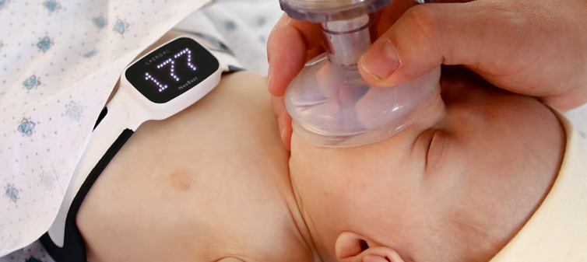
Want to save a newborn?
Time to try out neonatalie Live…..

