Slide 1

COMMODITIES
AND SUPPLY CHAIN
April 2025

Slide 2

Objectives & Agenda
Gather input to shape C&SC work
Understand ‘unmet’ demand for support
Request FP/LO help on country engagement
C&SC Approach – Focus on equitable access
Examples of current work
Disruption analysis
Implementation progress
Supply chain leaders forum

Slide 3

GFF’s Commodities and Supply Chain Work is focused on equitable access
For Communities:
“We don’t want to be sick, we want to feed our families, pursue our goals…”
For Individual Care Seekers:
“No more worrying about clinic queues or affording transport, my medication arrives at the nearest pharmacy and takes 10 minutes to collect”
For Health System Leadership:
“If we don’t help people and communities when they are in need of commodities, they won’t help or listen to us when we need them”

Slide 4
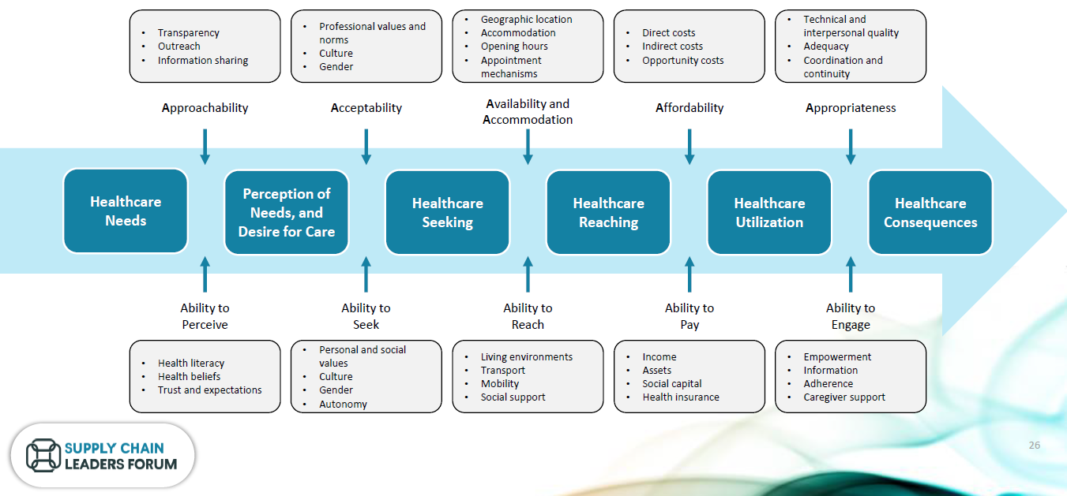
Achieving Equitable Access is a complex of multiple factors

Slide 5
GFF Commodities & Supply Chain focus
Access Factors (C&SC Addressable)
Impacts
Reduced Stockouts: Improved matching of demand & supply for all target channels
Increased service utilization
Equitable Funding to Last Mile Channels: Resources allocated to a mix of channels that improve patient-centricity
Reduced catastrophic health expenditure
Proximity: Supply Chain supports commodity delivery closer to patients to reduce cost & time access barriers
More lives of mothers & children saved
Inclusivity: Supply Chain supports differentiated & inclusive service delivery points to reduce cultural access barriers
Increased spacing of births
Quality: Incentives and Regulations influence markets to provide higher quality commodities
Reduced stunting and wasting
Affordability: Reduced unit prices for governments, insurers and individuals

Slide 6
CASE STUDY: Impact of supply chain reform
Comparing two states in India shows the impact of supply chain reforms on Access;
Substantial differences in OOP Spend and Utilization of Publicly Provided Services
Comparison Data from 2018
U.P. Availability Improvement 2020-24
Out of Pocket Expenditure | Tamil Nadu​ | Uttar Pradesh​
Per Hospitalization in Govt. Hospitals (excluding childbirth) – Rural​ | ₹520 (£ 5.7 )​ | ₹6911 (£ 75.9)​
Per Hospitalization in Govt. Hospitals (excluding childbirth) – Urban​ | ₹421 (£ 4.6 )​ | ₹9653 (£ 106)​
Per treatment spell in Govt. Hospitals (Rural)​ | ₹28 (£ 0.3)​ | ₹935 (£ 10.3)​
Per treatment spell - Govt. Hospitals - Urban ​ | ₹107 (£ 1.2)​ | ₹1130 (£ 12.4)​
Child Birth - Govt. Hospitals (Rural)​ | ₹615 (£ 6.8)​ | ₹1035 (£ 11.4)​
Child Birth - Govt. Hospitals - Urban ​ | ₹747 (£ 8.2)​ | ₹1197 (£ 13.1)​
​ | ​ | ​
% Population seeking treatment in public health facilities (Rural)​ | 63%​ | 14%​
% Population seeking treatment in public health facilities (Urban)​ | 40%​ | 14%​

Slide 7
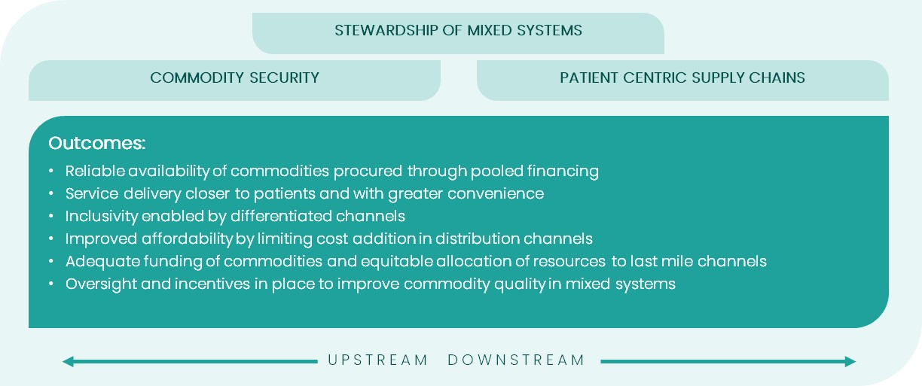
GFF Comparative Advantage exists downstream, and Developing Solutions across ‘whole of government’
Improving Access by developing patient-centric channels, leveraging private sector
Commodity Security through sector-wide Supply/Demand transparency and DRM
Investing in Stewardship Capabilities of Mixed Systems, linking up- and downstream elements
Notes:
Stewardship Capabilities are what link the Down and Upstream parts of the supply chain, and have been under-invested.

Slide 8









CS&C inputs: Tools and activities
STEWARDSHIP OF MIXED SYSTEMS
Formalize the Supply Chain Leaders Forum (LMIC Community of Practice)
Analyze procurement and distribution channels (PDC) for RMNCAH-N commodities in mixed SC systems
Assess supply chain maturity
Build capabilities to address stockouts and employ cost-effective distribution
COMMODITY SECURITY
PATIENT CENTRIC SUPPLY CHAINS
Catalyze DRUM and On-budget funding to finance commodities
Build HR diagnostic and investment capacity to manage mixed SC systems
Build commodity resource mapping and expenditure tracking capabilities
Landscape private sector SC innovators and hurdles to scale
Expand RHSC role as RMNCAH-N Observatory and increase scope of SC Planning VAN to MCH commodities
Develop private sector investment mechanisms to support mixed SC systems
UPSTREAM DOWNSTREAM

Slide 9
CS&C inputs: Tools and activities
STEWARDSHIP OF MIXED SYSTEMS
Formalize the Supply Chain Leaders Forum (LMIC Community of Practice)
Analyze procurement and distribution channels (PDC) for RMNCAH-N commodities in mixed SC systems
Assess supply chain maturity
Build capabilities to address stockouts and employ cost-effective distribution
COMMODITY SECURITY
PATIENT CENTRIC SUPPLY CHAINS
Catalyze DRUM and On-budget funding to finance commodities
Build HR diagnostic and investment capacity to manage mixed SC systems
Build commodity resource mapping and expenditure tracking capabilities
Landscape private sector SC innovators and hurdles to scale
Expand RHSC role as RMNCAH-N Observatory and increase scope of SC Planning VAN to MCH commodities
Develop private sector investment mechanisms to support mixed SC systems
UPSTREAM DOWNSTREAM

Slide 10
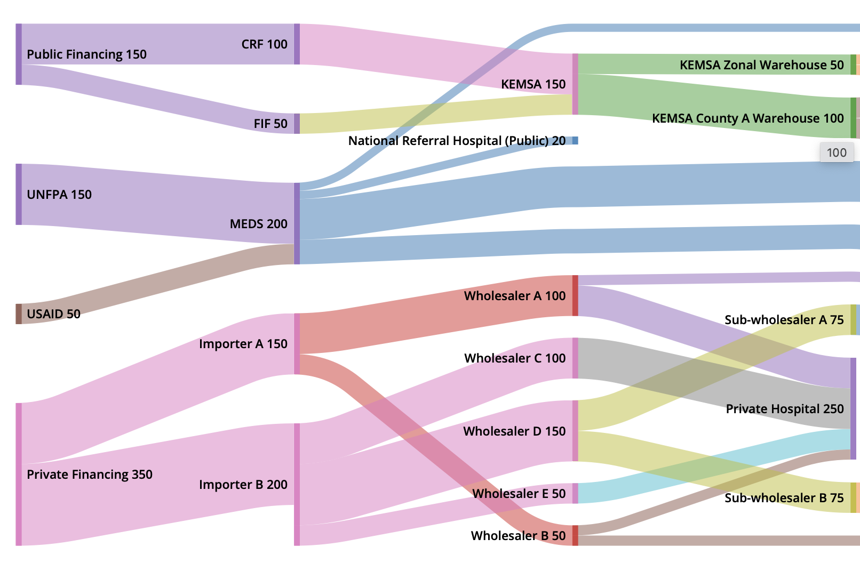



Access PDC - Theory of Change
Problem
Access PDC Analysis
Goal
Mixed Supply Chain System
Mixed Supply Chain System
"You cannot fix what you cannot see"
Equitably available, quality, affordable medicines
Public and private sector procurement and distribution channel dynamics are not optimally performing to deliver life-saving products.
Access PDC seeks to understand channel dynamics to determine where mixed system interventions and investments are required to address identified challenges
Outputs:
Report with findings and prioritized interventions for increasing access to RMNCAH-N commodities
Advocacy tools to support shaping investments

Slide 11

Understanding Procurement and Distribution Channels (PDCs)
Mapping will clarify decision-making, incentives and the enabling environment that facilitates or constrains product access – looking at flows of product, finance and information
PDC Mapping
Procurement and Distribution Channel & Nodes
End User
Financier
Procurer
Importer/
Supplier
Point of Delivery
Distributor
Wholesaler/
Sub-Wholesaler
Storage/
Warehouse
Point of Care
Product Flows (across the various permutations of public & private channels)
Financing Flows (e.g., Sources: Donors, Basic Drug Healthcare Provision Fund, Drug Revolving Funds, Free MNCH- from state budget, etc.)
Information Flows
Demand Analysis
Capturing community perspective on preferred channels to access products

Slide 12
CS&C inputs: Tools and activities
STEWARDSHIP OF MIXED SYSTEMS
Formalize the Supply Chain Leaders Forum (LMIC Community of Practice)
Analyze procurement and distribution channels (PDC) for RMNCAH-N commodities in mixed SC systems
Assess supply chain maturity
Build capabilities to address stockouts and employ cost-effective distribution
COMMODITY SECURITY
PATIENT CENTRIC SUPPLY CHAINS
Catalyze DRUM and On-budget funding to finance commodities
Build HR diagnostic and investment capacity to manage mixed SC systems
Build commodity resource mapping and expenditure tracking capabilities
Landscape private sector SC innovators and hurdles to scale
Expand RHSC role as RMNCAH-N Observatory and increase scope of SC Planning VAN to MCH commodities
Develop private sector investment mechanisms to support mixed SC systems
UPSTREAM DOWNSTREAM

Slide 13

FASTR Supply Chain Root Cause Analysis (RCA)
RCA Leverages existing FASTR governance within countries to test a new approach to diagnosing commodity availability challenges at sub-national levels in public facilities.
Challenge
Solution
Project Objectives
Challenges persist with commodity availability in the public sector, as highlighted by the FASTR Facility Survey.
Commodity availability depends on multiple, interconnected factors.
The FASTR Root Cause project aims to leverage FASTR data & supplementary interviews to identify and diagnose public health supply chain challenges, empowering local teams to implement preventative interventions effectively.
Validate a methodology for collecting and analyzing RCA data from sub-national supply chains.
Empower local government stakeholders with a pramatic tool to generate longitudinal evidence about supply chain challenges, in order to take preventative action and direct resources for maximum impact.
Notes:
Bhavya to present –
I’m going to provide a quick refresher of the rationale for piloting and refining the root cause analysis approach within the FASTR survey.
Our motivation for this root cause analysis work came from the fact that we know the FASTR survey allows us to see when stockouts are happening. We’re also aware, especially in the current climate, that challenges exist with commodity availability due to poor supply chain performance. However, commodity availability typically is the result of dozens of supply chain processes working well enough to bring a commodity to the last mile. Often data visibility is too limited to be able to predict and anticipate supply chain failures, so we only know something has gone wrong once a stockout has occurred.
Through this we work, we are going to be piloting a root cause analysis approach to help identify the causes of sub-national stock-outs and equip governments to take preventative action to resolve causes of supply chain failure.
We’re piloting this work in two countries, starting with Madagascar. To-date, stakeholders in both countries have been engaged, and as you’ll see later in the presentation, the work in Madagascar is progressing quickly and aiming to leverage the next data collection round in May.

Slide 14
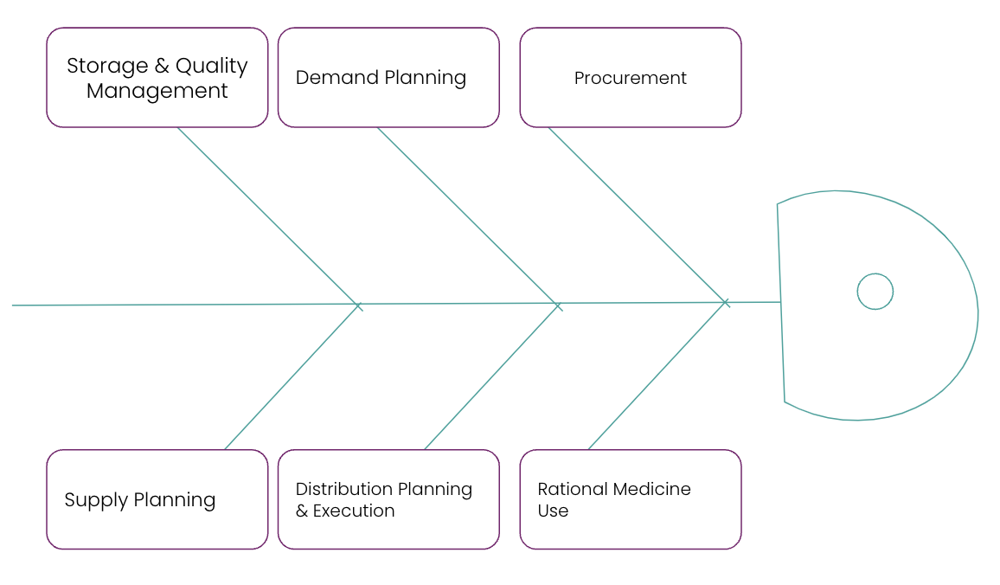
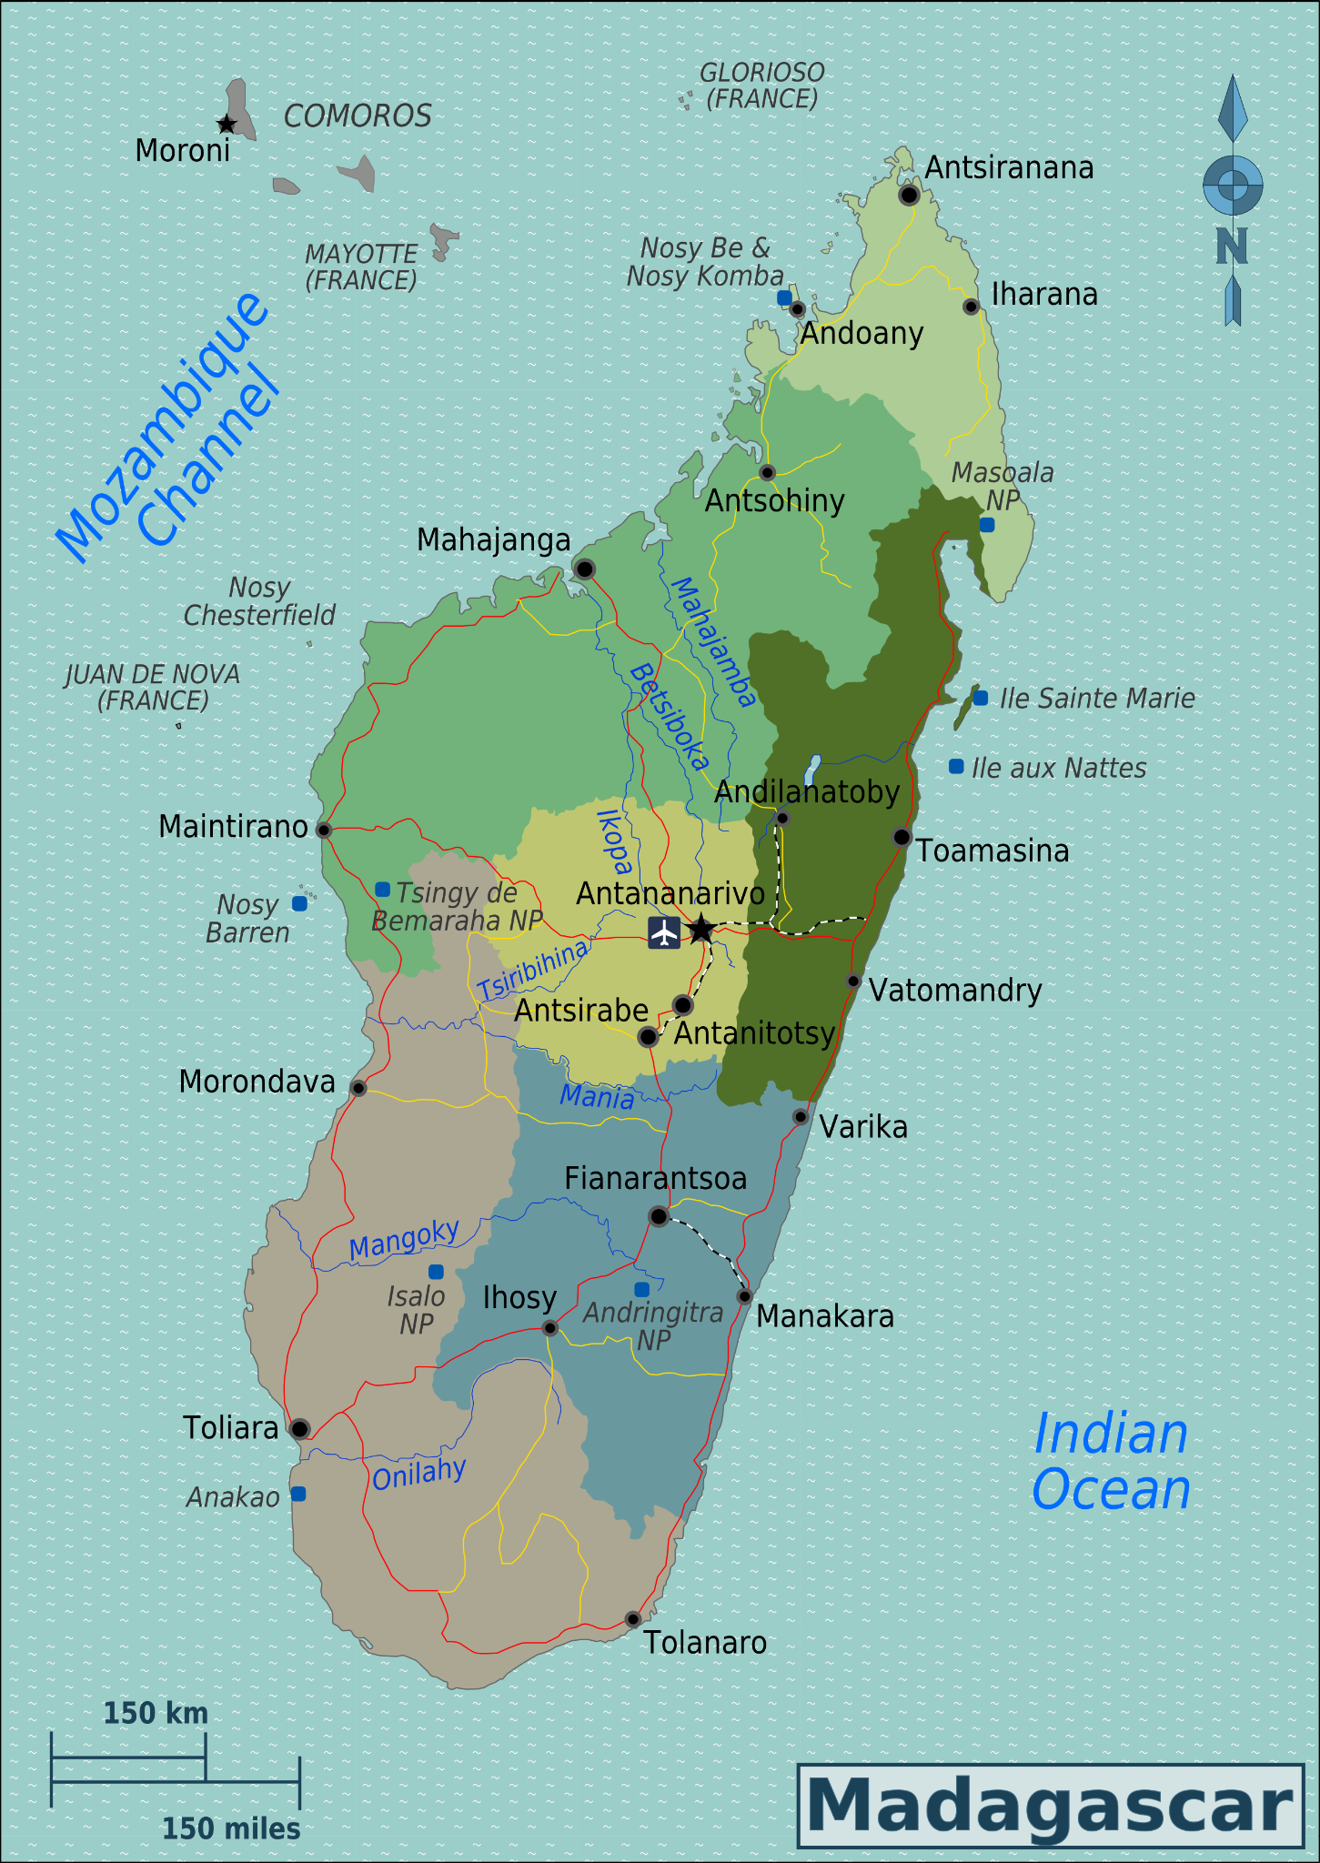


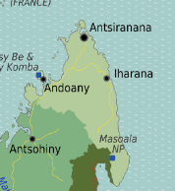
Illustrative Root-Cause Analysis Flow
During FASTR survey data collection, stock-out events will be reported, and supplementary data collection from higher supply chain nodes will confirm the root cause data
Facility level root-cause analysis
Root cause at facility level? Y/N
If N, identify stakeholder to engage, and move upstream to identify challenge
District level root-cause analysis
Cause at district level? Y/N
If Y close and document if N, identify stakeholder to engage, and move upstream to identify challenge
Region level root-cause analysis
Cause at region? Y/N
If Y close and document if N, identify stakeholder to engage, and move upstream to identify challenge
Notes:
Olivier to present:
To quickly zoom ahead, these next two slides illustrate the picture of the supply chain we aspire to generate during the data collection rounds in Madagascar, kicking off with the next round starting in May. Where possible, we aim to identify the root causes of stock-outs by tracing issues to their origins at higher supply chain nodes.
In the first data collection round, we will learn a lot through trial and error about data availability at higher supply chain nodes, particularly in terms of record keeping and human resource availability. We will use this to inform the goals of future data collection rounds.

Slide 15
CS&C inputs: Tools and activities
STEWARDSHIP OF MIXED SYSTEMS
Formalize the Supply Chain Leaders Forum (LMIC Community of Practice)
Analyze procurement and distribution channels (PDC) for RMNCAH-N commodities in mixed SC systems
Assess supply chain maturity
Build capabilities to address stockouts and employ cost-effective distribution
COMMODITY SECURITY
PATIENT CENTRIC SUPPLY CHAINS
Catalyze DRUM and On-budget funding to finance commodities
Build HR diagnostic and investment capacity to manage mixed SC systems
Build commodity resource mapping and expenditure tracking capabilities
Landscape private sector SC innovators and hurdles to scale
Expand RHSC role as RMNCAH-N Observatory and increase scope of SC Planning VAN to MCH commodities
Develop private sector investment mechanisms to support mixed SC systems
UPSTREAM DOWNSTREAM

Slide 16
Incentivizing DRM and on-budget commodity FINANCING
By drawing on the combination of GFF grant financing and World Bank/IDA concessional financing, countries will have more flexible resources to address their needs
Leverage DLIs/ DLR to encourage Governments to put in sufficient resources for commodities
Domestic procurement values geared from 2:1 against grant disbursements.
Additional DLRs focus on front-line availability or use
Examples: Mozambique, Nigeria, Ethiopia
Funding Leverage backed with SC system strengthening support to help ensure commodities are procured and managed adequately
Attract more donors into
on-budget funding pools as Governments commitment is a guarantee to sustainability
GFF can act as a vehicle for brokering agreements (e.g. through DLI’s in WB Operations) that encourage countries towards more Domestic Resource Mobilisation for Commodity Procurement
Example: FCDO and CIFF are co-financing on budget with the WB in Nigeria for Family Planning
Linking Downstream and Upstream Actvities: As we develop this approach we will explore how procurements are planned and executed and identify whether DLRs can be linked to procurement of quality commodities and accurate quantification and cross-programme resource allocation
Notes:
Nigeria example : The operation in Nigeria for example has CIFF putting in $12.5m, USAID putting in $12.5m, GFF /WB putting in $12.5m and then G.O. Nigeria are supposed to raise $25m – linked to a DLI for commodity resourcing
This is the topic of collaboration with UNFPA on Data Use, Procurement, Quantification and PFM Advocacy

Slide 17
CS&C inputs: Tools and activities
STEWARDSHIP OF MIXED SYSTEMS
Formalize the Supply Chain Leaders Forum (LMIC Community of Practice)
Analyze procurement and distribution channels (PDC) for RMNCAH-N commodities in mixed SC systems
Assess supply chain maturity
Build capabilities to address stockouts and employ cost-effective distribution
COMMODITY SECURITY
PATIENT CENTRIC SUPPLY CHAINS
Catalyze DRUM and On-budget funding to finance commodities
Build HR diagnostic and investment capacity to manage mixed SC systems
Build commodity resource mapping and expenditure tracking capabilities
Landscape private sector SC innovators and hurdles to scale
Expand RHSC role as RMNCAH-N Observatory and increase scope of SC Planning VAN to MCH commodities
Develop private sector investment mechanisms to support mixed SC systems
UPSTREAM DOWNSTREAM

Slide 18
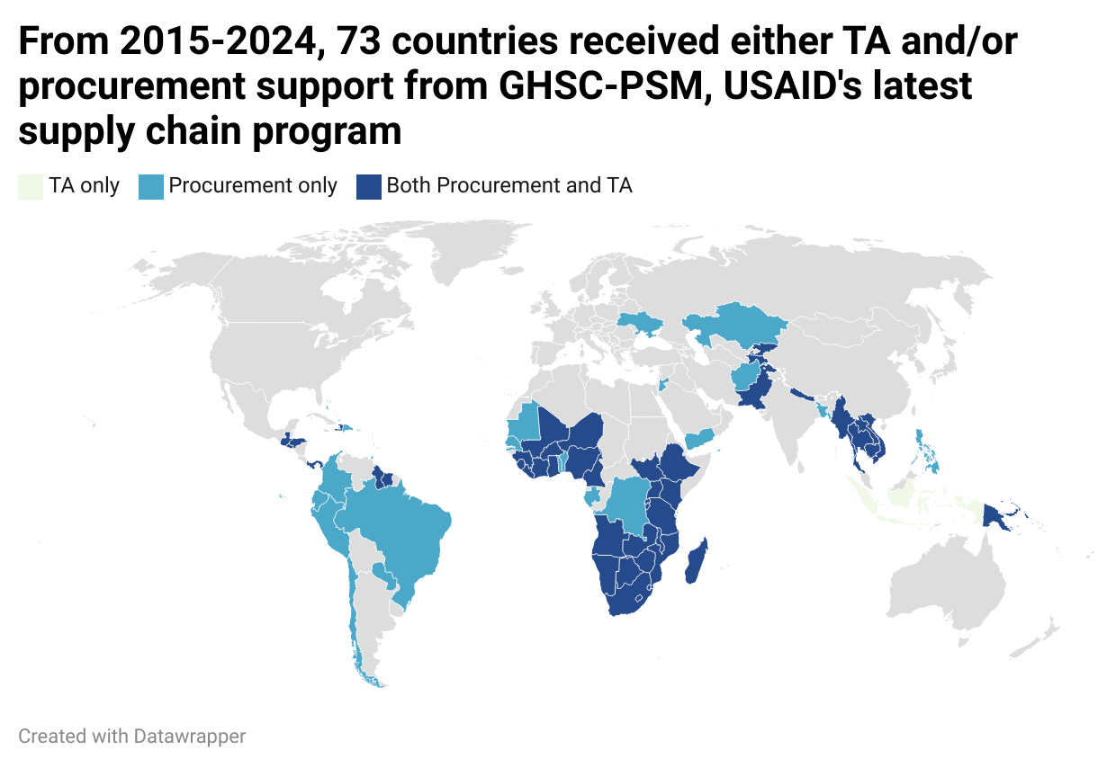
Disruption Analysis
Withdrawal of USAID support to Supply Chain impacts Technical Assistance for Supply Chain Management as well as Commodity Financing
Country | USAID SC Funding (FY23 & 24 average, millions USD) | USAID SC funding as % Domestic GGHE | Debt Distress Status
Haiti | 23.7 | 37% | High
Burundi | 11.3 | 18% | High
Malawi | 19.7 | 18% | Distress
DRC | 71.7 | 16% | Moderate
Mozambique | 73.7 | 15% | High
Tanzania | 96.2 | 13% | Moderate
Liberia | 6.2 | 12% | High
Zambia | 83.9 | 11% | Distress
Zimbabwe | 36.2 | 10% | Distress
Benin | 7.5 | 8% | Moderate

Slide 19
The majority of USAID’s Technical support has been managed from Washington DC
Action is needed to address the dependency on USAID technical assistance. Against the backdrop of fiscal shock the need to allocate resources and plan the supply chain is acute
Plan
Procure
Market intelligence
Product selection
Forecasting
Tendering
Price negotiation & contract
Ordering
Purchasing
Pooled purchasing advantage
Pooled purchasing advantage
Reliance on local project TA
Pooled purchasing advantage
Pooled purchasing advantage
Project TA informs quantity & dates needed
Committed funds on behalf of countries & dates & quantities
Deliver
Delivery at port of entry
Storage
Distribution
Pick up from suppliers,
Delivery to the port of entry
Clearance from port of entry
Delivery to storage site
Donor dependence on operating costs for warehousing
Regional distribution centers
Purchasing of new vehicles
Route optimization software
Managed centrally (Washington DC)
Hybrid
Managed locally: predominantly through project-based or Mission staff

Slide 20
Systemic Impact of USG Funding Interruptions on Global Health Commodities and Supply Chains
Global health agencies are struggling to safeguard program specific mandates. Meanwhile countries will grapple with cross-program prioritization amidst shrinking fiscal space.
MCH and Essential Medicines are likely to be at substantial risk of budget ‘cannibalization’
GFF countries were disproportionately affected:*
Of the $149M USAID FP commodity spend (2022–2024), 97% ($144M) went to GFF-supported countries, severely disrupting contraceptive access in priority geographies like Mozambique, Tanzania, and Madagascar.
Overall funding inevitably reduced:
Reduced fiscal space will drive re-engineering of service packages and country-level cross-program prioritization.
RMNCH&N, NCDs and other Essential Medicines, which are likely to be displaced in order to protect previously donor-driven priority programs (HTM).
Poor Demand & Supply Planning Compounds Disruption:
The interruption of SC TA will inevitably result in reduced planning capacity. Poor demand and supply planning leads to misaligned procurement, overstocking of low-priority commodities, and stockouts of essential ones, ultimately eroding service continuity and undermining trust in public health systems.
Source: RMET Expert Review Deck (Internal)
Notes:
GHI’s unable to collaborate on a narrowly-scoped X-Programme SP intervention... but there may be more chance of orchestrating collaboration if we broaden the scope... unusual
Comment on the issue of ‘Country Prioritization’ – Should GFF focus on those countries with biggest FP impact, for example, or those countries with greatest overall fiscal shock?

Slide 21
Connecting Financing to Delivery: GFF’s Unique Role in Sustaining Country Resilience
The GFF’s comparative advantage is helping countries link fiscal prioritization with supply chain decisions that maintain access, through RMET, HRT, PFM reforms and interoperable data
Challenge | GFF Comparative Advantage
Lack of real-time financial visibility | RMET & HRT as a platform to track fragmented resource flows (by program, source, execution status)
Weak links between budgets & SC delivery | Use of RMET to connect financing → procurement → service coverage
Parallel program views | Use finance data to support cross-programmatic prioritization (e.g. FP vs HIV vs MNCH)
Unclear, or implicit trade-off decisions | Financing data enables program valuation (normative cost, coverage, quality impact)
Fragmented data systems | GFF supports country-owned, interoperable digital systems to reduce duplication and increase sustainability
RMET & HRT
Cross-Program Planning
Commodity Prioritization
Coordinated Procurement
Sustained Access

Slide 22




Integrating C&SC into GFF Three-Pronged Approach
The GFF should deploy a coordinated C&SC strategy that aligns financial tracking, service availability monitoring, with supply chain planning at country level. This aligns with the existing GFF three-pronged approach for country disruption response engagement.
RMET, C&SC HRT: Enables integration of Public Financial Management (PFM) and supply chain planning workflows, providing end-to-end visibility of resource flows and operational decisions across programs. → Contract vehicle: HRT Project
FASTR: Disruption Analysis & Root Cause Assessment (RCA) Delivers visibility into supply chain disruptions and diagnostic insights through structured root cause analysis, enabling evidence-based corrective actions. → Enabled by: FASTR RCA Project
Prioritization & Supply Chain Planning Supports country-level decisions on which programs and products to protect, using integrated, cross-program supply planning tools → Confirming Investment Case for Global FP VAN
RMET + C&SC HRT
FASTR Disruption & RCA
RHSC + TA
Prioritization & SC Planning

Slide 23


CGD ‘Nexus’ Working Group
This new working group brings together Health Financing and Supply Chain experts to guide research on a range of interconnected issues
Recent Key Takeaways:
Must distinguish Commodity Financing and SC Financing and fund the supply chain
  >50% of Supply Chain cost is Distribution (Senegal)
Budget Under-execution in LIC’s averages 87%
  Highly variable for Commodities
  Less variable for Salaries
Tension between Centralisation and Decentralisation:
  Drug prices (China) found to reduce 24-72% once Centralised
  22 Steps and 4 branches of government in the PFM process to pay a Supplier (Sierra Leone)
Stewardship Capabilities:
‘De-verticalize’ and facilitate x-program prioritization
Integrate HF/PFM and SC for ownership & accountability
Digitize transactions to connect downstream and upstream analysis
Analytics to permit ‘What if?’ Analysis & Cost Effectiveness Trade-offs wrt SC Channels
These capabilities require investments across People, Process, Technology and Policy

Slide 24
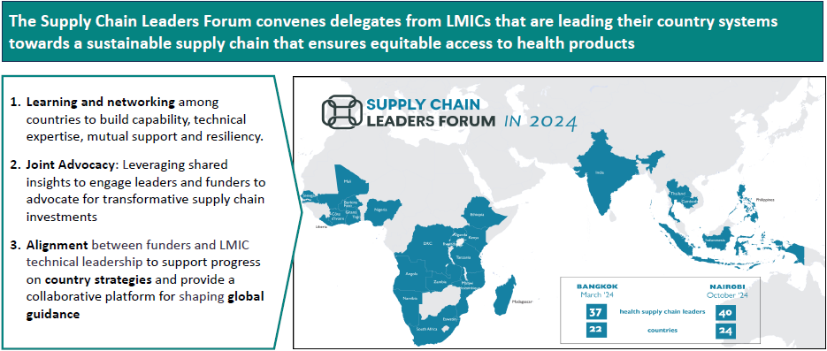
Supply chain leaders forum (SCLF)
There is an urgent need for an ‘entry point’ to discuss and influence supply chain stewardship concerns as a counterbalance to program-specific discussions

Slide 25
Progress and Next Steps for Discussion

Slide 26
Building and scaling out C&SC tools & Activities
Currently Deployed:
Analyze procurement and distribution channels (PDC) for RMNCAH-N commodities in mixed SC systems
Countries Engaged:
Build capabilities to address stockouts and employ cost-effective distribution
BETF Only
Landscape private sector SC innovators and hurdles to scale
AFGHANISTAN*
BETF + RETF
FASTR Root Cause
Access PDC
Almost there !
GUINEA
CAMBODIA
SIERRA LEONE
ETHIOPIA*
Challenge Fund
COTE D’IVOIRE
NIGERIA*
SOMALIA*
Formalize the Supply Chain Leaders Forum (LMIC Community of Practice)
KENYA
DRC*
TANZANIA
In Development:
MADAGASCAR
Future Work:
MOZAMBIQUE*
Catalyze DRUM and On-budget funding to finance commodities
Build HR diagnostic and investment capacity to manage mixed SC systems
Build commodity resource mapping and expenditure tracking capabilities
Assess supply chain maturity
Expand RHSC role as RMNCAH-N Observatory and increase scope of SC Planning VAN to MCH commodities
Develop private sector investment mechanisms to support mixed SC systems
Notes:
NB Camilas Work

Slide 27
Next Steps & Discussion
Tools and Technical Assistance that is relevant to our clients
Plan to deliver alongside our partners – old and new
Contracting service providers to support us on this mission
Elements to Deliver on this
Better linkage to customers both inside and outside the SCLF (supply chain leaders forum)
  Guidance to FPs and Los on how to engage with SC TWG’s at country level
  Interlock with GFF’s CES (Country Engagement Strategy) process and IDA pipeline
Build out partnerships (Revitalize the PSISC partnership? – ‘Private Sector Innovations for Supply Chain’)
Build out a service provider network – Re-examine a Framework procurement approach based on CF demand?

Slide 28
Appendix

Slide 29
GFF Commodities and Supply Chain – Theory of Change
inputs
activities
outputs
intermediate outcomes
outcomes
impact
Procurement and Distribution Channels analysis (PDC) Tools for Mixed Systems Evaluation
STRENGTHEN COUNTRY PLATFORMS
Capacitate Country Platforms:
SC Performance Scorecards
Routine Equity Analysis
Stockout Root Cause Analysis
South-South Leaders Forum to Strengthen technical leadership and resource advocacy
Engagement of CSOs/NGOs to strengthen patient-centricity of policy and roadmaps
Government systems deliver improved analytics of equitable access & SC performance
Transparent Governance:
Multi-stakeholder domestic stewardship of commodity budget allocation and investment in patient-centric supply chains
Reduced Stockouts: Improved matching of demand & supply for all target channels
Increased service utilization
Commodity stockout root cause analysis (FASTR)
Government systems deliver Improved analytics of available resources and expenditure on commodities (RMET)
Equitable Funding to Last Mile Channels: Resources allocated to a mix of channels that improve patient-centricity
Reduced catastrophic health expenditure
Global guidance on Integrating PFM and Supply Chain data
& analytics
Government SC and PFM data integrated for evidence-based policy making on SC channel investment
Cost-Effective Supply Chains:
Functional mixed systems with differentiated channels for cost effective and inclusive RMNCAH-N service delivery
Proximity: Supply Chain supports commodity delivery closer to patients to reduce cost & time access barriers
SC System Maturity and HR Diagnostics
Government policy supports professionalization of SC management for mixed systems
TECHNICAL ASSISTANCE
Specialized Technical Assistance:
Maturity Assessments
SC Roadmaps
Mixed Systems approach
Investment Cases for Private Sector Leverage
More lives of mothers & children saved
Capacity diagnostic for private sector SC service providers
Government invest in differentiated channels to improve inclusive & equitable commodity access
Inclusivity: Supply Chain supports differentiated & inclusive service delivery points to reduce cultural access barriers
On-budget financing of commodity gaps and system strengthening
Government policy enables leverage of and partnering with private sector in mixed SC
Increased spacing of births
Private sector financing instruments to complement IDA
INFLUENCE/ALIGN FUNDERS
Influence / Align Funders:
Invest in capacity to assess country commodity funding gaps and funding transition
Leverage grant funding to catalyse on-budget support
System Strengthening
Technical alignment
Market Driven Cost and Quality Improvements:
Increased pooling of RMNCAH-N procurement (at National and Regional level) results in lower unit costs and price volatility, plus higher quality commodities
Quality: Incentives and Regulations influence markets to provide higher quality commodities
Private sector integrated into public sector delivery channels for agility and cost-effectiveness
Challenge Fund
Reduced stunting and wasting
GFF Integrated and influencing GHI SC Funders Forum & RMNCAH-N funding partnerships
Countries capacitated to manage commodity and SC service procurement with increasingly on-budget resources
Affordability: Reduced unit prices for governments, insurers and individuals

Slide 30
Key themes from 20+ years of USG’s global health supply chain programs
Fast growth
Increasing reliance on project staff
Shift in management from central (Washington HQ) to country
Focus on performance
Expand procurement to cover exponentially more commodities from FP to malaria, HIV and MCHN
Trained project staff to provide TA, procurement support or both to protect investments
Support projects directly where activities take place and optimize for local knowledge transfer and engagement
Implementation priorities reflected shifting USG policies from ‘AIDS Free generation’ and ‘malaria eradication’ to ‘Journey to self-reliance’,
Intention
Unintended consequences
Expanding operations to adhere to rules & regulations
High turn over rates because trained staff are incentivized to move to alternative higher paying jobs
Deprioritized focus on consolidating cross-country learnings has led to a dearth of available information about trends and comparisons over time
Limited focus on sustainability characterized by shifting goal posts;approaches to eliminate a disease may not necessarily be sustainable

Slide 31
USAID Supply Chain Funding Disruption
Top country recipients of USAID Supply Chain funding (averaged FY2023 Disbursement and FY2024 Obligation), as a percentage of Domestic General Government Health Expenditure
Country | USAID Supply Chain funding (FY2023 & 2024 average, millions USD) | Domestic GGHE (2022, millions USD) | USAID SC funding as % Domestic GGHE | World Bank Income Group (2023) | Debt Distress Status | Fragile/ Conflict-Afflicted
Haiti | 23.7 | 64 | 37% | LMIC | High | Fragile
Burundi | 11.3 | 62 | 18% | LIC | High | Fragile
Malawi | 19.7 | 110 | 18% | LIC | Distress | -
DRC | 71.7 | 459 | 16% | LIC | Moderate | Conflict
Mozambique | 73.7 | 498 | 15% | LIC | High | Conflict
Tanzania | 96.2 | 728 | 13% | LMIC | Moderate | -
Liberia | 6.2 | 51 | 12% | LIC | High | -
Zambia | 83.9 | 731 | 11% | LMIC | Distress | -
Zimbabwe | 36.2 | 369 | 10% | LMIC | Distress | Fragile
Benin | 7.5 | 90 | 8% | LMIC | Moderate | -
Notes:
Lots of central dependencies – to show what might be possible for a pooled procurement/coordinating platform on the continent
Indicates highest areas of risk without additional support

Slide 32
Achieving patient access requires spend in multiple categories; many more than commodity unit cost
Few LMIC countries have capability to aggregate / disaggregate the costs to deliver patient access and allocate adequate resource to activities along supply chains
Simplified Cost Addition Factors to Commodity Unit Cost:
Stewardship Hurdles:
Off budget spend
In-kind Donation
Inadequate PFM
Few PPP Examples
Delivery 'Duty Paid' to Country
Demmurage
Central Storage & Distribution
Storage
Sub-national Storage & Distribution
Facility Replenishment
HRH for Quantification
HRH for Supply Planning
HRH for Distribution
HRH for Order to Cash
15-30% of Unit Cost that must be properly allocated sub-nationally to achieve Availability
Investments in Stewardship:
Interoperable IT and ‘What If?’ Analytics
HR with competencies for contracting private sector
Governance and Policy for Enabling Public/Private Integration
In some countries a significant portion of this was off-budget USAID TA, but program-based budgeting can obscure true costs

Slide 33
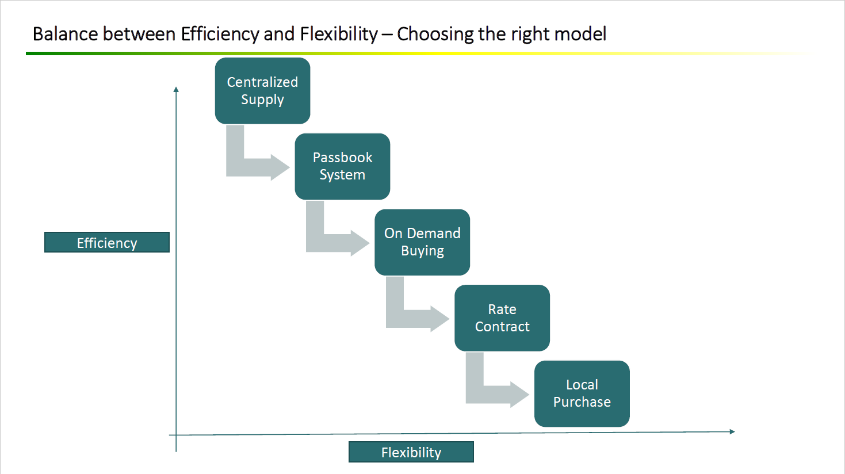

Slide 34



Consultation on next steps
Tools and Technical Assistance that is relevant to our clients
Plan to deliver alongside our partners – old and new
Contracting service providers to support us on this mission
Clients?
WB TTLs
SCLF
Donors
Governments and populations (Do CSO’s fit here?)
Partners?
GHA’s through the SCFF
IFC
CSOs
Private sector
Advisors
Co-investors
Service providers
R4D
RHSC
Other Service providers

