Slide 1
Kigoma MRH Program Overview
SUNDAY A. DOMINICO; M, MMED, FOG
DIRECTOR OF PROGRAMS (THAMINI UHAI)
PRESIDENT (AGOTA)

Slide 2

Outline
Overview of Kigoma MRH Program
Strategies
Select Results
Lessons learned
Program implications for Tanzania
Sustainability approaches

Slide 3
MRH PROGRAM OVERVIEW
By 2017, Program was on track to meet or surpass many of the targets established by the GoT
Over the following 2 years, efforts to sustain Program interventions intensified.
In April 2019, the Program fully transitioned to GOT oversight.
Aimed to improve and sustain the availability of, access to, and demand for high-quality MRH care services for rural communities.

Slide 4
Background
Conceived by Late Dr. Godfrey Mbaruku (RIP) in 2006, a Tanzanian obstetrician who served as a RMO in Kigoma
Proposed to decentralize lifesaving emergency obstetric care, traditionally offered in hospitals, to health centres that women could more readily access.
Through infrastructure improvements and building capacity of lower cadres

Slide 5
Why Kigoma
  Kigoma one of the most underserved regions at that time.
  Estimated population of 2.5m
  Reproductive and maternal health indicators below the national average
  Geographically challenged, remote, bordering Burundi and Congo with isolated communities along Lake Tanganyika
  One of the Lake and western zone regions prioritized by the national policies for RMNCAH

Slide 6









MRH Kigoma Partners

Slide 7
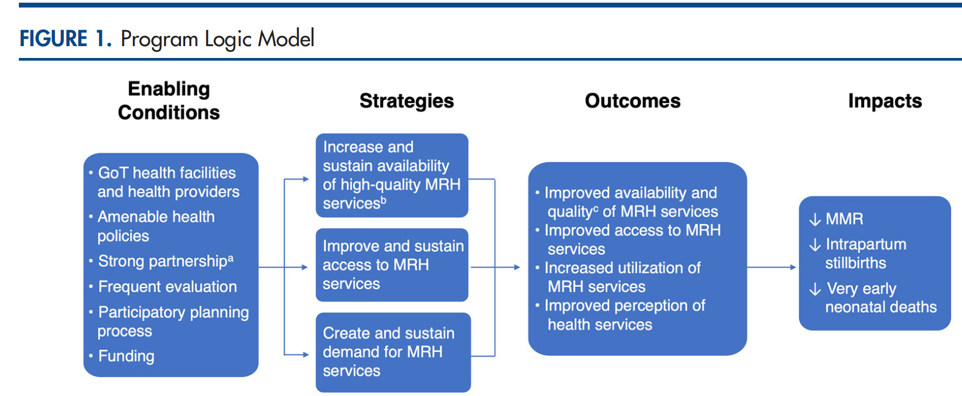
Logic model…

Slide 8
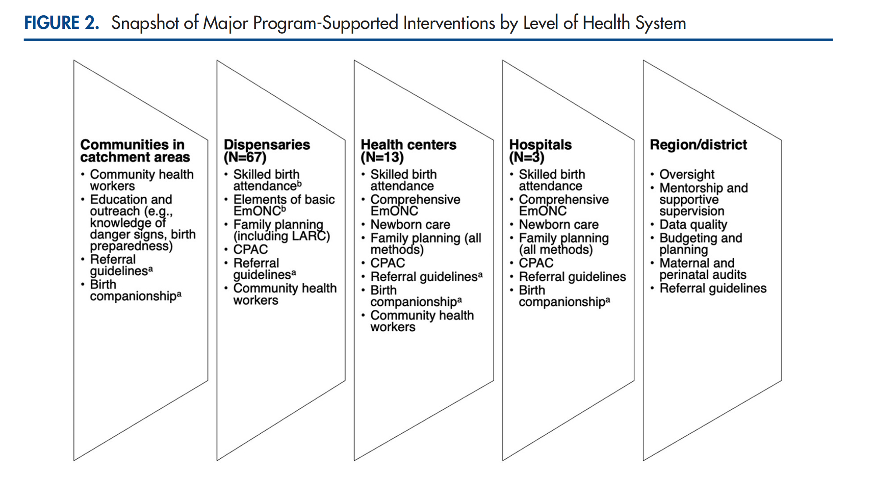

Slide 9
Strategies
Decentralize CEmONC from hospitals to health centres
Improve skilled birth attendance and BEmONC in dispensaries
Sustain availability of good-quality EmONC
Improve newborn care infrastructure and skills
Improve experience of intrapartum care through birth companionship (BC)
Strengthen referral systems
Increase demand for facility delivery and improve birth preparedness
Robust monitoring and evaluation
Advocacy and support for sustainability

Slide 10
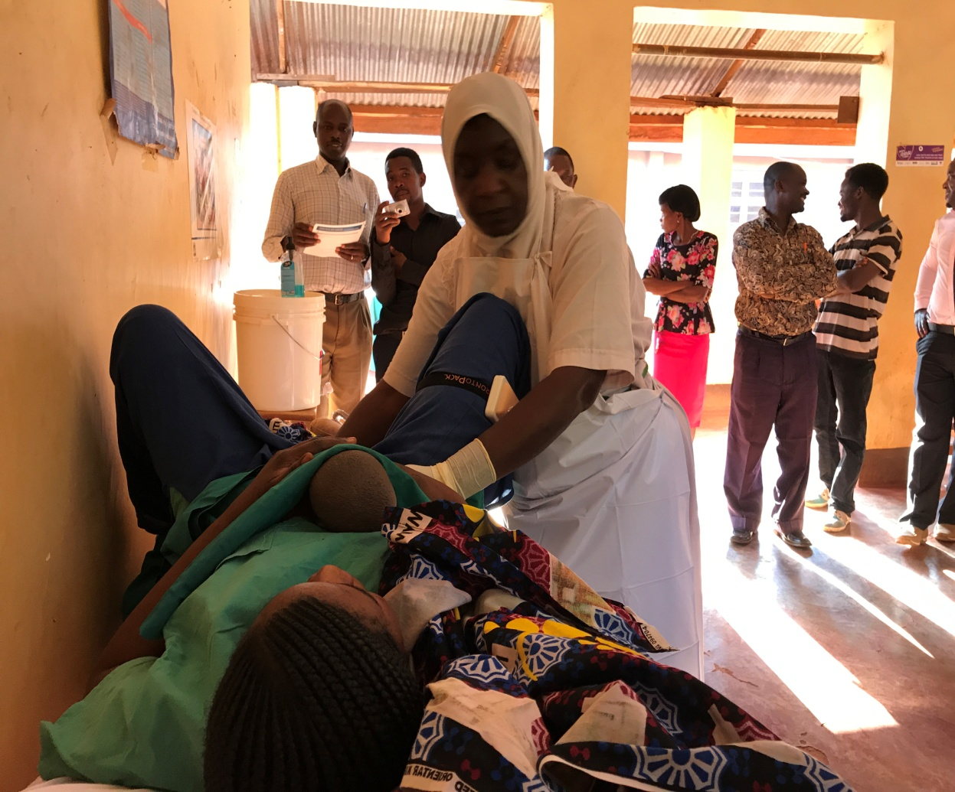

Sustaining good-quality EmONC
Skills-based trainings
Targeted in-person CMEs and eLearning
24/7 Emergency call tele support
Train to plan, budget, and manage resources and services
Weekly teleconferences and case reviews
Routine clinical audits and death reviews
Create/adapt and distribute job aids
Introduce new evidence-based clinical interventions
Recruit staff in extreme needs
Support life-saving commodities, including blood

Slide 11
Sustainability measures
Team with local health managers supervision and mentorship
Train a regional mentorship team
Strengthen capacity to plan, budget, manage, and support program interventions
Improve the quality and use of data for decision making

Slide 12
Sustainability…
Train technicians to repair biomedical equipment
Train regional and district council officials on MPDSR
Strengthen accountability for good-quality service delivery
Identify and support national level champions

Slide 13

Selected results

Slide 14
Availability of EmONC
12/13 upgraded health centers sustained performance of obstetrical surgery.
91%⬆
Notes:
The number of EmONC facilities in Kigoma increased by over 90%, going from 11 in 2013 to 21 in 2018.

Slide 15
Institutional delivery
85%
74%⬆
49%

Slide 16
Caesarean section rate
4.5%
2.6%
73%⬆

Slide 17
Met need for EmONC
61%
39%⬆
44%

Slide 18
Institutional MMR
43%⬇

Slide 19
Trend of MMR in Kigoma

Slide 20
Intrapartum stillbirth rate
Predischarge neonatal mortality rate
58%⬇
29%⬇

Slide 21
Lessons Learned
Multistakeholder partnerships are critical;
Demand creation for services, while critical, must rest on a foundation of well-functioning and high-quality clinical services
It is imperative to not only collect robust monitoring and evaluation data, but to be responsive in real time to what the data reveal; and
Developing a deliberate sustainability strategy from the start is necessary.
Embed the Program in the existing health system, build local capacity

Slide 22
Program Implications
Contributed to the Government of Tanzania’s goal of improving the availability and use of high-quality EmONC services in Kigoma
Demonstrated that decentralization of CEmONC is effective in contributing to a reduction in maternal and neonatal mortality
Shared at the BRN in 2014 , and played a key role in informing the Government of Tanzania’s decision to scale up CEmONC services

Slide 23

THANK YOU FOR LISTERNING

Slide 24
Sustainability of maternal and newborn health programs: what can we learn from Tanzania?
Florina Serbanescu, MD, MPH
CDC Foundation
Notes:
Reducing maternal and newborn mortality is a global priority. Because maternal and newborn health benefits may diminish or disappear after donor funding ends, assessing program sustainability is important to understand facilitators and barriers to maintaining services and positive outcomes. I am going to talk about the highlights from a sustainability evaluation conducted 4 years after a long- duration donor-supported Program to Reduce Maternal Deaths in TZ has ended.

Slide 25
Disclaimer
  Funding for this evaluation was provided by Bloomberg Philanthropies through a grant to the CDC Foundation. The content is solely the responsibility of the author and does not necessarily reflect the views of Bloomberg Philanthropies or the CDC Foundation.
  The author was formerly employed by the Centers for Disease Control and Prevention where this work was conducted and the presentation developed and now, she has transitioned to the CDC Foundation to continue the same type of work.

Slide 26
Background
Kigoma Region in Western Tanzania has some of the greatest needs for improving maternal/neonatal health services and outcomes.
Bloomberg Philanthropies funded a regional program in Kigoma to reduce maternal deaths during 2006–2018.
The Program to Reduce Maternal Deaths in Tanzania (2006–2018) promoted three broad strategies:
  To increase and sustain availability of high-quality maternal and reproductive health services.
  To improve and sustain access to maternal and reproductive health services.
  To create and sustain demand for maternal and reproductive health services.
In 2019, the donor support ended and the program was taken over by the Tanzania health authorities.
In 2022–2024, a sustainability evaluation was conducted.
Notes:
With a population of 2.3 million (5% of Tanzania’s total population in 2015), over 80% rural, Kigoma lagged behind the national average for facility-based births, delivery by cesarean section, and contraceptive use. Kigoma also had an extreme shortage of skilled health providers; in 2013, the density of skilled birth attendants (4.6 per 10,000 population),⁶ was nearly 10 times lower than the minimum recommended by the World Health Organization (44.5 per 10,000 population)
3 broad strategies…
Interventions supporting these strategies were implemented in and around the catchment areas of an increasing number of supported health facilities (the Program supported 3 out of 6 hospitals, 13 out of 27 health centers, and 67 out of 164 dispensaries by 2018
Tanzanian program partners Thamini Uhai and EngenderHealth implemented interventions such as upgrading facilities, including renovating and building surgical wards; supplying essential drugs and equipment for EmONC; increasing access to emergency obstetric care, including supporting timely referrals; staff retention; providing training and supportive supervision in EmONC and contraceptive technology; ensuring adequate contraceptive supplies; and supporting birth companionship and respectful care at birth in program-supported facilities. Since 2010, the United States Centers for Disease Control and Prevention, Division of Reproductive Health (CDC/DRH) collaborated as one of the Program’s partners by supporting the monitoring and evaluation activities.

Slide 27

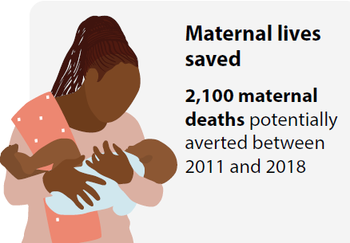
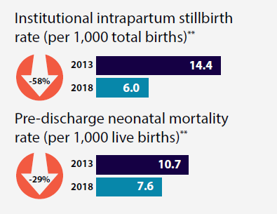
What Did the Program to Reduce Maternal Deaths in Tanzania Achieve?
Maternal Mortality Ratio
in health facilities declined
(2013-2018)
Estimated Maternal Deaths Averted through EmONC*
Perinatal Mortality in health facilities declined (2013-2018)
303
-43%*
174
* EmONC = Emergency Obstetric and Neonatal Care
** P=<0.05
MMR = number of maternal deaths per 100,000 live births
* P=<0.01

Slide 28
What is Sustainability?
Program sustainability has been often defined as:
“the continued use of program components and activities [at sufficient intensity] for the continued achievement of desirable program and population outcomes”ª
Facilitators of program sustainability include:
program’s duration,
early planning,
resources needed to continue program’s core strategies,
program’s capacity to maintain services and scale-up, and
integration into the national health planning.
ª Scheirer MA, Dearing JW. An agenda for research on the sustainability of public health programs. Am J Public Health 2011;101(11):2059-67. doi: 10.2105/AJPH.2011.300193

Slide 29


Sustainability Evaluation Objectives
The evaluation measured the sustainability of:
  Emergency Obstetric and Neonatal Care (EmONC) life-saving interventions implemented during the Program
Obstetric care and maternal and newborn health benefits 4 years after the end of external funding and transition to the regional authorities.

Slide 30
Study Design
The evaluation measured program sustainability in all 202 Kigoma health facilities using primarily 3 methods:
  Health facility assessments to assess status of routine and emergency obstetric and neonatal care (EmONC)
  Pregnancy outcome monitoring to enumerate all individual birth records during 2019–2022 (over 336,000 records were extracted and triangulated)
  Rapid Ascertainment Process of Institutional Deaths (RAPID) methodology to extract, verify, and triangulate data on maternal and perinatal deaths from all available sources (e.g., patient records, birth registers, nurses’ notebooks, morgue) during 2019–2022
These were the same methods used to document the Program’s accomplishments in 2019 at the program closing

Slide 31

Number of EmONC Facilities Continued to Increase
21
27
+29%
2019 Health Facility Assessment
2023 Health Facility Assessment

Slide 32
Performance of Emergency Obstetric Care
All Health Facilities
EmONC Life-saving Interventions | 2019 | 2023 | % Change
Administer parenteral antibiotics | 99.5% | 100% | + 0.5%
Administer parenteral oxytocin | 100% | 100% | 0.0%
Administer parenteral anti-convulsants | 92.9% | 93.6% | + 0.8%
Perform manual removal of the placenta | 10.7% | 15.3% | + 43.0%
Perform procedure for removing retained products of conception | 58.9% | 74.3% | + 26.1%*
Perform vacuum-assisted delivery/assisted vaginal delivery | 6.1% | 9.9% | + 62.3%*
Perform neonatal resuscitation with bag and mask | 80.7% | 84.7% | + 5.0%
Perform cesarean section surgery: hospitals | 100% | 100% | 0.0%
Perform cesarean section surgery: health centers | 55.6% | 82.8% | + 48.9%*
Perform blood transfusion: hospitals | 100% | 100% | 0.0%
Perform blood transfusion: health centers | 59.3% | 89.7% | + 51.3%*
Performance during the previous 3 months preceding the assessment. While the EmONC assessments were conducted in early 2019 and 2023, respectively,
the status extends to the end of the preceding years (2018 and 2022)
Asterisks indicate significance at P<0.05 level

Slide 33
Selected Pregnancy Outcomes
Indicator | 2018 | 2022 | % Change
Maternal Health
Institutional delivery rate | 84.9% | 97.8% | + 15.2%*
Met need for emergency obstetric care | 61.3% | 84.3% | + 37.5%*
Population-based cesarean section rate | 4.5% | 7.6% | + 68.9%*
Direct obstetric case fatality rate | 1.4% | 1.1% | - 21.4%*
Maternal mortality ratio—All facilities | 174 | 145 | - 16.7%
Maternal mortality ratio—EmONC facilities | 378 | 283 | - 25.1%*
Perinatal Health
Institutional total stillbirth rate (per 1,000 births) | 12.8 | 11.2 | - 12.5%*
Pre-discharge neonatal mortality rate (per 1,000 live births) | 7.6 | 5.7 | - 25.0%*
Institutional perinatal mortality rate (per 1,000 births) | 20.3 | 16.8 | - 17.2%*
Asterisks indicate significance at P<0.05 level

Slide 34


Conclusion
EmONC lifesaving interventions continued to be maintained, and obstetric care and maternal and newborn health outcomes improved in Kigoma after the Program ended, demonstrating that program gains can be sustained.
Lessons learned from Tanzania can inform program sustainability where similar approaches are used to reduce preventable maternal and newborn deaths.

Slide 35
Thank You!

Slide 36
Replication and scale up : Government of Tanzania and Thamini Uhai)

Slide 37

Outline
Tanzania Government Scale-up efforts
Achievements
Persistent challenges
Thamini Uhai Scale-up Program

Slide 38
Leadership, Governance, Policies and Accountability
Strong national frameworks: One Plan III, HSSP V, NSOAP, BRN, Star Rating, RBP
Nationwide MPDSR institutionalized and linked with DHIS2 since 2018
Routine national and regional performance reviews (MTR 2026)
Strengthened governance across national, regional and council levels
Data-driven decision making with improved feedback loops

Slide 39

Service Delivery and Infrastructure
Health facilities increased: 8,458 (2020) → 9,366 (2023)
Health centres: 926 → 1,126
  CEmONC health centres from < 100 to 600+
Hospitals: 369 → 436
>1,700 primary facilities constructed/upgraded
CEmONC availability: 54% of health centres, 88% of hospitals (2023)
Expanded theatres, maternity and newborn care units

Slide 40
Health Workforce
>7,500 nurses and midwives recruited (2015–2024)
Training enrolment expanded from 6,400 to >18,500 annually (2015–2022), driven by the scale-up of pre-service training across all clinical cadres to address HRH shortages.
National EmONC training, CPD, simulation and e-learning scale-up
Mentorship, virtual reviews and rural deployment incentives

Slide 41
Commodities, Referral Systems and Access
Medicines budget: TZS 31B → TZS 269B (2015–2019)
Improved availability: oxytocin, MgSO4, TXA, antibiotics
Strengthened MSD supply chain and logistics systems
m-mama scaled nationally across all regions
>200,000 emergency referrals completed
Digital dispatch, community transport and mobile payment integration

Slide 43
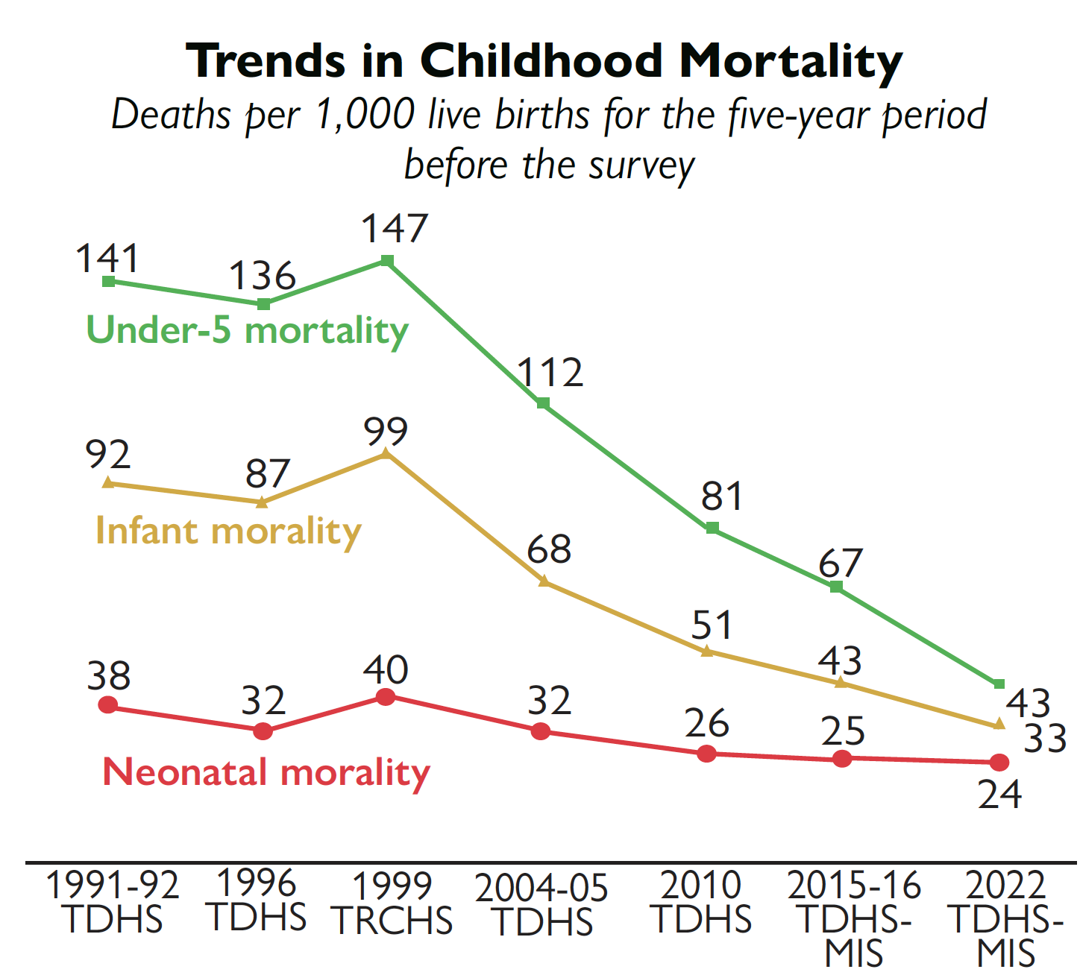
Trend in child mortality(TDHS)

Slide 44

Tanzania’s Continental Leadership in RMNCAH (AU Champion, 2026)
H.E. President Samia Suluhu Hassan appointed AU Champion for RMNCAH, SRHR and Gender
Recognition of Tanzania’s progress in expanding CEmONC access, strengthening health systems, and reducing MMR
Continental leadership mandate to drive coordination, advocacy, and accountability across AU Member States
Strategic opportunity to shape regional priorities on quality of care, health financing, and system strengthening
Elevates Tanzania’s global positioning as a credible platform for scaled investment, partnerships, and innovation aligned with Agenda 2063

Slide 45
HE President recognized By Goalkeepers Award in February 2025

Slide 46
Persistent Challenges
93.1% of maternal deaths occur in health facilities; 92% linked to delays in receiving care
85% of deaths due to direct causes: haemorrhage (47%), pre-eclampsia/eclampsia (14%), sepsis (6.8%)
Anaemia in pregnancy 56% , Severe anaemia contributes 7% of maternal deaths
Only 54% of health centres provide CEmONC; only 39% dispensaries provide full BEmONC signal functions
Critical readiness gaps: anaesthesia (21%), blood availability (56%),
Highly variable C-section rates: Average 11%, < 2% to 33%

Slide 47

Challenges…
Fresh stillbirths account for ~46%, indicating intrapartum care gaps
80% of neonatal deaths due to preventable causes (asphyxia, prematurity, infections)
Early neonatal deaths contribute 87% of total neonatal mortality
Mismatch between service coverage and readiness
Persistent regional disparities in outcomes and service readiness

Slide 48
Project Title | Improving Maternal and Newborn Health through Strengthening ANC, intrapartum care, EmONC and Care of Small and Sick Newborns in Tanzania
Proposed Program name | Partnership Program for Comprehensive and Integrated Maternal and Newborn Health Improvement in Tanzania Short form: Partnership for Maternal and Newborn Health in Tanzania(PMNH-Tz)
Swahili name | Thamini Uhai – Mjamzito na Mtoto Salama
Start Date and End Date | 5 Years Timeline (September 2025 to June 2030)
Key GOT Stakeholders | National Leadership: MoH, PMO-RALG, Regional Oversight: RHMT & CHMTs
Geographical Coverage | Geita, Katavi , Kigoma Health Facilities: 164 HFs (3 RRH 15 DH; 42 HCs and 104 dispensaries)
Funding Sources | Bloomberg Philanthropies and the Gates Foundation ($ 12,150,000)
BP-Supported Interventions | Quality and respectful EmONC, MoH Technical Support and MERL
GF-Supported Interventions | Care of small and sick, PPH Care bundle and Quality ANC

Slide 49
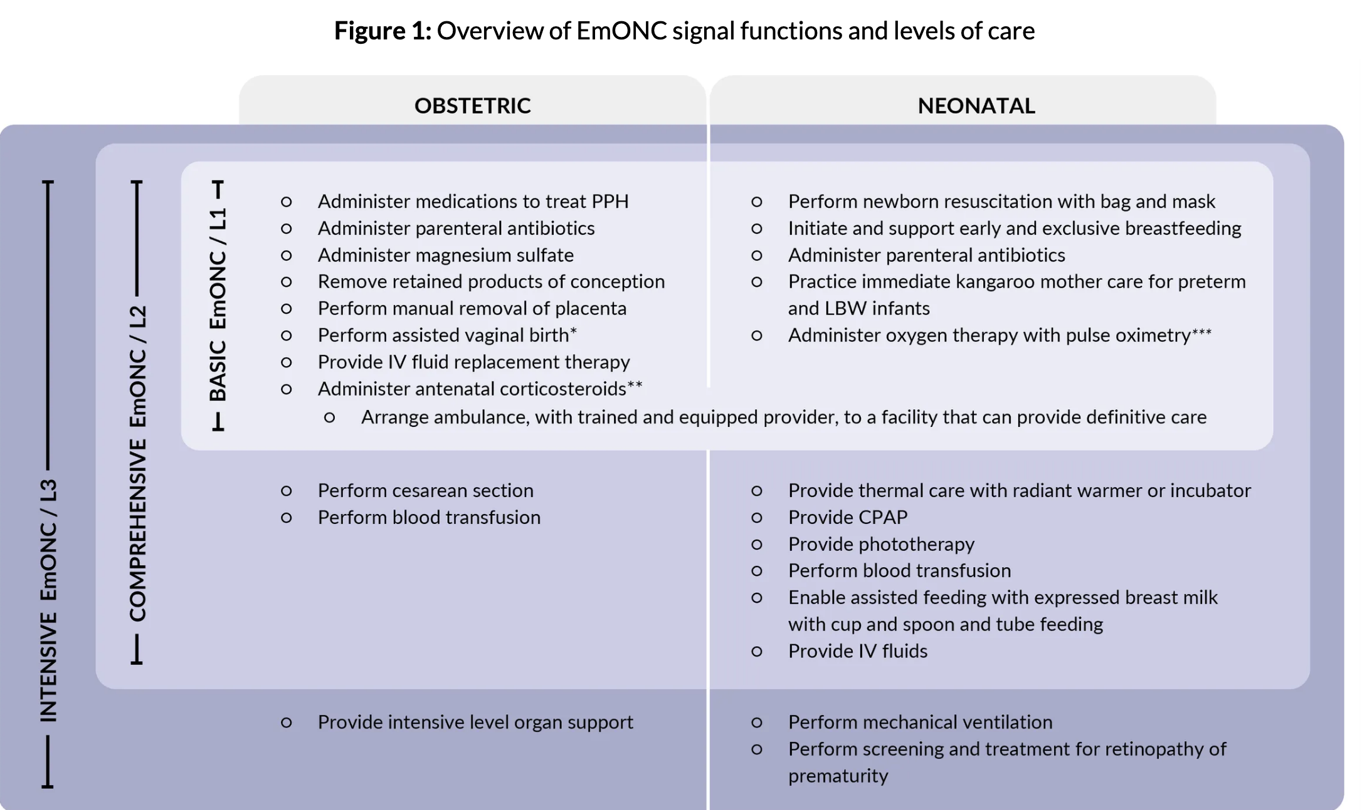
Program vision: Revised EmONC Signal functions

Slide 50
Why Geita, Katavi, Kigoma
Regions in the lake and Western Zone are among 10 regions with a high burden of maternal and neonatal mortality(MPDSR)
Low service utilization rates in ANC, EmONC and Neonatal care
Strategic priority regions for Thamini Uhai(SP: 2024-2029)
Thamini Uhai previous(EmONC) and current work(Birth companionship in Kigoma, Katavi, Geita and Kigoma

Slide 51
Selected demographic, reproductive and MNH indicators by region and national estimates
Indicator | Geita 2022 | Katavi 2022 | Kigoma 2022 | National 2022
Population | 2,977,608 | 1,152,958 | 2,470,967 | 61,741,120
Population share (of the total Tanzania population) | 4.8% | 1.9% | 4% | 100%
Women of reproductive age 15-49 (% of female population) | 44% | 44% | 48% | 47%
Total fertility rate (births per woman) | 6.1 | 5.8 | 5.8 | 4.8
Total wanted fertility rate | 5.4 | 5.4 | 5.6 | 4.4
Attended at least 4 antenatal care visits during pregnancy | 56% | 42% | 61% | 65%
First antenatal care visit in the first trimester | 24% | 10.2% | 40.6% | 34.4%
Delivered in a health facility | 72% | 67% | 94% | 81%
Delivered by Cesarean section | 1.8% | 4.1% | 8.1% | 11.%

Slide 52
Program Approaches
Health facility need assessment for readiness and support minor renovations
Competency-based training of health care providers (Hub and Spoke model, Low-dose-high frequency)
Centralize training of Trainers and Regional mentors with simulation skills(GIC and Simbegin)
OJT
Clinical attachments,
One year anaesthesia training
Routine mentorship visits,
Targeted (offsite) and coordinated (onsite)te) CMEs,
Establish/Strengthen Skills lab/learning corner with facility champions
Theatre management short course
Establish/Strengthen neonatal care units

Slide 53
Approaches…
Strengthen antenatal care (ANC)
Multiple Micronutrient Supplementation (MMS)
Calcium supplementation for pregnant women
Anaemia screening
Point of care USS
Antenatal corticosteroids
Institutionalizing the WHO-recommended PPH care bundle
Calibrated drapes
Heat-stable Carbetocin
MOTIVE Bundle
NASG
Support blood collection campaigns and improved storage facilities

Slide 54
Approaches………..
Improve intrapartum care including Labour care Guide use with Birth companionship
Gap filling essential equipment's and supplies
Strengthened referrals in m-mama:
Assessment and equipping ambulances,
Training escort teams,

Slide 55
Approaches….
Continuous quality improvement initiatives:
Regional and Council MPDSR support – including targeted reviews
Integrated quarterly clinical audits, supportive supervision and mentorship
Real-Time expert Teleconsultations
Strengthen Virtual networks of care through WhatsApp
Data management training, commodity forecasting & data quality assessments.
Community sensitization through CHWs and existing community structures

Slide 56

Thank you!

